Slide 1
What is a “model”?
Modeling the atmosphere an activity from the little shop of physics
Becca Hatheway
Spark UCAR Science Education
Randy Russell
Spark UCAR Science Education

Slide 2
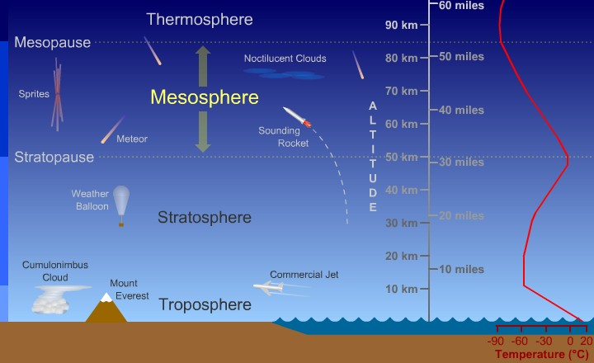
Layers of the atmosphere

Slide 3
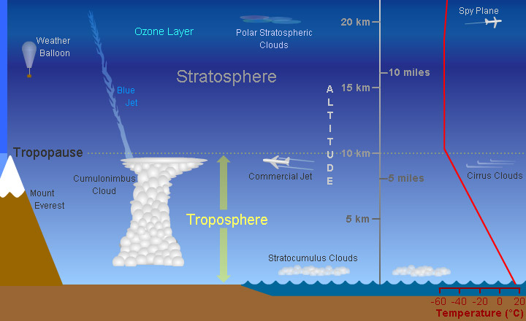
Troposphere and stratosphere

Slide 4
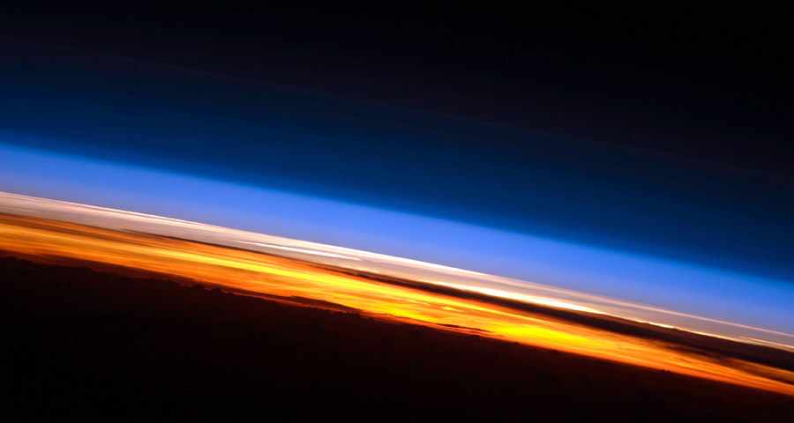
Image of earth’s atmosphere taken from the international space station

Slide 5
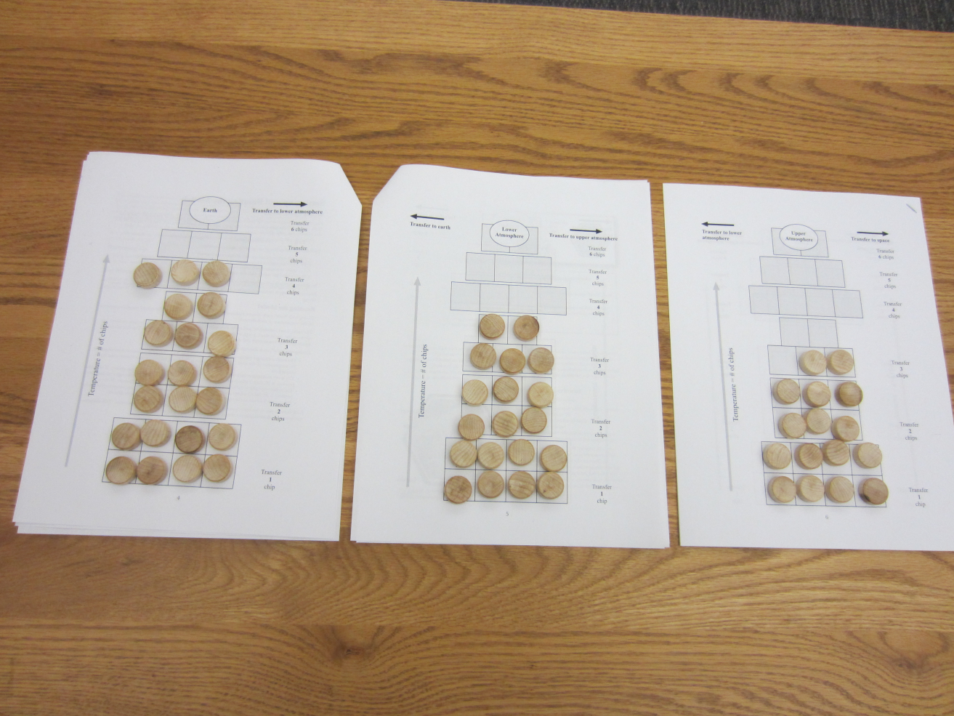
Model run #1

Slide 6
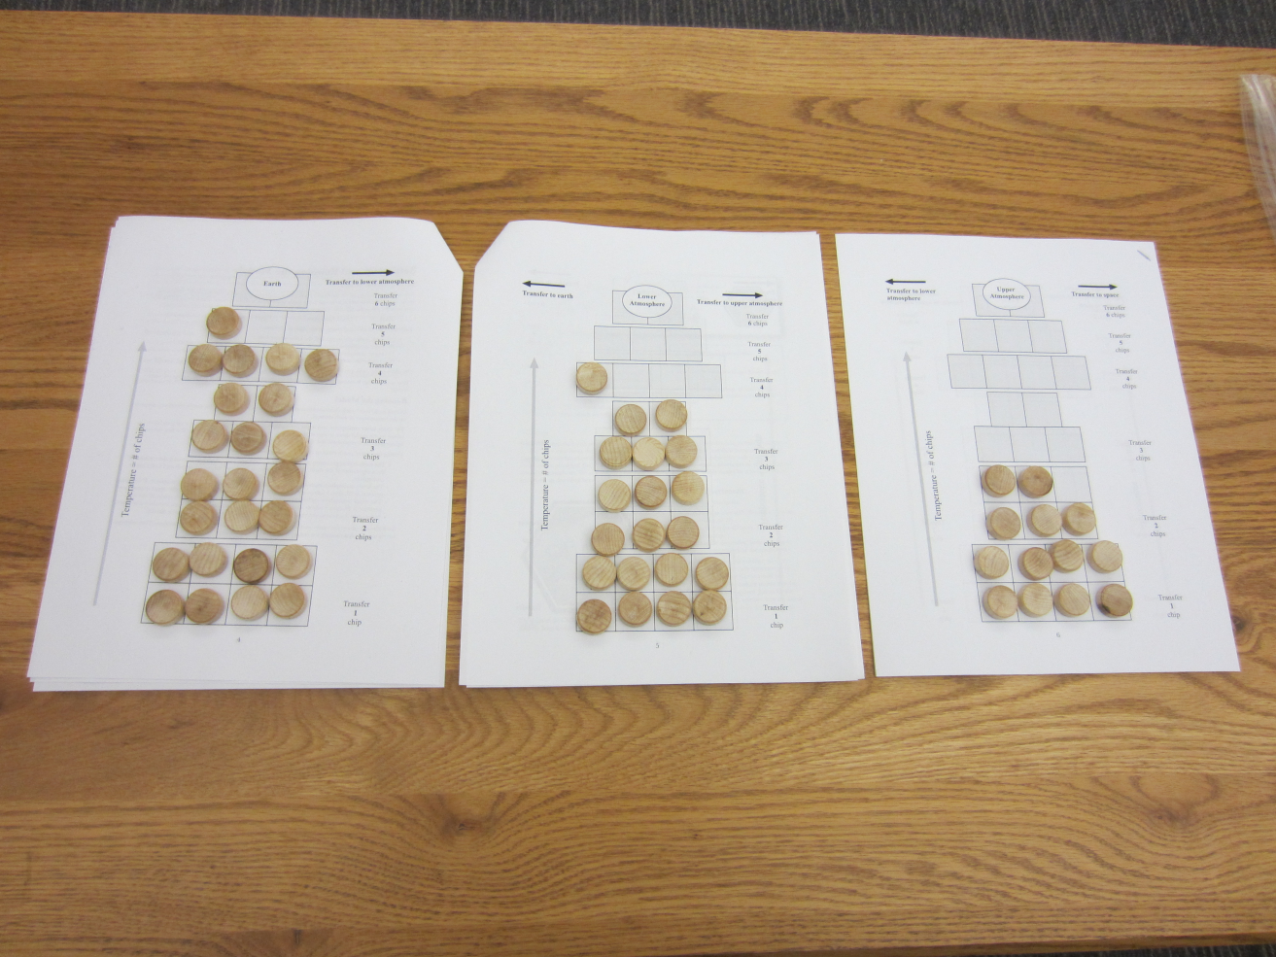
Model run #2

Slide 7
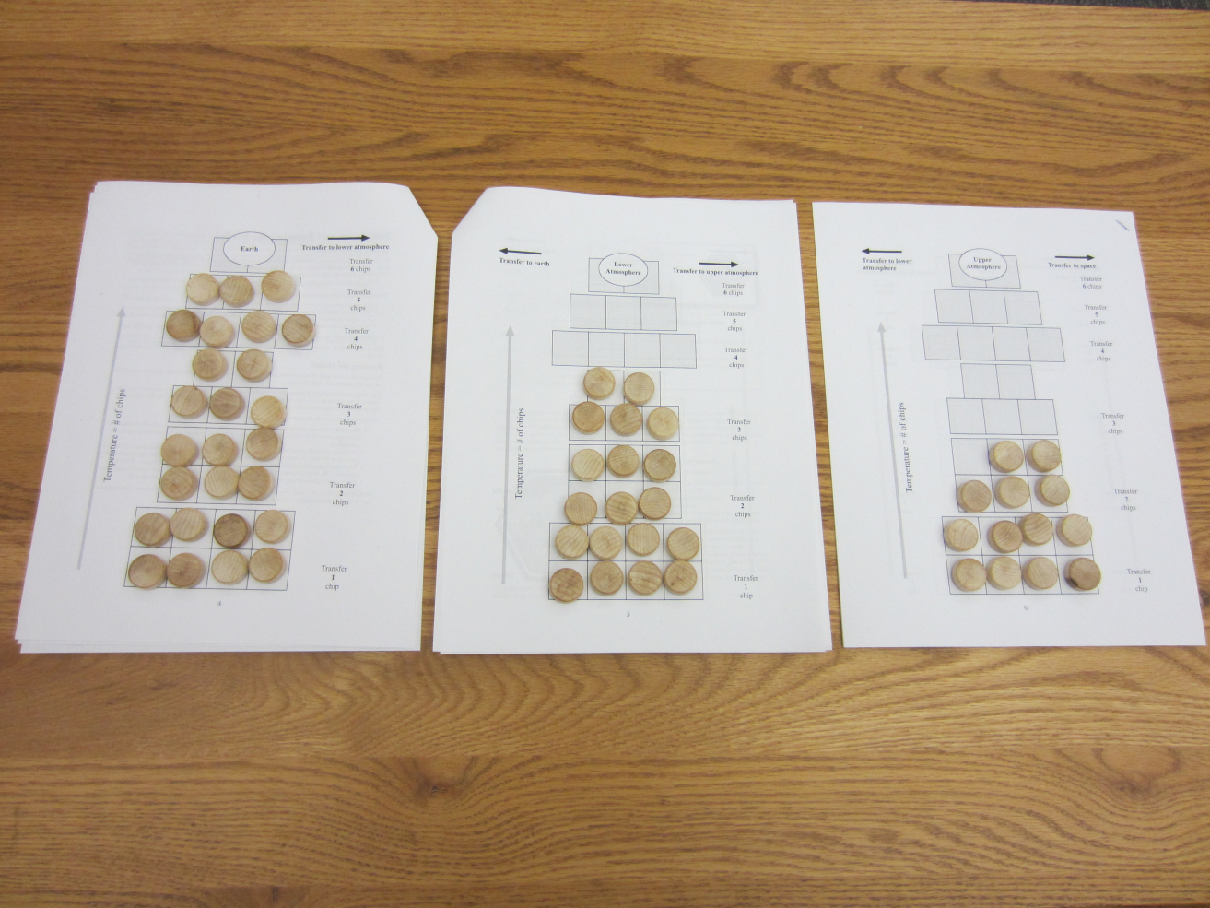
Model run #3

Slide 8
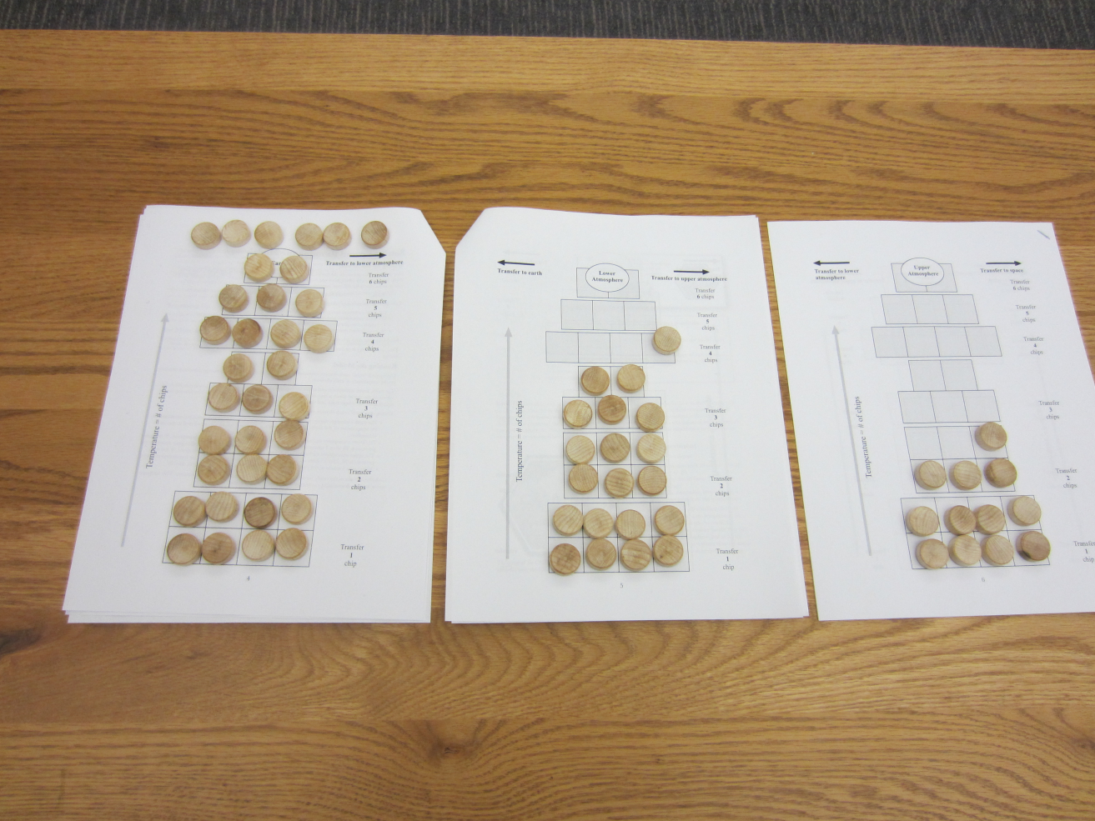
Model run #4

Slide 9
“All models are wrong,
some are useful.”
George Box, industrial statistician

Slide 10
Resources from this workshop: spark.ucar.edu/workshops
Available the week of December 12th

