Slide 1
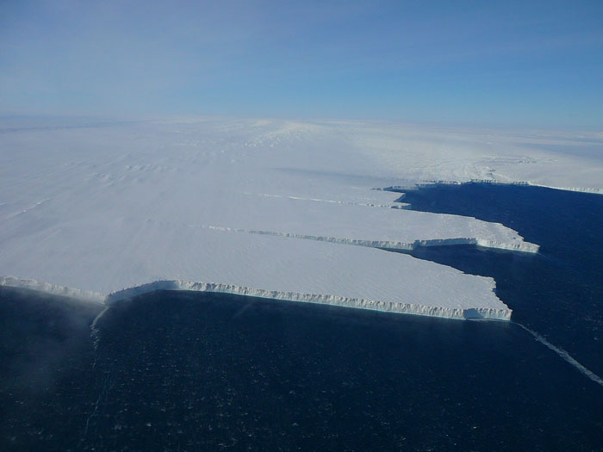
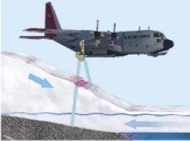


POLAR I.C.E.
(Interactive Climate Education)
ICE Pod Program – LDEO of Columbia University
WHAT IS HAPPENING TO ANTARCTICA’S PINE ISLAND GLACIER?
P.I.G. ice shelf, photo M. Wolovick
http:/www.ldeo.columbia.edu/polareducation
Notes:
Image: floating ice shelf of Pine Island Glacier on the West Antarctic peninsula, taken by Mike Wolovick, LDEO, from a flight in the NASA IceBridge mission (http://www.ldeo.columbia.edu/icebridge/).
Activity Goal: Introduce students to the role of an ice shelf in slowing the advance and loss of ice from a land glacier into the surrounding ocean, and the impact climate is having on this system. We will focus on Pine Island Glacier (P.I.G.) as a case study.
*This ppt can be used to introduce the activity & background information to your students – it is not required to complete the activity.

Slide 2
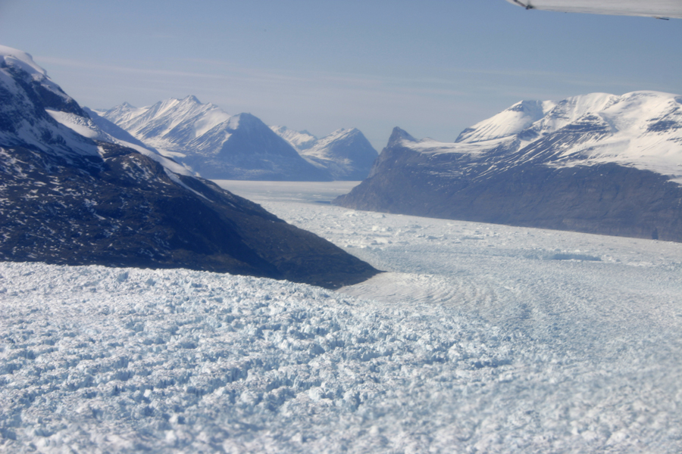
Glaciers are large expanses of ice.
In the polar regions they are continental sized!
ABOUT GLACIERS…
Greenland’s Kangerdlugssuaq Glacier, photo by P. Spector
Glaciers form where snow remains year-round, compressing into ice over time.
Glacier Accounting is like a bank account:
  They remain balanced (equal in size) if the snow added annually equals the snow lost;
  They grow when more is added (snow) than removed (melt);
  They shrink when more is removed (melts) than added (snow).
Notes:
Review of key concepts in glacier ‘mass balance’ (Mass _{out} = Mass _{in} )
They form in places where it is cold enough for snow to remain year round over many years compressing into ice.
For glaciers to maintain their size, or be in in what we call ‘steady state’, they require an equal amount of snow to be added each year as is lost.
They lose mass if more snow is lost than added and they gain mass if more snow is added than lost
Why is glacier mass balance important?
Changes over time in glacial ice balances are an indicator of a changing climate (either warming or cooling).
Large amounts of glacial ice are key in cooling out climate
Loss of glacial ice into the global oceans will cause sea level to rise

Slide 3
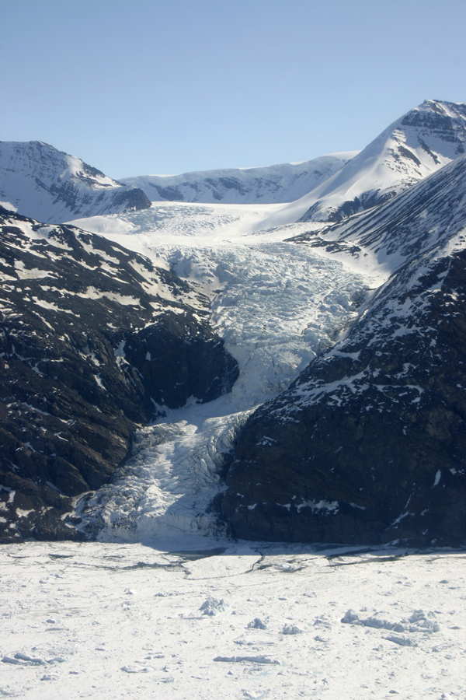
Tugged by gravity they move under their own weight, flowing from areas of higher elevation to areas of lower elevation.
Glaciers are in
constant motion.
Greenland’s Kangerdlugssuaq Glacier, photo by P. Spector
Notes:
Key understanding: glaciers are not just stable blocks of ice, they are in constant motion.
Explain Scale - Be sure students grasp the size scale of glacier and time scale of formation and movement of a glacier. Size - Note that a person at the base of the mountains in this image would be a so tiny they would appear not much bigger than an ant. Time – formation - These glaciers have formed over millions of years. The amount of snow needed to form a continental-sized ice sheet does not accumulate in a human timeframe. – movement - Outside the ice streams (the fast moving sections of of the glaciers) movement can be 1-2 meters (~6.5 ft.) a year. The ice streams that are in the center of the glacier move more quickly – Antarctica’s largest glacier, the Byrd glacier, moves 3 meters (~9.5 ft.) a day, but there are some glacial ice streams that are much faster.
Activity - Students are asked to label this image with where they would expect to find accumulation (snow addition) and ablation (snow loss). The goal is to encourage the students to think of snow accumulating in the higher elevations in colder temperatures and ablation primarily occurring in the lower elevations where warmer climates allow melting & calving (see next slide) to occur.

Slide 4
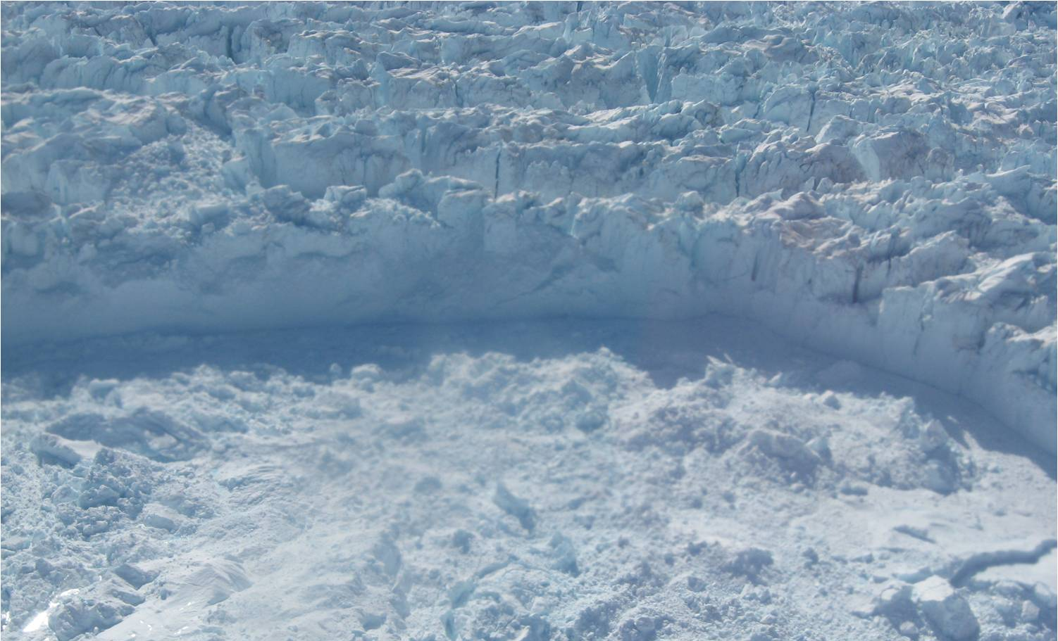
Calving – One way in which glaciers lose mass
Steep edge where sections of ice break off at the front of a glacier, collapsing into icy rubble.
Glaciers in the polar regions can lose ‘mass’ in several ways – calving (chunks of ice breaking off ), melting, wind blow, and sublimating straight to water vapor. This loss of ice mass is called ‘ablation’.
Greenland’s Jakobshavn Glacier, photo by I. Das
Notes:
How do glaciers lose mass? Depending on their type and location glaciers lose mass differently. Pine Island Glacier, like other glaciers on the perimeter of the West Antarctic peninsula, loses mass mainly through calving and melting.

Slide 5
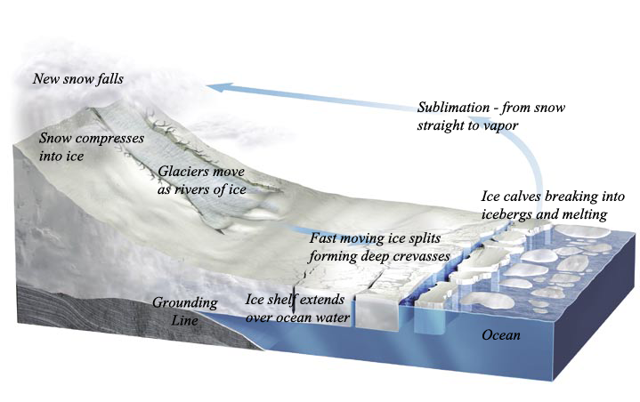
The Glacial System
Start with ‘New snow falls’ and move counter clockwise to follow the system .
‘Accumulation’
‘Ablation’
edited from R. Bell, The Unquiet Ice, Scientific American, Feb. ‘08)
Notes:
Glacial System - Have the students follow this representation of a glacial system moving from the falling of new snow → into a glacier or river of ice → fast moving ice forms crevasses → calving into icebergs and moving out into the ocean to melt → back to more snow.

Slide 6
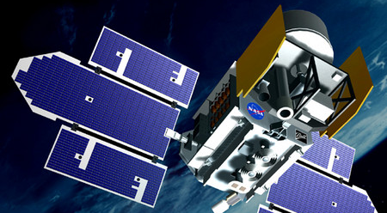
About Measuring Glaciers…
Satellites have been collecting information about the Earth since the 1990’s.
NASA ICESat I used a laser to measure ice surface elevation from 2003 to 2009. These measurements are accurate to ~15 cm (6 inches) of elevation!
Today’s activity uses ICESat data to measure changes to ice elevation of Pine Island Glacier.
Notes:
Satellites are key in tracking information on changes in glaciers. For many years we have relied on satellites for data on the polar regions.
Satellites can gather data consistently over a period of months, seasons and years, and have a wide range of coverage.
They are able to access areas that are remote and difficult for us to reach in other ways.
Their have good accuracy – look at their surface elevation measures – accurate to 15 cm or 6 inches!
ICESat stopped working in 2009 but this information continues to be collected by aircraft flights under a NASA program called IceBridge.

Slide 7
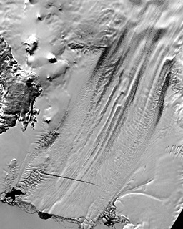
About Pine Island Glacier (P.I.G.)…
This activity focuses on ice surface elevation on P.I.G.
The red line shows where the ICESat ice surface data used in this activity was collected.
Glacier flow direction
Notes:
This activity – We will look at ‘changes over time’ in the surface elevation (height) of the Pine Island Glacier. We have a series of data points collected along a transect or line (you may want to explain/define transect for your students) across on the face of the glacier. This provides us with data collected at the same location over a 4-year period.
The activity has the students label the two ends of the data transect in order to assist them in visualizing the data collection site.

Slide 8
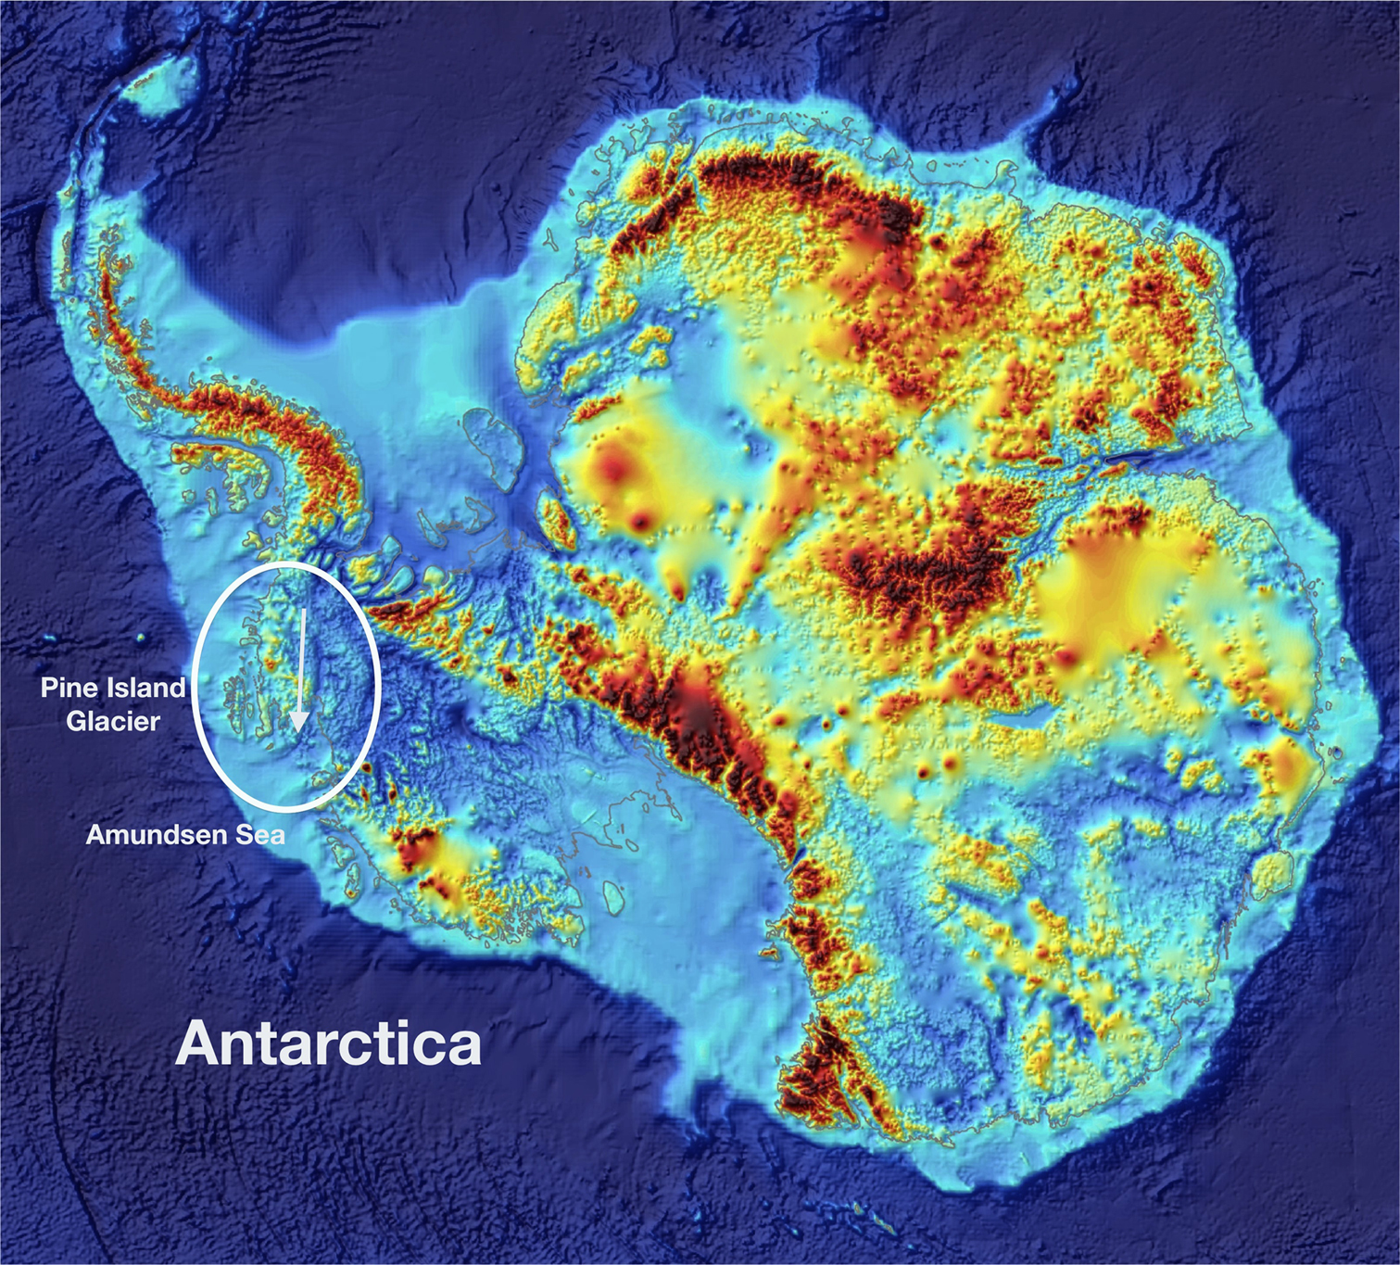
Where in Antarctica is Pine Island Glacier?
Edited Antarctic land surface map (without ice) from British Antarctic Survey BEDMAP program, 2011.
Notes:
Locating P.I.G. - This map shows Antarctica without its ice sheet cover, surrounded by the deep blue ocean bottom. The continent colors represent elevation with the rusty orange color indicating the highest elevation and the blue colors representing heights that range from sea level to below sea level (remember much of Antarctica is pressed down under meters and meters of ice). Pine Island Glacier is circled with the arrow showing the direction of ice flow. It is traveling fast, moving at rates of 3.5 km/yr. – over 31 feet a day - currently pushing more ice into the oceans than any other Antarctic glacier.
You may wish to spend some time talking about this map as it is an unusual map perspective for students –
They may be unfamiliar with the Antarctic continent – Antarctica is split into two sides, or sections, orient them to West Antarctica being the panhandle side that stretches up towards the southern tip of South America, and East Antarctica being the large land mass to the right above (the two sections are labeled in the next slide)
The map is without ice on the continent – instead they are looking at land surface elevation, and much of this is pressed down by the overlying ice to levels that are below sea level
There is no ocean showing, instead they see ocean bathymetry (underwater depth of the ocean floor)

Slide 9
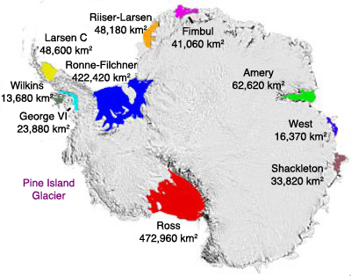
About Antarctica’s Ice Shelves…
East Antarctica
West Antarctica
Ice Shelves surround the Antarctic Ice Sheet.
Like barricades they block the glaciers, slowing the ice flow off the landmass.
The larger the ice shelf, the larger the barricade.
Pine Island Glacier has a very small ice shelf – too small to show in this graphic.
Edited from T. Scambos, National Snow and Ice Data Center
Notes:
Ice Shelves - Extremely important ice shelves are the extension of ice off the continent into the surrounding ocean shelf. They form shelves that act as barriers or blockades that slow the movement of land ice from the continent into the surrounding oceans. The larger the shelf, the larger the barricade. The P.I.G. ice shelf is too small to show in this graphic. In the activity students are asked to calculate its size to see how it compares to the other ice shelves shown.

Slide 10


Is P.I.G. a ‘climate canary’*?
Let’s do the activity! Working with Ice Elevation Data from P.I.G. you can answer this important question!
*Years ago miners used canaries as an early warning signal to alert them to toxic changes in the air inside the mines. Canaries have become a symbol of an early alert to approaching danger.
Our canary wears shades as protection from the reflectivity of the glacial snow (known as albedo). Ice albedo is a key ingredient in the ongoing cooling of our Earth system.
Notes:
This slide launches students into the main activity with a question. Are there changes in the P.I.G. glacier over the sampling period (4 years) and, if so, are they significant enough to be considered an alert to approaching danger?
The next slide show the P.I.G. datasets and graphing results. If you are doing this activity as an in class exercise you may want to use these slides as the students move through, or you may wish to end the slideshow here.

Slide 11
GRAPHING P.I.G. DATA FOR LINE #279
LOCATION RECORDED BY KM | ELEVATION IN METERS NOV. 2003 | ELEVATION IN METERS APR. 2007 | ELEVATION IN METERS OCT. 2007 | DELTA NOV. 2003 TO APRIL 2007 | DELTA NOV. 2003 TO OCT. 2007
239 | 746 | 746 | 746 | 0 | 0
240 | 512 | 511 | 511 | -1 | -1
241 | 392 | 389 | 387 | -3 | -5
242 | 343 | 335 | 334 | -8 | -9
243 | 279 | 267 | 264 | -12 | -15
244 | 245 | 229 | 227 | -16 | -18
245 | 293 | 281 | 274 | -12 | -19
246 | 332 | 316 | 312 | -16 | -20
247 | 389 | 374 | 372 | -15 | -17
248 | 480 | 468 | 475 | -12 | -5
249 | 507 | 500 | 497 | -7 | -10
250 | 557 | 545 | 545 | -12 | -12
251 | 573 | 569 | 569 | -4 | -4
252 | 604 | 600 | 600 | -4 | -4
253 | 690 | 687 | 687 | -3 | -3
Notes:
This is a set of data from 3 separate series collected across the ‘face’ of P.I.G. Some of your students might note that the 2007 data was collected in different times of the year and question if this is really a good way to complete a comparison.
This is a good question.
In Antarctica people often note there are just two seasons – winter and summer. The Nov. and Oct. collections would be considered summer dates for Antarctica, while the April collection would be a winter date. With these two distinctly different seasons of data to plot there are things we would expect to learn - we would expect that snow retention and snow accumulation might be lower in the Oct. and Nov. summer dates than in the April winter date.
Students will see if this expected result is actually observed.

Slide 12

Complete Part I… the first graphing activity.
Notes:
The following slide shows the graphed results for Part I – do not proceed until the students have completed this section of the activity.

Slide 13
Graph of 3 sets of P.I.G. elevation data
Meters of elevation
Distance in kilometers
Notes:
Results from graphing the 3 sets of data together: it is difficult to see any real change in elevation in P.I.G. in the 4 years. Students may be tempted to stop here and assume that no significant change has occurred over the 4 year period. However, a better way to examine the data would be to use 2003 as a baseline and compare 2007 data against it. The next activity, or Part II, will do this.

Slide 14

GRAPHING P.I.G. DATA FOR LINE #279
LOCATION RECORDED BY KM | ELEVATION IN METERS NOV. 2003 | ELEVATION IN METERS APR. 2007 | ELEVATION IN METERS OCT. 2007 | DELTA IN METERS NOV. 2003 TO APRIL 2007 | DELTA IN METERS NOV. 2003 TO OCT. 2007
239 | 746 | 746 | 746 | 0 | 0
240 | 512 | 511 | 511 | -1 | -1
241 | 392 | 389 | 387 | -3
242 | 343 | 335 | 334
243 | 279 | 267 | 264 |  | -15
244 | 245 | 229 | 227 | -16 | -18
245 | 293 | 281 | 274 | -12
246 | 332 | 316 | 312 | -16
247 | 389 | 374 | 372 |  | -17
248 | 480 | 468 | 475 | -12
249 | 507 | 500 | 497 | -7 | -10
250 | 557 | 545 | 545 | -12
251 | 573 | 569 | 569 | -4
252 | 604 | 600 | 600 |  | -4
253 | 690 | 687 | 687 | -3 | -3
For each dataset in 2007 you will calculate the change (delta ) from 2003, completing the last two columns in this chart. Then graph the in Part II, using 2003 as your zero line and the for April and October 2007.
Notes:
In Part II 2003 will be used as a baseline, with the two 2007 datasets graphed against it – graphing the change (delta). Students should begin their graph with a zero line high up on the graph since most of the change has been negative ( the Y axis range will be from 0, as the high, to -20). They will draw a line across at zero and label it Nov 2003.

Slide 15
Complete Part II…. the second graphing activity.
Notes:
The following slide shows the graphed results for Part II – do not proceed until the students have completed this section of the activity.

Slide 16
Graph of delta-comparison to 2003
Delta in elevation ( Meters)
Distance in kilometers
Notes:
Results of graphing the changes from 2003 – Graphing the delta shows a noticeable change. Be sure to note to the students that the results are a loss of meters of elevation of snow. Students may have a hard time visualizing meters – this equates to about 66 ft. or a 6 story building.
Is this significant? Where PIG is located on West Antarctica is a common target of storms, with an annual snow accumulation of ~1 meter. Losing 20 meters of snow in 4 years would be a loss each year of five times the average gain.
NOTE: The next parts of this activity are done as a lab working with glacier goo.

Slide 17
ICE Pod Program – LDEO of Columbia University
Project website: http://www.ldeo.columbia.edu/icepod/
Education website: http://www.ldeo.columbia.edu/polareducation/

