Slide 1

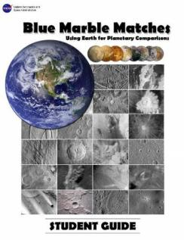












AGU-NESTA GIFT Workshop
Blue Marble Matches:
Using Earth for Planetary Comparisons
PRESENTERS:
Paige Valderrama Graff and Jackie Allen
Jacobs/ESCG @ NASA Johnson Space Center

Slide 2
ARES
Astromaterials Research
and Exploration Science
Directorate at Johnson Space Center

Slide 3
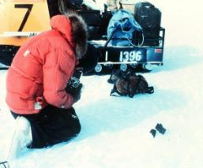
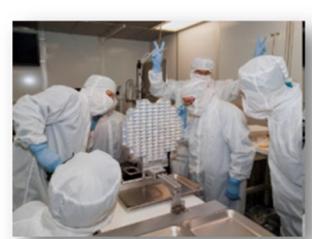
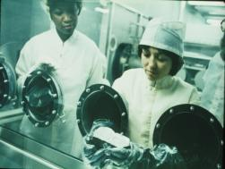
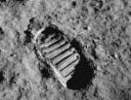
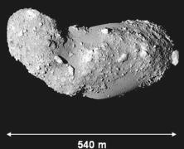
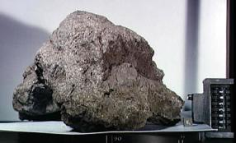
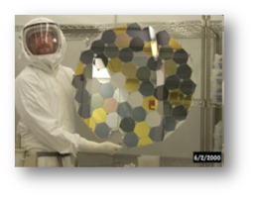
ARES Acquisition and Curation
6 Curation Collections Antarctic
Meteorites
Stardust &
Cosmic Dust
Hayabusa
Apollo
Genesis

Slide 4
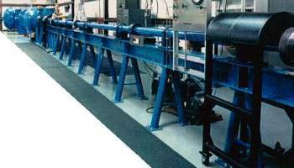

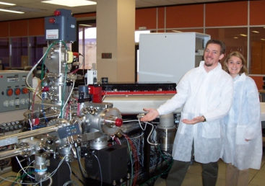
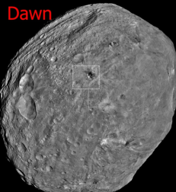


ARES Astromaterials Research
Hypervelocity Impact Experiments
NanoSIMS – isotopic analysis
taking us further back in solar
System history! Mission Science @ Vesta

Slide 5

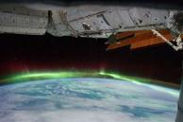
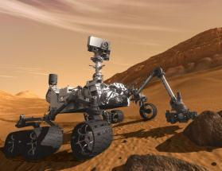
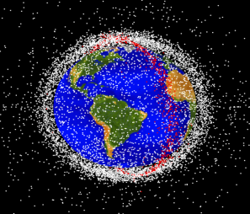
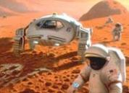
ARES Exploration Science
Earth Observations & Space Station Support
Orbital Debris
Exploration Science
- Present and Future

Slide 6
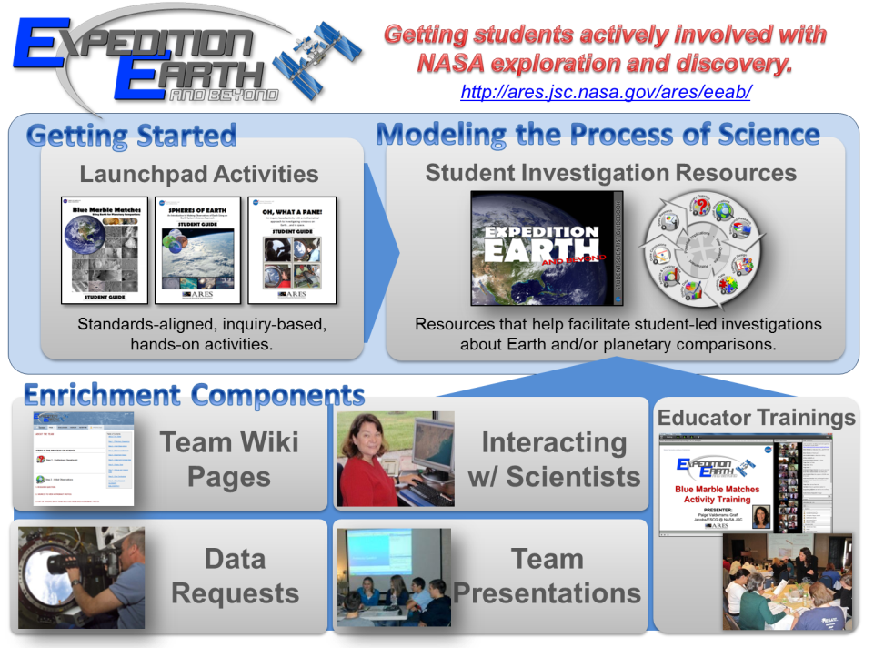

Slide 7
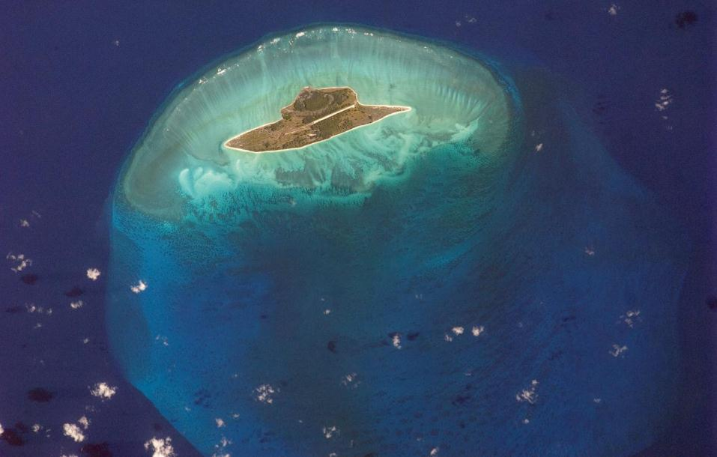


CHARLESTON MIDDLE SCHOOL TEAM IMAGE
Juan de Nova Island and Reef, Mozambique Channel
Image ID: ISS027-E-11429 Acquired 4/19/11
Image courtesy of Crew Earth Observations and Image Science & Analysis Laboratory,
NASA Johnson Space Center

Slide 8
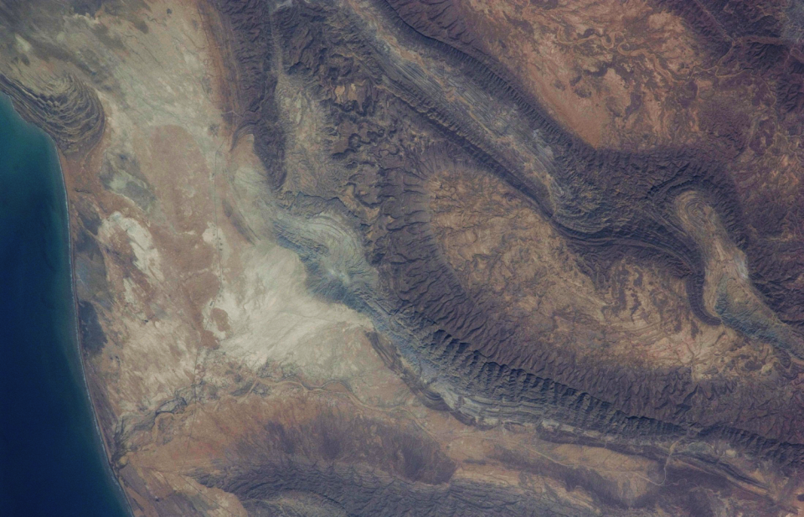
EVERGREEN MIDDLE SCHOOL TEAM IMAGE
Research Topic: Mud Volcanoes Target Region: Pakistan
Image ID: ISS031-E-41812 Acquired 5/15/12
Image courtesy of Crew Earth Observations and Image Science & Analysis Laboratory,
NASA Johnson Space Center

Slide 9

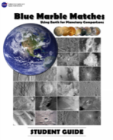
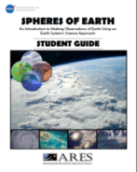



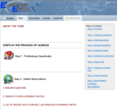

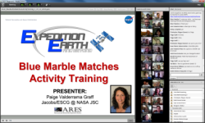
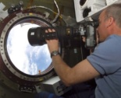
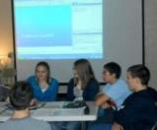
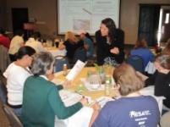
Getting students actively involved with NASA exploration and discovery.
http://ares.jsc.nasa.gov/ares/eeab/
Getting Started
Modeling the Process of Science
Launchpad Activities
Student Investigation Resources
Standards-aligned, inquiry-based, hands-on activities.
Resources that help facilitate student-led investigations about Earth and/or planetary comparisons.
Supplemental Components
Educator Trainings
Team Wiki
Pages
Interacting w/ Scientists
Data Requests
Team Presentations

Slide 10

Today we will:
Identify common characteristics to describe features in images.
Identify geologic processes and features and how they form on Earth.
Create a list of criteria to identify geologic features.
Use criteria to identify features on other planetary bodies.
“Build” a planetary comparison feature wall.
Designed using the
5-E MODEL OF INQUIRY

Slide 11
BLUE MARBLE MATCHES
CONTEXT FOR ACTIVITY:
  NASA explores planetary bodies, including Earth, to better
understand our Solar System.
  How do scientists determine what geologic features exist on other planets? This activity will help you understand part of that process.
It starts with making good observations, being descriptive, and using what we know about Earth.

Slide 12
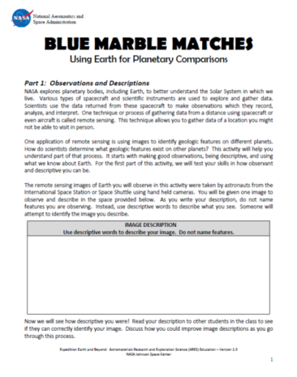
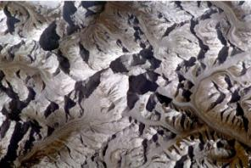
BLUE MARBLE MATCHES
Part 1: Be Descriptive!
OPTION 1: Students could write their own descriptions of a given image in the space provided.
OPTION 2: Listen to a given DESCRIPTION and IDENTIFY which image is being described.
Write descriptions here

Slide 13
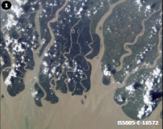
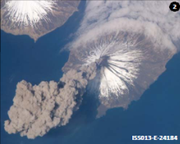
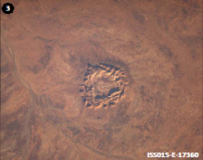
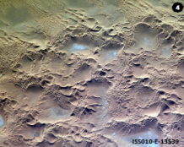
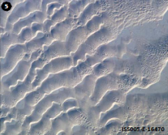
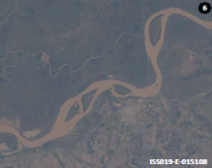
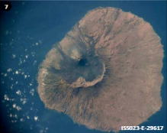
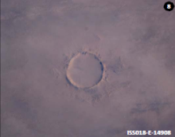
BEING DESCRIPTIVE
Listen to the image description and try to identify the image being described.

Slide 14
BEING DESCRIPTIVE
What were good descriptive characteristics (descriptors) or good ways to describe the features in these images.

Slide 15
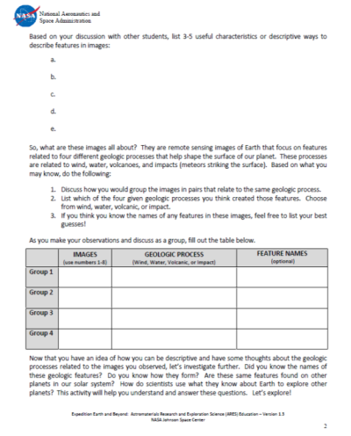
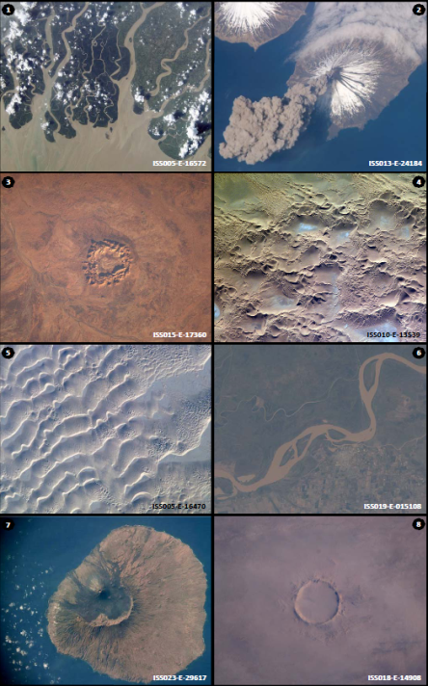
So what are these images all about?
Which images would you pair together that represent the same geologic process.

Slide 16
E X A M P L E
3 & 8
Impact
Which images would you pair together that represent the same geologic process.

Slide 17
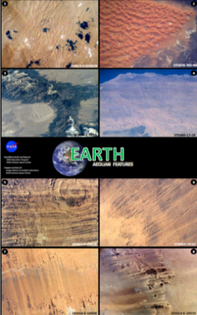
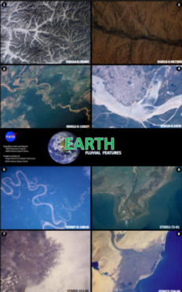
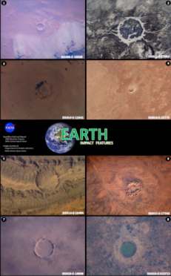
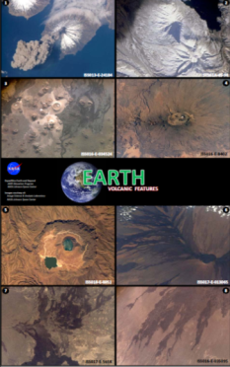
BLUE MARBLE MATCHES
Part 2: Developing Identification Criteria
Aeolian Fluvial Impact Volcanic
(Wind) (Water)

Slide 18

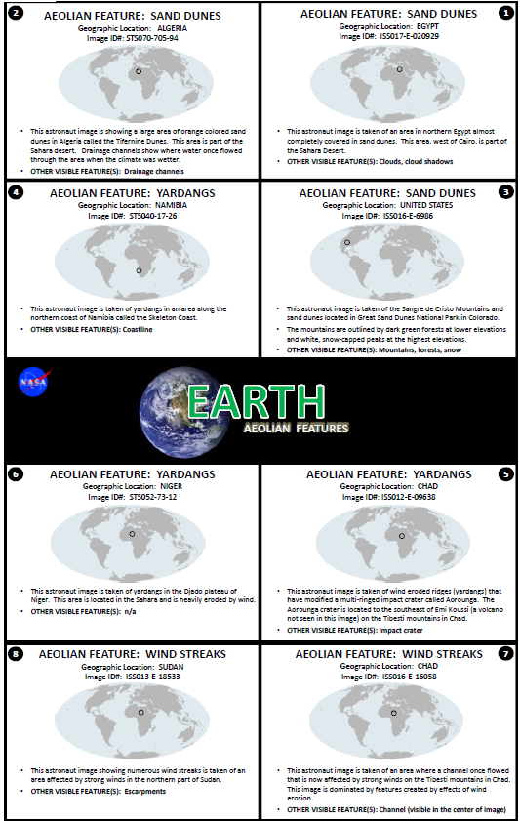

Slide 19

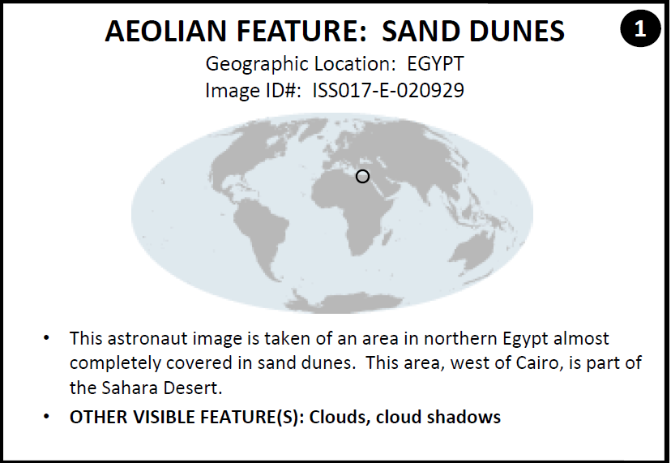
Notes:
This slide show shows the information provided on the back of each image. Note how at the very top of the image the main feature in the image is clearly identified.

Slide 20
Notes:
Students should be aware of how each feature chart is organized. Each feature chart:
Focuses on features related to a specific process
Information is provided on the back to ensure they know what feature is visible in each image. (note: students should not try to guess what feature is being shown – they should focus on identifying common characteristics that they can use to help describe each feature.
Features are “grouped”. For example, the first 3 images on the Aeolian Feature chart are sand dunes, the next 3 images are yardangs and the last 2 images are showing wind streaks. This enables students to look at the images showing the same feature to identify common characteristics.

Slide 21
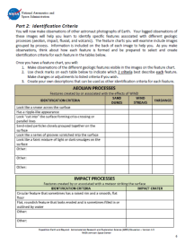


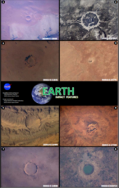
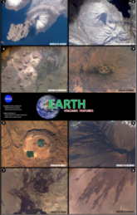
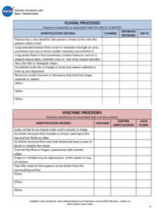
BLUE MARBLE MATCHES
Part 2: Developing Identification Criteria
WHAT YOU WILL DO:
Make observations of images related to each geologic process.
Select/revise 2 CRITERIA that best describe each feature. (Use Identification Criteria tables in your handout.)

Slide 22
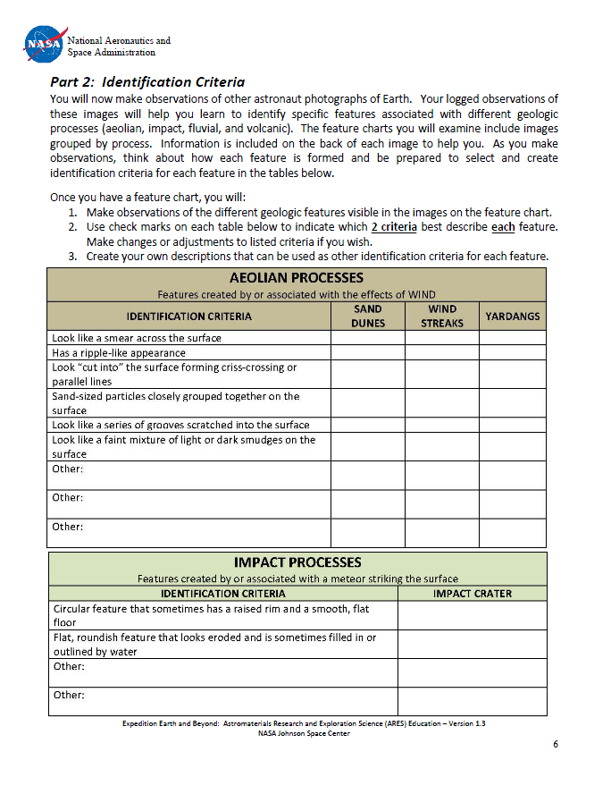

E X A M P L E
AEOLIAN FEATURES
Notes:
Show the next few slides to students to help reinforce the following:
They will be looking for criteria to identify each geologic feature. Geologic features on given on the right. In this example there are 3 features (sand dunes, wind streaks, and yardangs).

Slide 23
E X A M P L E
AEOLIAN FEATURES
Select/revise 2 CRITERIA that best describe each feature.
Notes:
Show the next few slides to students to help reinforce the following:
They will be looking for criteria to identify each geologic feature. Geologic features on given on the right. In this example there are 3 features (sand dunes, wind streaks, and yardangs).

Slide 24
E X A M P L E
AEOLIAN FEATURES
Select/revise 2 CRITERIA that best describe each feature.

Slide 25
E X A M P L E
AEOLIAN FEATURES
Select/revise 2 CRITERIA that best describe each feature.

Slide 26
E X A M P L E
AEOLIAN FEATURES
Select/revise 2 CRITERIA that best describe each feature.
Notes:
Students should read each identification criteria and based on their observations, decided which ONE feature that criteria best describes. They will repeat this process for each criteria listed. In the end, there will be 2 criteria marked for each geologic feature.
The next few slides provide an example for the aeolian features.

Slide 27
E X A M P L E
AEOLIAN FEATURES
Select/revise 2 CRITERIA that best describe each feature.

Slide 28
E X A M P L E
AEOLIAN FEATURES
Select/revise 2 CRITERIA that best describe each feature.

Slide 29
E X A M P L E
AEOLIAN FEATURES
Select/revise 2 CRITERIA that best describe each feature.

Slide 30
E X A M P L E
AEOLIAN FEATURES
Select/revise 2 CRITERIA that best describe each feature.

Slide 31
E X A M P L E
AEOLIAN FEATURES
Select/revise 2 CRITERIA that best describe each feature.

Slide 32
E X A M P L E
AEOLIAN FEATURES
Select/revise 2 CRITERIA that best describe each feature.

Slide 33
E X A M P L E
AEOLIAN FEATURES
Select/revise 2 CRITERIA that best describe each feature.

Slide 34
E X A M P L E
AEOLIAN FEATURES
Select/revise 2 CRITERIA that best describe each feature.

Slide 35
E X A M P L E
AEOLIAN FEATURES
Select/revise 2 CRITERIA that best describe each feature.

Slide 36
E X A M P L E
AEOLIAN FEATURES
Select/revise 2 CRITERIA that best describe each feature.

Slide 37
E X A M P L E
AEOLIAN FEATURES
Select/revise 2 CRITERIA that best describe each feature.

Slide 38
E X A M P L E
AEOLIAN FEATURES
Select/revise 2 CRITERIA that best describe each feature.

Slide 39
E X A M P L E
AEOLIAN FEATURES
Select/revise 2 CRITERIA that best describe each feature.

Slide 40
E X A M P L E
AEOLIAN FEATURES
Select/revise 2 CRITERIA that best describe each feature.
Only 2 criteria for each feature. Revise criteria as you wish.
Notes:
Only 2 criteria should be selected for each feature.

Slide 41
E X A M P L E
AEOLIAN FEATURES
Select/revise 2 CRITERIA that best describe each feature.
Only 2 criteria for each feature. Revise criteria as you wish. Circle, underline, or highlight KEY WORDS.
Notes:
You might want to have students circle, underline, or highlight key words that best describe each feature. Students can also rewrite criteria if they wish.

Slide 42
E X A M P L E
AEOLIAN FEATURES
Select/revise 2 CRITERIA that best describe each feature.
Only 2 criteria for each feature. Revise criteria as you wish. Circle, underline, or highlight KEY WORDS.
Waves of Sand-sized particles
Looks like a smudge
Scratches on the surface
Write your own descriptions (optional).
Notes:
Students can also write in their own descriptions or shorten some of the previously written descriptions. This is optional.

Slide 43
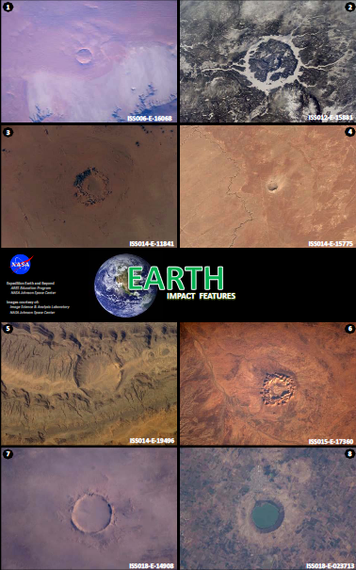
E X A M P L E
IMPACT FEATURES
Select/revise 2 CRITERIA that best describe each feature.

Slide 44
E X A M P L E
IMPACT FEATURES
Select/revise 2 CRITERIA that best describe each feature.
1
There are only 2 criteria and only 1 feature.
2

Slide 45
E X A M P L E
IMPACT FEATURES
Select/revise 2 CRITERIA that best describe each feature.
1
There are only 2 criteria and 1 feature.
Focus on identifying KEY WORDS.
2

Slide 46
E X A M P L E
IMPACT FEATURES
Select/revise 2 CRITERIA that best describe each feature.
1
There are only 2 criteria and 1 feature.
Focus on identifying KEY WORDS.
2
Write your own descriptions here!

Slide 47
E X A M P L E
AEOLIAN FEATURES
Select/revise 2 CRITERIA that best describe each feature.
Only 2 criteria for each feature. Revise criteria as you wish. Circle, underline, or highlight KEY WORDS.
Notes:
You might want to have students circle, underline, or highlight key words that best describe each feature. Students can also rewrite criteria if they wish.

Slide 48


Slide 50



Slide 51
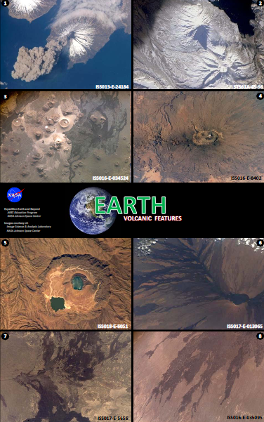

Slide 52



BLUE MARBLE MATCHES
Part 3: Feature Recognition and Review
WHAT YOU WILL DO:
Complete Feature Recognition and Review handout.
1

Slide 53



Feature Recognition & Review Handout
Observe EARTH FEATURES images.
Decide which geologic process is represented.
List identification criteria KEY WORDS that best describe feature.
Identify geologic feature.

Slide 54

E X A M P L E
Notes:
Show students this example prior to having them begin. They MUST list identification criteria (from the identification criteria lists) to determine what the feature and geologic process is being illustrated in the image.
You can decide if you want students to complete all 16 images or if you wish to have students complete this exercise for at least 8 images. This depends on how much reinforcement you think students need to reinforce using the identification criteria to decide on what the feature and process is in each image.

Slide 55
E X A M P L E
Fluvial
Notes:
Show students this example prior to having them begin. We recommend they first identify the geologic process, followed by the criteria (from the identification criteria lists) before they determine the specific geologic feature.
You can decide if you want students to complete all 16 images or if you wish to have students complete this exercise for at least 8 images. This depends on how much reinforcement you think students need to reinforce using the identification criteria to decide on what the feature and process is in each image.

Slide 56
E X A M P L E
birds foot; fan-like triangular shape
Fluvial
Notes:
Only after students have listed the identification criteria, should they determine and list the main geologic feature.

Slide 57
E X A M P L E
birds foot; fan-like triangular shape
Delta
Fluvial
Notes:
We recommend they first identify the geologic process, followed by the criteria (from the identification criteria lists) before they determine the specific geologic feature.

Slide 58
E X A M P L E
birds foot; fan-like triangular shape
Delta
Fluvial

Slide 59
E X A M P L E
birds foot; fan-like triangular shape
Delta
Fluvial
Aeolian

Slide 60
E X A M P L E
birds foot; fan-like triangular shape
Delta
Fluvial
“cut into” surface; grooves scratched into surface
Aeolian
Notes:
We recommend they first identify the geologic process, followed by the criteria (from the identification criteria lists) before they determine the specific geologic feature.

Slide 61
E X A M P L E
birds foot; fan-like triangular shape
Delta
Fluvial
“cut into” surface; grooves scratched into surface
Yardangs
Aeolian

Slide 62
E X A M P L E
birds foot; fan-like triangular shape
Delta
Fluvial
“cut into” surface; grooves scratched into surface
Yardangs
Aeolian
  Complete this for as many images as you can during time allotted.

Slide 63


  Name the following for each image:
    Identification Criteria
    Geologic Feature
    Geologic Process

Slide 64
  Name the following for each image:
    Identification Criteria
    Geologic Feature
    Geologic Process

Slide 65

Begin “Building” a Planetary Comparison
Feature Wall
WHAT PROCESS?
WHAT TO DO
Observe Image
Decide which geologic process it represents
On a POST-IT list:
  2 Criteria/KEY WORDS
  Name of feature
  4. Tape onto the Planetary Comparison Feature Wall
Criteria:
1)List KEY WORDS
2)List KEY WORDS
Feature: Name Feature
Notes:
One alternative or additional reinforcement to Part 3 (Review) is to have students reexamine the initial image they wrote a description of in Part 1 of the activity and begin creating a planetary comparison wall of images.
If you wish to have your students begin creating the “planetary comparison wall” with the image(s) used in Part 1 of the activity, use this slide as instructions.

Slide 66

WIND
WATER
VOLCANIC
IMPACT
EARTH
Descriptors:
1)Ripple-like
2)Particles grouped together
Feature: Sand Dunes
MARS
VENUS
MERCURY
EARTH’S
MOON
Notes:
Once students have their criteria/key words listed and the feature named, they should tape their image onto the “planetary comparison wall”.

Slide 67







WIND
WATER
VOLCANIC
IMPACT
EARTH
Criteria: 1)Ripple-like; 2) particles grouped together.
Feature: Sand Dunes
Criteria: 1)asdfljdkf;lad; 2)ssdfl;jd f;lskdjf l;jdkf .
Feature: Channels
Criteria: 1)sdlfj;lsjdf;ljsde; 2)sdfljs;dfjl fj;sldjf ;sldjf.
Feature: Volcanoes
Criteria: 1)sdfj;sldfjk ;lsdfj;lsdfkj; 2)sdfjl;sdkfj f;lsdjf;lkdfs.
Feature: Impact Crater
Criteria: 1)Ripple-like; 2) particles grouped together.
Feature: Sand Dunes
Criteria: 1)sdfljsdf;lkj dsf;lkjdf ; 2)j;sldfj;lsdkjf ;lsdjkf .
Feature: Channel
Criteria: 1)asdklhflksdfh lkdfh sdfk; 2) dksldkfjsdfjl ;sdf sdflkjhsdf l.
Feature: Volcano
Criteria: 1)sdfj;sldfjk ;lsdfj;lsdfkj; 2)sdfjl;sdkfj f;lsdjf;lkdfs.
Feature: Impact Crater
MARS
VENUS
MERCURY
EARTH’S
MOON
Notes:
Once students have their criteria/key words listed and the feature named, they should tape their image onto the “planetary comparison wall”.

Slide 68
ADDITIONAL CRATER CHARACTERISTICS
Notes:
These next slides show common crater characteristics (central peak/uplift and ejecta blanket) that are difficult to observe in image of craters on Earth, but are commonly seen in images of craters on other planetary worlds.

Slide 69
CENTRAL PEAK

Slide 70
CENTRAL PEAK

Slide 71
EJECTA BLANKET

Slide 72
EJECTA BLANKET

Slide 73
ADDITIONAL CRATER CHARACTERISTICS
Central Peaks & Ejecta Blankets
Oftentimes difficult to see in craters on Earth.
Commonly visible in craters found on other planetary surfaces.

Slide 74

BLUE MARBLE MATCHES
PLANETARY BODY COMPARISONS:
Use Earth as your home laboratory!
Planetary scientists must have an understanding of how processes on Earth work in order to make comparisons to other bodies in the Solar System.

Slide 75






BLUE MARBLE MATCHES
Part 4: Using Earth for Planetary Comparisons

Slide 76



BLUE MARBLE MATCHES
Part 4: Using Earth for Planetary Comparisons
Use Identification Criteria/KEY WORDS to identify features on other planetary bodies.

Slide 77



BLUE MARBLE MATCHES
Part 4: Using Earth for Planetary Comparisons:
WHAT TO DO: 2 Initial Tasks
Arrange planetary cards by geologic process.
Fill out planetary comparison table. (Be prepared to discuss and defend your answers!)
1
2
Mars
9
Entire structure with circular opening, entire structure with cone shape.
Not 100% sure if feature is raised, but our group thinks it is.
Volcano
Volcanic
3

Slide 78

1
ARRANGE IMAGES BY GEOLOGIC PROCESS
Be sure to think about and discuss the Feature Criteria/Key Words and Geologic Feature.
E X A M P L E
    NOTES: A. There is not an “even” # of images or features per category.
    B. Focus in on what you feel is the “main” feature in each image.
    C. Think about what you may be unsure about.
Notes:
Division of 8 images of Mars into the 4 different geologic processes.

Slide 79

2
FILL OUT PLANETARY COMPARISON TABLE
E X A M P L E
Mars
9
Entire structure with circular opening, entire structure with cone shape.
Not 100% sure if feature is raised, but our group thinks it is.
Volcano
Volcanic
3

Slide 80
2
E X A M P L E
What geologic feature?
Which geologic process?
Mars
9
Entire structure with circular opening, entire structure with cone shape.
Not 100% sure if feature is raised, but our group thinks it is.
Volcano
Volcanic
3
KEY WORDS

Slide 81
2
E X A M P L E
Level of confidence
Mars
9
Entire structure with circular opening, entire structure with cone shape.
Not 100% sure if feature is raised, but our group thinks it is.
Volcano
Volcanic
3
Doubtful characteristics

Slide 82
BLUE MARBLE MATCHES
Part 4: Using Earth for Planetary Comparisons:
WHAT TO DO: 2 Initial Tasks
Arrange planetary cards by geologic process.
Fill out planetary comparison table. (Be prepared to discuss and defend your answers!)
1
2
Mars
9
Entire structure with circular opening, entire structure with cone shape.
Not 100% sure if feature is raised, but our group thinks it is.
Volcano
Volcanic
3

Slide 83











3
Continue “Building” Planetary Comparison Feature Wall
3. Add images to Planetary Comparison Wall. Include post-it with your group names. (Be prepared to discuss and defend your answers!)
WIND
WATER
VOLCANIC
IMPACT
EARTH
Criteria: 1)Ripple-like appearance; 2)Sand-sized particles grouped together.
Feature: Sand Dunes
Criteria: 1)Ripple-like appearance; 2)Sand-sized particles grouped together.
Feature: Sand Dunes
Criteria: 1)asdfljdkf;lad; 2)ssdfl;jd f;lskdjf l;jdkf .
Feature: Channels
Criteria: 1)sdfljsdf;lkj dsf;lkjdf ; 2)j;sldfj;lsdkjf ;lsdjkf .
Feature: Channel
Criteria: 1)sdlfj;lsjdf;ljsde; 2)sdfljs;dfjl fj;sldjf ;sldjf.
Feature: Volcanoes
Criteria: 1)asdklhflksdfh lkdfh sdfk; 2) dksldkfjsdfjl ;sdf sdflkjhsdf l.
Feature: Volcano
Criteria: 1)sdfj;sldfjk ;lsdfj;lsdfkj; 2)sdfjl;sdkfj f;lsdjf;lkdfs.
Feature: Impact Crater
Criteria: 1)sdfj;sldfjk ;lsdfj;lsdfkj; 2)sdfjl;sdkfj f;lsdjf;lkdfs.
Feature: Impact Crater
MARS
VENUS
Maria, Sue, Tom, Jose
MERCURY
EARTH’S
MOON
Mars
JOVIAN
MOONS
9
Entire structure with circular opening, entire structure with cone shape.
Not 100% sure if feature is raised, but our group thinks it is.
Volcano
Volcanic
3

Slide 84

Planetary Comparison Feature Wall
Wind
Water
Volcanic
Impact
Features shown here are not necessarily in their correct category.
Notes:
View of “planetary comparison wall”

Slide 85


Notes:
Make sure students realize that even though the feature in this image matches the criteria to be a channel (fluvial feature) on Earth, they must realize that knowledge of the planetary body itself can “trump” the matching of the criteria. In this case, the Moon has never had water flow across the surface. Ask students what else can flow across the surface of a planetary surface….for example, lava.
This is the only card I recommend you “correct” with students. The other features students would be “correct” as long as they can discuss, defend, and justify their answers.

Slide 86

E X A M P L E
Notes:
Division of 8 images of Mars into the 4 different geologic processes.

Slide 87

BLUE MARBLE MATCHES
Part 4: Using Earth for Planetary Comparisons
You may decide to focus on 1 planetary comparison at a time….
Notes:
You may decide to complete this activity focusing on only 1 planetary comparison at a time. You can choose to focus on Mars….(or any of the other planetary bodies provided).

Slide 88


BLUE MARBLE MATCHES
Part 4: Using Earth for Planetary Comparisons
Notes:
….or you can choose to focus on Earth's Moon, Venus, Mercury, or Jovian Moons (Moons of Jupiter).
Please note – some of the images included in the Jovian Moon Feature Chart contain features that are not related to wind, water, volcanic, or impacts….this is included to allow students to realize that there are other processes occurring in our Solar Systems (such as ice related processes).

Slide 90
Getting students actively involved with NASA exploration and discovery.
http://ares.jsc.nasa.gov/ares/eeab/
Getting Started
Modeling the Process of Science
Launchpad Activities
Student Investigation Resources
Standards-aligned, inquiry-based, hands-on activities.
Resources that help facilitate student-led investigations about Earth and/or planetary comparisons.
Supplemental Components
Educator Trainings
Team Wiki
Pages
Interacting w/ Scientists
Data Requests
Team Presentations

Slide 91












Blue Marble Matches:
Using Earth for Planetary Comparisons
NASA Website: http://ares.jsc.nasa.gov/ares/eeab
Teacher Wiki: http://eeabteachers.wikispaces.com/
Astronaut Imagery: http://eol.jsc.nasa.gov
CONTACT EMAIL: Paige Graff (paige.v.graff@nasa.gov)

