Slide 1
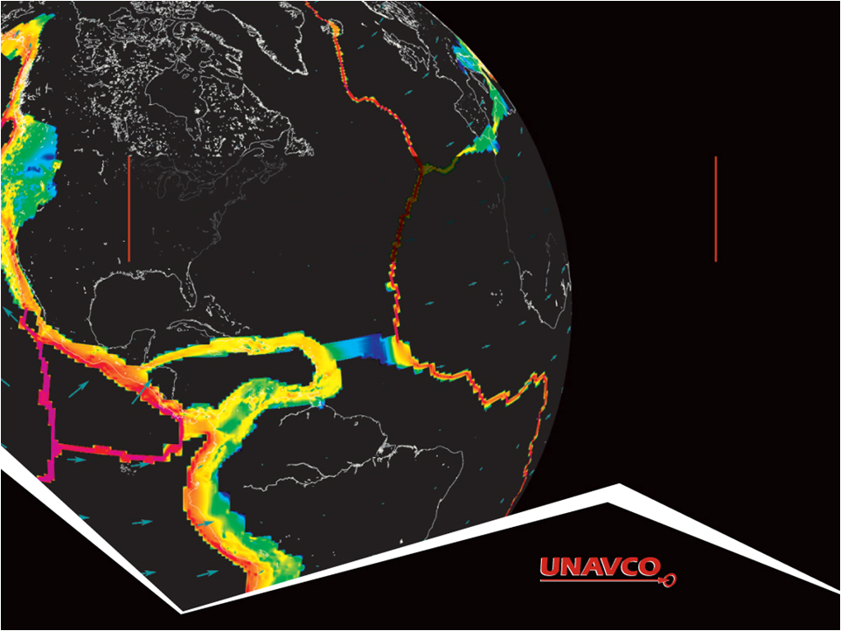

Measuring plate movements with GPS to understand earthquake hazard
GIFT 2012 Presentation: Beth Pratt-Sitaula (UNAVCO), Shelley Olds (UNAVCO), Jamie McCaughey (EOS), Feng Lujia (EOS)
Previous authors/contributors: Cate Fox-Lent (UNAVCO Master Teacher), Andy Newman (Georgia Institute of Technology), Vince Cronin (Baylor University)

Slide 2
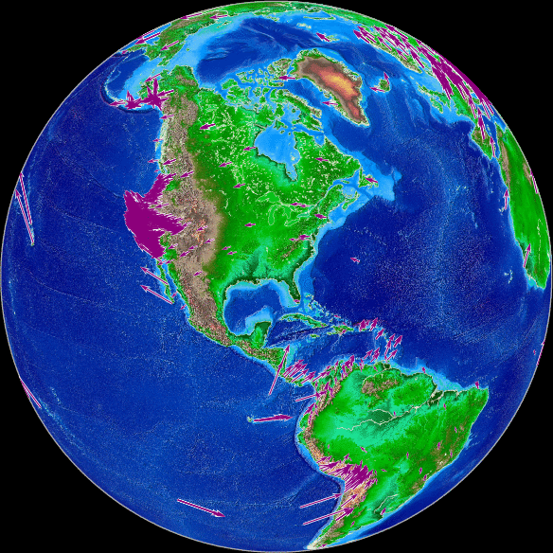
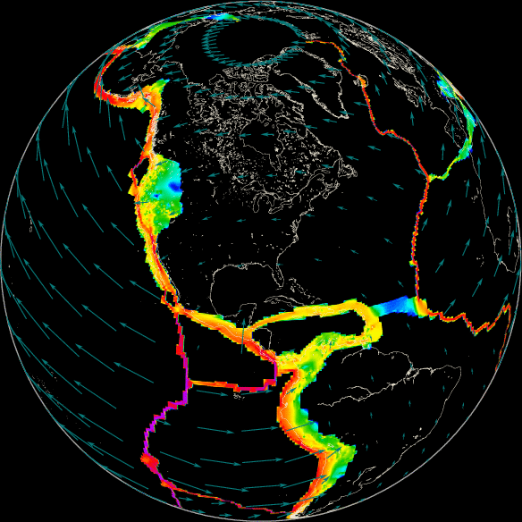
Program components
Lecture
  Intro to UNAVCO & EOS
  Overview of high precision GPS
    Function
    Applications
  Snapshot of other geodesy techniques
Activity
  Reading GPS graphs (time series)
  GPS & Earthquakes in California
  GPS & Earthquakes in Asia

Slide 3

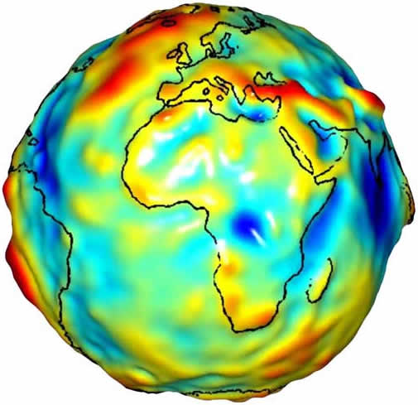

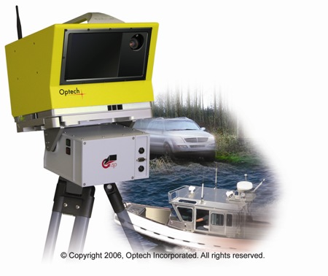

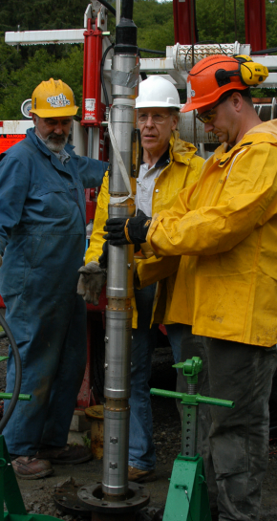
About Geodesy
Geodesy is the science of …
accurately measuring the Earth’s
size, shape, orientation,
mass distribution and
the variations of these with time.
Traditional Geodetic Application:
Precise positioning of points on the surface of the Earth
Modern geodesy:
A toolbox of techniques to better measure the Earth
3
Notes:
3
3
As we got better and better at measuring points on the Earth, it evolved into being able to determine how they change.
Think of geodesy as a toolbox of ways to better measure the Earth’s size, shape…etc

Slide 4
UNAVCO—research consortium for geodetic support
UNAVCO Support
Engineering Services
  Network Installation & Management
  Development and Testing
Equipment Pool
Data Management and Archiving
Education and Outreach
Technologies - A Growing Geodetic “Toolbox”
Global Positioning System (GPS)
Strainmeters, Tiltmeters
Geodetic Imaging
  Terrestrial Laser Scanners
  Airborne Laser Swath Mapping project support
  InSAR Data Archives (radar)

Slide 5

EOS – Research Institute
Conducts fundamental research on earthquakes, volcanic eruptions, tsunami and climate change in and around Southeast Asia, toward safer and more sustainable societies
Includes significant geodetic/GPS research

Slide 6
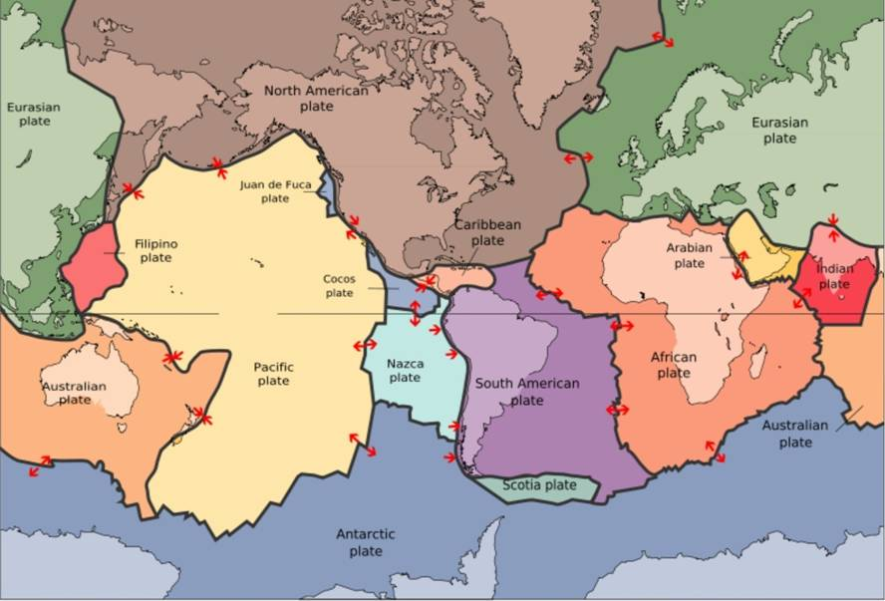
Earth’s Tectonic Plates
Traditionally plates have been considered to be rigid…
but geodetic and geologic studies show boundaries are deforming

Slide 7
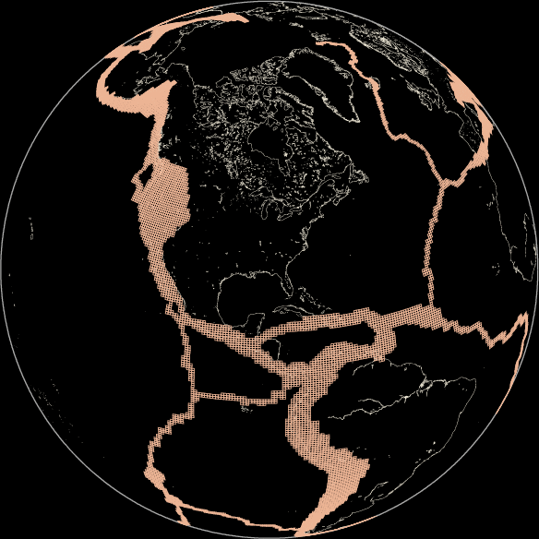
GPS – the global perspective
Global Plate Motions and Boundary Zones
Observed GPS
Velocities
Plate Tectonic
Model with Deformable
Boundaries
Model Velocities and Plate
Boundary Strain
5170 geodetic velocities from 86 different studies
GSRM Model of Kreemer and Holt
Notes:
Topics:
Funding
E&O
EarthScope relations

Slide 8
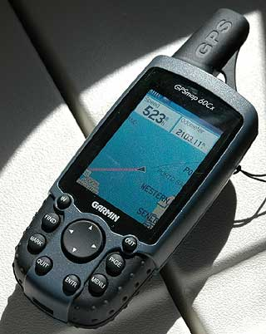
GPS receiver
Notes:
This is a handheld GPS unit that has been available to the public for more than a decade now and is often used for hiking or other outdoor activities.

Slide 9

GPS receiver
Notes:
Whether they know it or not, students use GPS receivers daily in their cars, phones, cameras, and more. Most have heard the term “GPS” but few know much about how the system actually works or high precision GPS for science and industrial use.

Slide 10
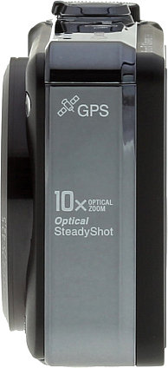

GPS receiver
Notes:
Whether they know it or not, students use GPS receivers daily in their cars, phones, cameras, and more. Most have heard the term “GPS” but few know much about how the system actually works or high precision GPS for science and industrial use.

Slide 11
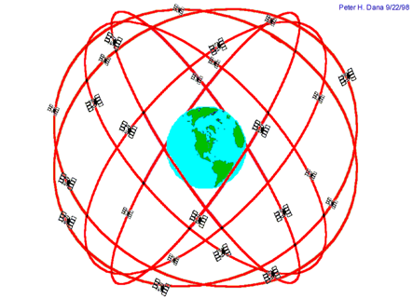
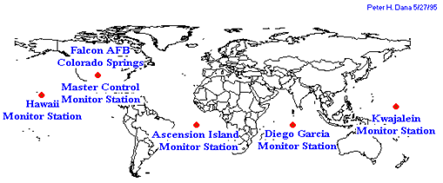
The Global Positioning System
24-32 satellites
20,200 km altitude
55 degrees inclination
12 hour orbital period
5 ground control stations
Need 4 satellites to be accurate
Each satellite passes over a ground monitoring station every 12 hours
Notes:
From the users point of view, GPS is a passive system: you need only a low-powered receiver to obtain the signals, which contain all the information you need to determine your position. This requires that the satellites carry atomic clocks to keep accurate time and transmit to the user the position of the satellite in the sky. The orbits are computed by Department of Defense (DoD) by tracking the satellites at five ground Master Control Monitoring stations with known positions and then uploaded to the satellites which then transmit the information continuously along with the time. With hand-held receivers, it is possible to find your position to a few meters, limited primarily by the accuracy of the broadcast orbits. As we shall see, the civilian scientific community uses over 200 stations to determine the orbits with an accuracy of a few centimeters, allowing millimeter positioning with after several hours of tracking.

Slide 12
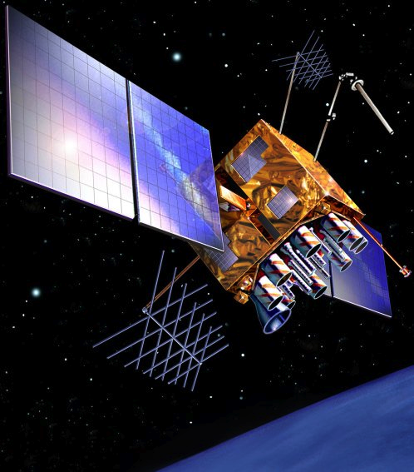
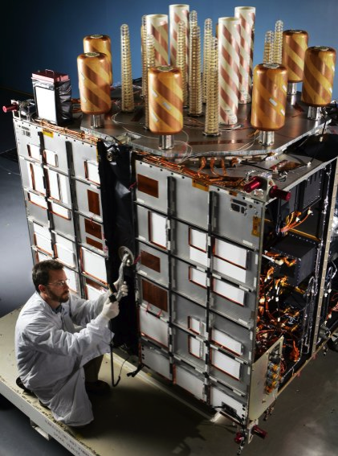
GPS Satellite
Images from Lockeed-Martin (http://www.lockheedmartin.com/products/GPS/)

Slide 13

Consumer-grade GPS accuracy
Horizontal: +/- 3 m (10 ft) error
Vertical: +/- 15 m (45 ft) error
Your location is:
37º 23.323’ N
122º 02.162’ W
Notes:
Since each satellite maintains time very accurately (~1 nanosecond = 30 cm), it can tag its signal with the time of transmission. This information, together with the location of the satellite, also transmitted to the receiver, is sufficient to allow the receiver to calculate the range to each satellite provided that the receiver also knows also knows the time. Equipping receivers with atomic clocks would be very expensive, so the receiver tags the signal with the time of its internal clock to create a “pseudorange” (range plus an unknown clock correction). The software in the receiver than uses the pseudoranges from four satellites to solve for the four unknowns: three coordinates and the receiver clock correction.

Slide 14
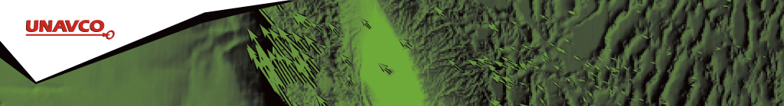
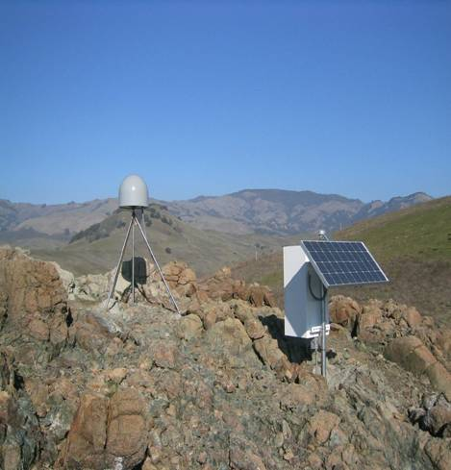
Anatomy of a High-precision Permanent GPS Station
GPS antenna inside of dome
Monument solidly attached into the ground with braces.
If the ground moves, the station moves.
Solar panel for power
Equipment enclosure
GPS receiver
Power/batteries
Communications/ radio/ modem
Data storage/ memory
Notes:
Example of a typical remote GPS station. In urban areas, some are also fixed to the roof of large reinforced buildings and hooked into grid power supply with battery backup. Many stations are now being equipped with “real time” communication to allow immediate transfer of data to researchers. In other places logistics or country-specific regulations require that data not be transmitted but is instead downloaded manually on a given schedule (monthly, quarterly, annually depending on the site)

Slide 15
High-precision GPS
Current accuracies 1-3 mm
Use the carrier phase
Dual-frequency receivers
High-precision orbital information
Good monuments
Multiple stations
Sophisticated processing software
Collect lots of data
Notes:
The primary GPS signal is transmitted at a “carrier’ frequency of 1575 MHz (“L-band”), corresponding to a wavelength of 19 cm. As with FM radio, This signal is then modulated at a much lower frequency to each modulated to incorporate information about the time and location of the satellites. The precision of the pseudorange is limited by the modulation frequency to about 10 cm. In high-precision GPS we use the carrier phase itself to obtain a measurement precision of 10 cm

Slide 16
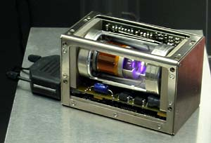
GPS & atomic clocks
Each GPS satellite has 4 atomic clocks, to be sure that one is always working. Each costs ~$100,000, and is accurate to 1 billionth of a second (1 nanosecond).
http://www.kowoma.de/en/gps/satellites.htm
Notes:
GPS depends on extremely accurate time-keeping, so the very best clocks must be used.

Slide 17
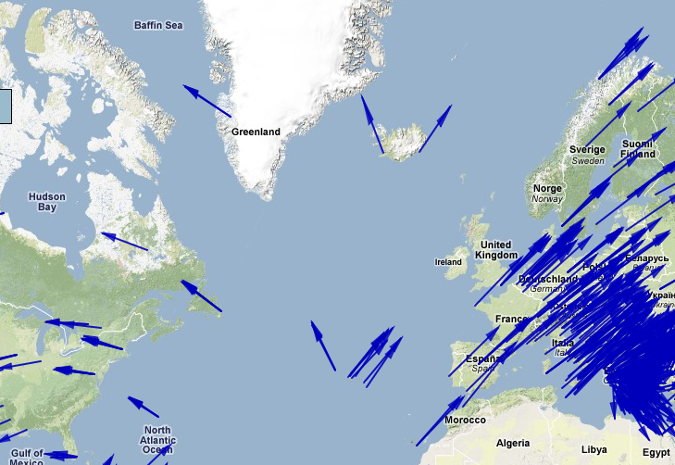
What is GPS telling us?
20 mm/yr
Data source: Global Strain Rate Map Project ; Reference Frame: No Net Rotation
UNAVCO GPS Velocity Viewer http://facility.unavco.org/data/maps/GPSVelocityViewer/GPSVelocityViewer.html
Notes:
Looking at the velocities across the N Atlantic, what are we seeing? → eastern and western Atlantic moving away from eachother
Scale – approx 20 mm/yr for vectors in Iceland
Reference Frame: No Net Rotation – using the velocity viewer

Slide 18
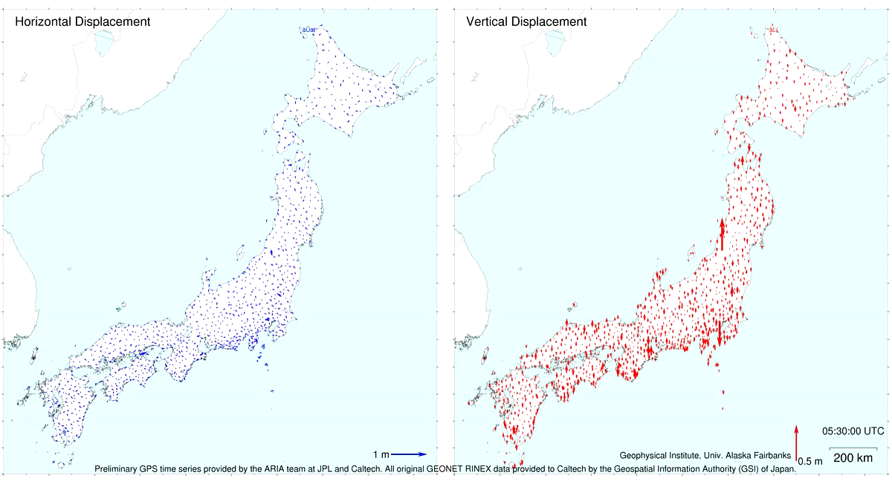
With GPS, You can SEE the Land Move!
Japan March 11 2011 Earthquake: Each dot/arrow represents a continuous high precision GPS station of which more than 1200 are distributed throughout Japan in a network called GEONET. If the ground moves (from an earthquake) then the GPS moves and records this movement. (Credit: Grapenthin, Freymueller )
Notes:
Kinematic GPS solutions for March 11 2011 Japan Earthquake Mag 9
http://gps.alaska.edu/ronni/download/Grapenthin_Freymueller_2011_earthscope_poster.pdf
Permanent displacements after the Mw 9.0 earthquake: blue is horizontal, red is vertical.
Vertical displacements are almost all subsidence, which means that all slip-induced uplift occurred off-shore.
Rupture took about 180 seconds.

Slide 19
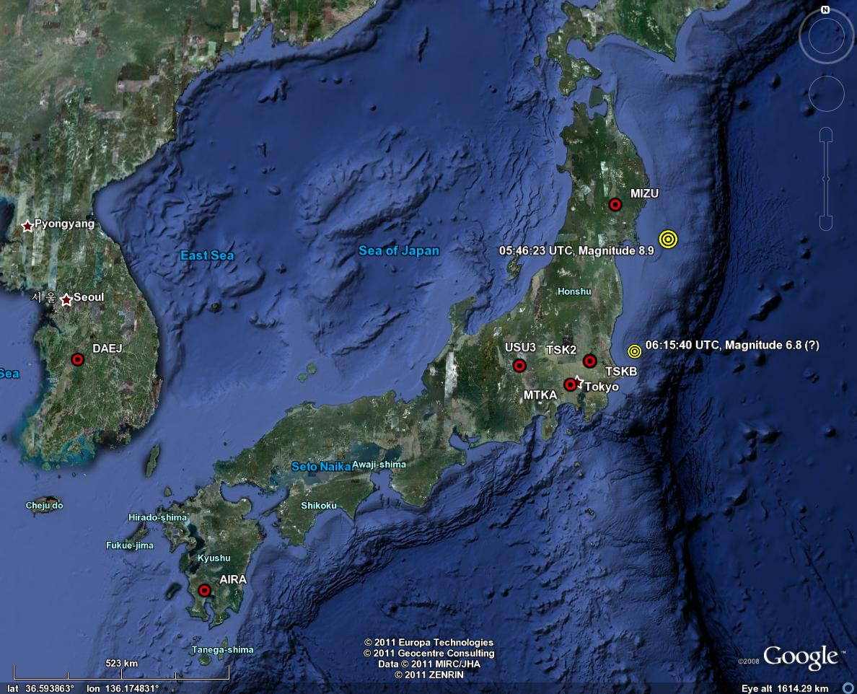
Japan 2011 Mar 11th Earthquake
Notes:
Other resources and presentations about this earthquake:
http://www.iris.edu/news/events/japan2011/
http://www.iris.edu/hq/retm
Scroll down to March 11, 2011 Magnitude 9.0 Near the East Coast of Honshu, Japan
Teachable moment presentation: http://www.iris.edu/hq/files/programs/education_and_outreach/retm/tm_110311_japan/110311japan.zip
http://www.slideshare.net/rgrapenthin/visualization-of-the-seismic-waves-and-permanent-displacements
Other animations
How did Japan move 8 feet in the earthquake? http://www.youtube.com/watch?v=RVaDXsqLUtI
Subduction zone animation: Subduction zone Animation
USArray Ground Motion Visualization: http://www.iris.edu/spud/gmv/4841
Seismic Wave Propagation: http://www.iris.edu/hq/files/programs/education_and_outreach/retm/tm_110311_japan/Japan%20110311_640.mov
Japan Earthquake Sequence, foreshocks, mainshock, and aftershocks, Southern California Earthquake Center: http://www.youtube.com/watch?v=o0-8C3ggC30
Aftershock Animation - Seismic Eruption (using Seismic Eruption tool): http://www.youtube.com/watch?v=1jSHDa-7-cQ

Slide 20
Sendai / Tohoku-oki earthquake displacements from 0530 - 0630 UTC
Animation versions available:
http://www.youtube.com/watch?v=1QCcVqZgNKw
http://www.youtube.com/watch?v=6Q-RzgdR0VM
http://www.youtube.com/watch?v=rMhhyb6Yy94
Notes:
http://www.youtube.com/watch?v=1QCcVqZgNKw
The movie shows the displacements due to the M9.0 and M7.9 earthquakes in Japan on March 11, 2011 (data, no model!). Each dot/arrow represents a continuous high precision GPS station of which more than 1200 are distributed throughout Japan in a network called GEONET. This is an absolutely unique instrumentation density found nowhere else on the world.
Shows body and surface waves, dynamic slip, and static displacements. Further details and higher resolution video for download at: http://gps.alaska.edu/ronni/sendai2011.html
Visualization: R. Grapenthin, Geophysical Institute, Univ. Alaska Fairbanks.
Data: preliminary GPS positioning solutions provided by ARIA/HPL/Caltech (ftp://sideshow.jpl.nasa.gov/pub/usrs/ARIA). All original GEONET RINEX data were provided to Caltech by the Geospatial Information Authority (GSI) of Japan.
I use GMT ( http://gmt.soest.hawaii.edu ) to create individual maps / frames.
-x-x-
http://www.youtube.com/watch?v=rMhhyb6Yy94
Does not remove the displacement from the 9.0 earthquake before moving to the 7.9 earthquake
Notes from the author:
The movie shows the displacements due to the M9.0 and M7.9 earthquakes in Japan on March 11, 2011 (data, no model!). Similar to http://www.youtube.com/watch?v=1QCcVqZgNKw , but using 1Hz solutions of the GEONET data as produced by GPS Solutions and published here: http://rtgps.com/rtnet_dl_eq.php . I deliberately kept the same scale as in the original 30s solution movies for comparison. Unfortunately, the whole network has not yet been processed.
Shows body and surface waves, and static displacements.
Further details and higher resolution video for download at: http://gps.alaska.edu/ronni/sendai2011.html
Visualization: R. Grapenthin, Geophysical Institute, Univ. Alaska Fairbanks.
Data: 1Hz GEONET data provided by the Geospatial Information Authority of Japan (GSI) via Nippon GPS Data Services Company (NGDS), were post-processed in real-time mode with realtime orbits and clock corrections from the VERIPOS/APEX global service. GPS Solutions' RTNet software was used for the PPP analysis performed by GPS Solutions and is also used for APEX service.
I use GMT ( http://gmt.soest.hawaii.edu ) to create individual maps / frames, and ffmpeg to glue them together.
--x-x-
http://www.youtube.com/watch?v=6Q-RzgdR0VM
Notes from author:
The movie shows the displacements due to the M9.0 and M7.9 earthquakes in Japan on March 11, 2011 (data, no model!). Similar to http://www.youtube.com/watch?v=1QCcVqZgNKw , but with the co-seismic displacements removed from 05:55:30 UTC on to isolate the effect of the M7.9 earthquake at 06:15:58 UTC.
Shows body and surface waves, and static displacements.
Further details and higher resolution video for download at: http://gps.alaska.edu/ronni/sendai2011.html
Visualization: R. Grapenthin, Geophysical Institute, Univ. Alaska Fairbanks.
Data: preliminary GPS positioning solutions provided by ARIA/HPL/Caltech (ftp://sideshow.jpl.nasa.gov/pub/usrs/ARIA). All original GEONET RINEX data were provided to Caltech by the Geospatial Information Authority (GSI) of Japan.
I use GMT ( http://gmt.soest.hawaii.edu ) to create individual maps / frames.

Slide 21
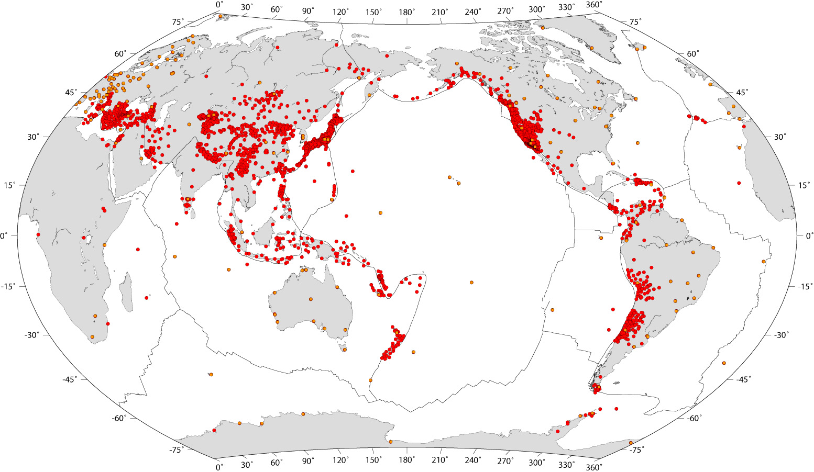
GNSS/GPS stations globally
>4000 stations with more added all the time
Some data freely available, some not
GNSS = Global Navigation Satellite System
http://gsrm.unavco.org/data/images/1.2/sites.jpg
Notes:
GNSS refers to the entire global network using this basic type of technology
Technically, GPS, is the USA system and only refers to the satellites within our country purview, but GNSS is not yet as well recognized a term as GPS.

Slide 22
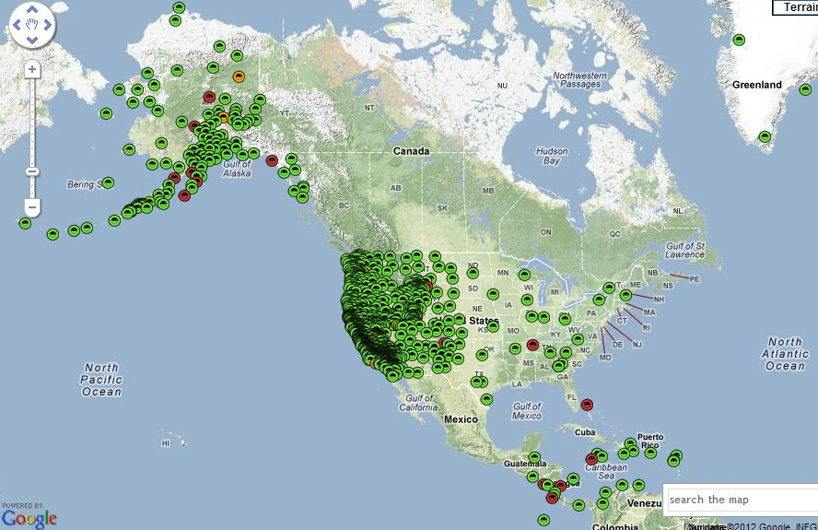


Plate Boundary Observatory (PBO)
PBO involves installation, operation and maintenance of >1100 continuously operating high-precision GPS stations (plus >170 other instruments: strainmeters, borehole seismometers and tiltmeters)
http://pbo.unavco.org/network/gps/; http://www.earthscope.org/
Notes:
Plate Boundary Observatory (PBO) is a major component of the large geophysics initiative, EarthScope. It is run by UNAVCO, a non-profit university-governed consortium dedicated to providing geodetic support to the research and educational communities. The PBO GPS stations are located throughout the USA states, territories, and a few other places around the world but the highest concentration of stations is in the actively deforming western USA and southern Alaska. PBO is the biggest GPS network in the USA and one of the biggest (if not the biggest) in the world.
All data from PBO (raw and processed) is freely available through a variety of data portals maintained by UNAVCO (http://www.unavco.org/crosscutting/cc-data.html). It is generally the easiest GPS data to get started using, especially with students.

Slide 23
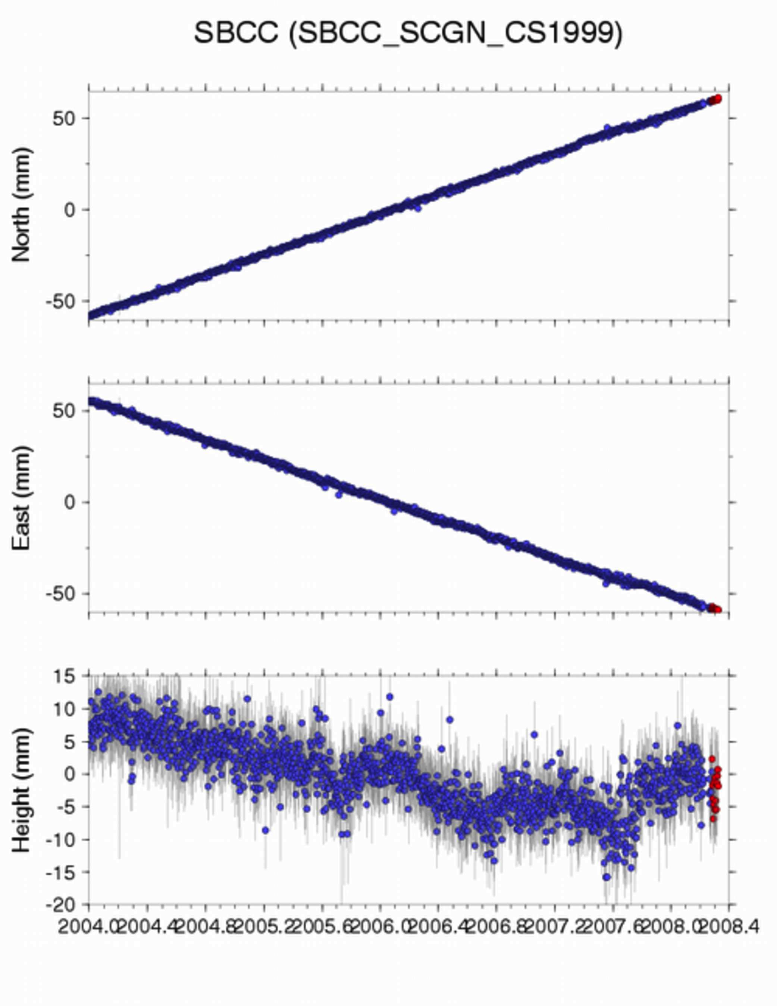
GPS time series data
Station position over time
  North-South
  East-West
  Up-Down
http://pbo.unavco.org/station/overview/SBCC
Notes:
A variety of data products are available for each PBO station (http://pbo.unavco.org/data/gps), but the most basic processed data is the station position over time = “time series”. The position is broken into the three orthogonal directions and set to an arbitrary zero datum. The most common reference frame for PBO data is Stable North American Reference Frame (SNARF) which assumes that the eastern North America is not moving and all the motion in western North America is shown relative to this fixed stable east. For more on reference frames: http://facility.unavco.org/data/maps/GPSVelocityViewer/GPSVelocityViewer-frames.html.
Vertical data are always much less accurate because of the angle to the satellite (if we could only put satellites below the surface of the Earth…vertical accuracy would improve)

Slide 24
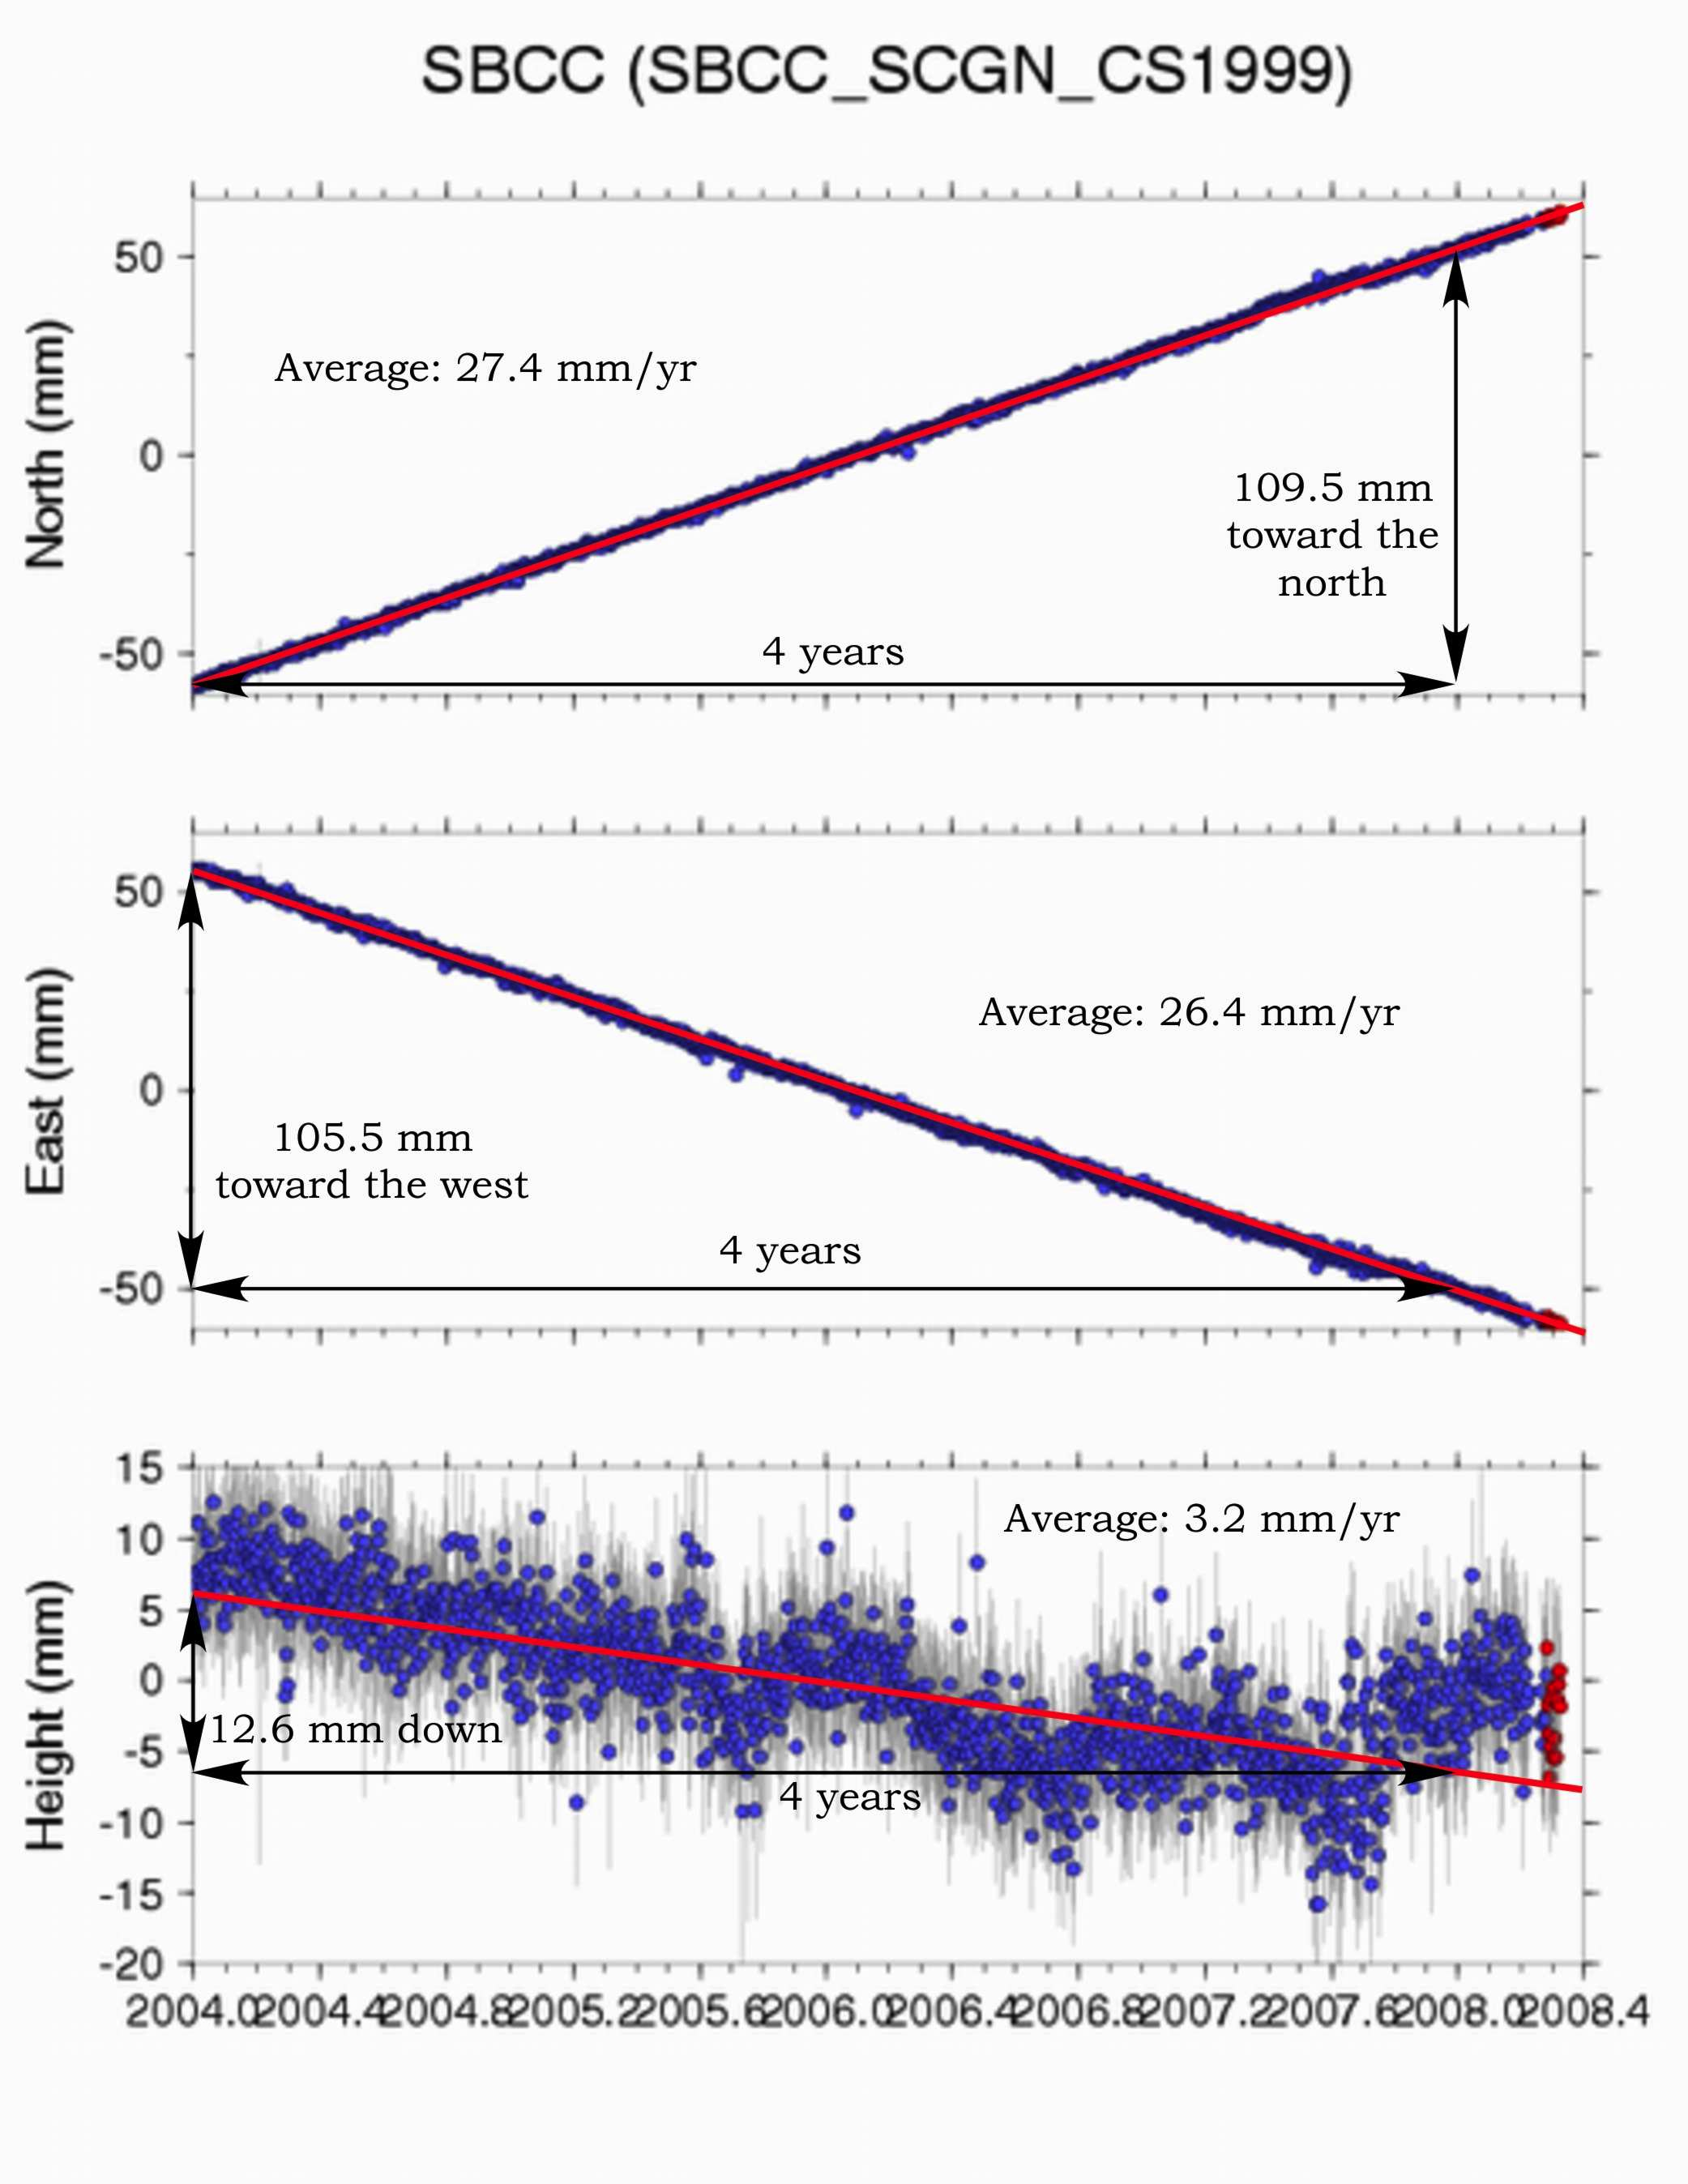
GPS time series data
From the changing position velocity can be calculated using slope (rise-over-run)
http://pbo.unavco.org/station/overview/SBCC

Slide 25
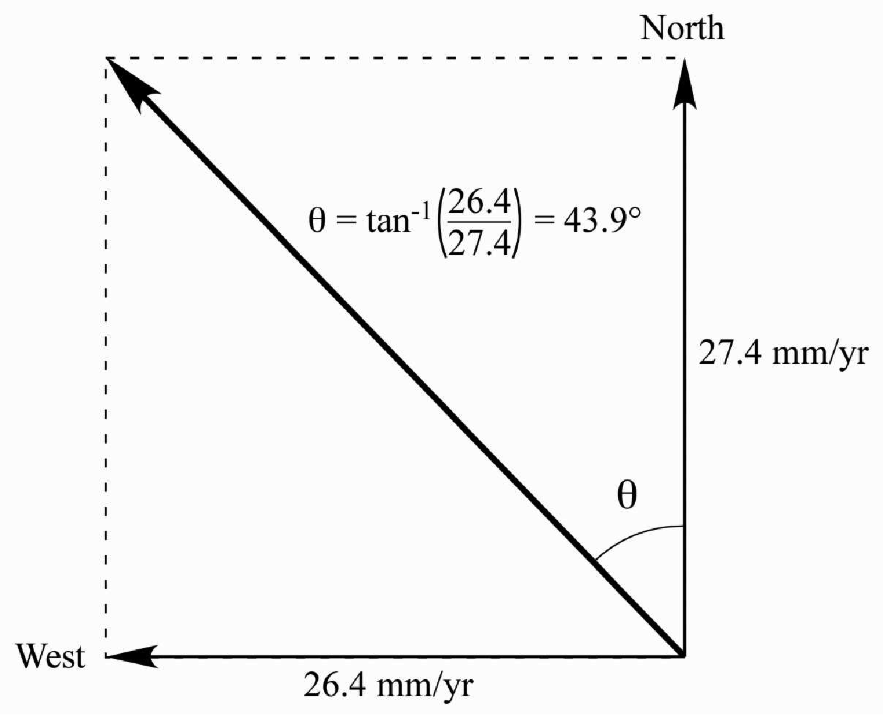
What compass direction is the site moving?
Using the horizontal components of velocity,
and a bit of high-school trigonometry…
43.9°west of north
or
316.1°azimuth

Slide 26
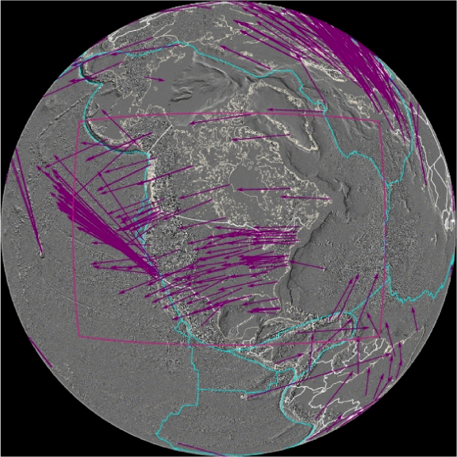
Reference Frames
All velocities are RELATIVE to a given reference frame
Velocities compared to International Terrestrial Reference Frame 2000
Hot spot constellation as “stable”
Notes:
Compared to plate motions, hot spots are much more fixed, so a global reference frame has been defined in comparison to that hot spot constellation.

Slide 27
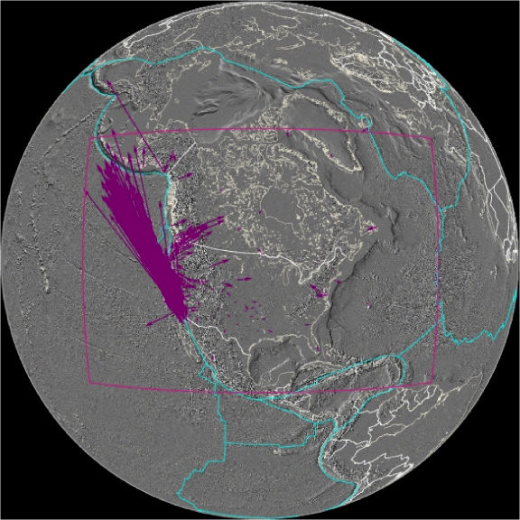
Reference Frames
All velocities are RELATIVE to a given reference frame
Velocities compared to Stable North America Reference Frame
Eastern North America as “stable”
Notes:
More useful for most typically applications is to consider a local reference frame where movement in a deforming plate boundary is compared to the more stable, less-deforming region. For morn on reference frames see: http://facility.unavco.org/data/maps/GPSVelocityViewer/GPSVelocityViewer-frames.html.

Slide 28
Few other geodesy applications
Volcanic deformation
Ice, water, air
Detailed elevation changes (LiDAR, InSAR)

Slide 29
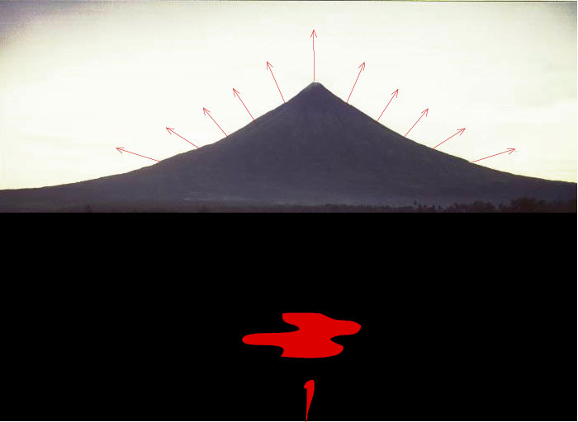
Inflation of Volcano
Notes:
When magma rises to higher levels below a volcano, it can cause the volcano flanks to move up and outwards. These movements can be measured with GPS.
A GREAT animation about monitoring volcanoes using geodesy can be found at http://www.iris.edu/hq/files/programs/education_and_outreach/aotm/16/VolcanoMonitoring_Deformation_Tilt_GPS.mov

Slide 30
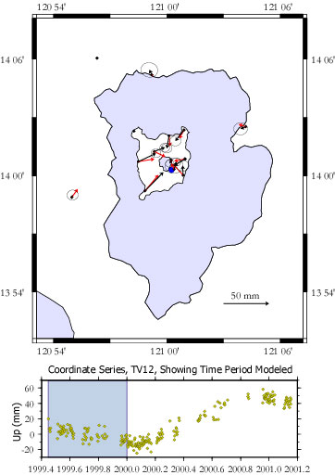
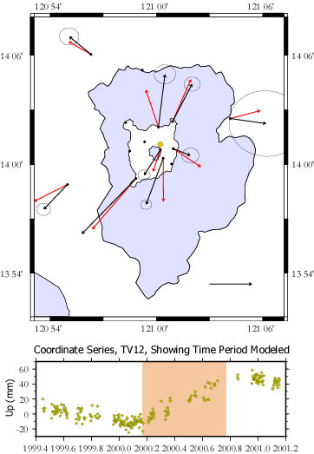
Inflation & Deflation
Deflation
Inflation
50 mm/yr
50 mm/yr
2000
2001
2000
2001

Slide 31
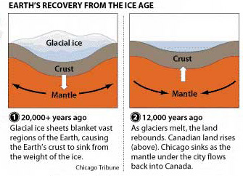
Crustal Loading from Glaciers
Viscous rebound from ancient glaciers
Elastic response of present-day melting from global warming
Notes:
Since the Earth’s crust has some rigidity, changes in the volume of ice or water on the surface, or changes in air pressure cause it to bend downward or upward in response. In the short term the crust responds elastically, so that changes in height--as measured by GPS--are a direct measure of the gravitational force of the fluid. Over longer time scales--years to thousands of years--the crust responds to the viscous flow of the mantle as it reaches gravitational equilibrium (“isostatic adjustment”), so, for example, we can still see today changes from the melting of the glaciers more than 10,000 years ago. Separating these various sources of loading requires reconstructing the pattern of glaciation from the last ice age and independently monitoring ocean loading from tides and storms, air pressure, and the runoff of surface water from snow, rainfall, and melting snowpack.

Slide 32
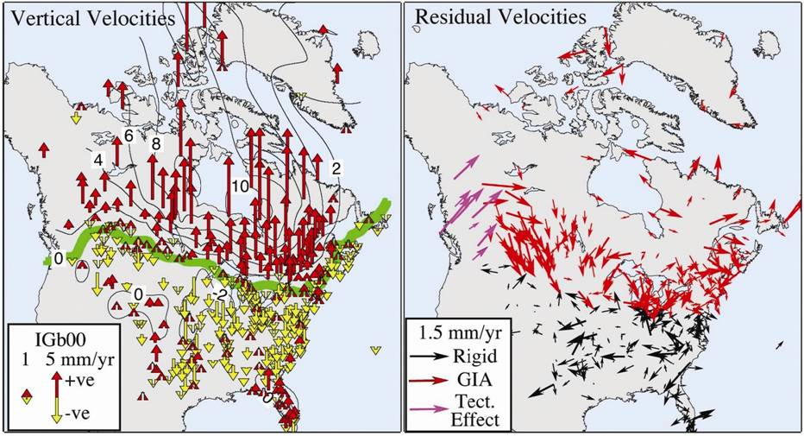
Isostatic Adjustment
(Sella and others, 2007)

Slide 33
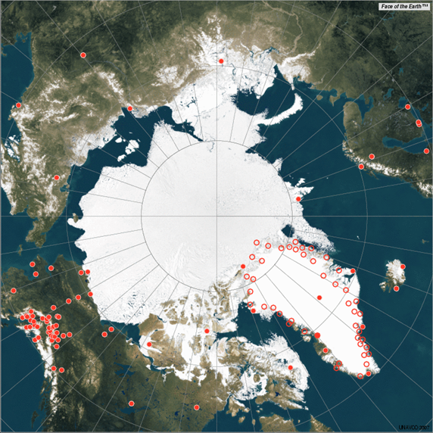
Weighing the modern ice sheets
Short-term elastic deformation of the ice load, providing a measure of large-scale melting, and hence contribution to sea-level rise
Open circles are the POLENET network installed for the International Polar Year (IPY)
Notes:
Measurements on the ice sheet, shown in the last slide are one way to monitor glacial ice. But we can also use measurements on protruding or surrounding bedrock to detect the elastic response from the reduced load of ice as the glaciers melt. These measurements are complementary: stations on ice see large (cm to m) but local changes; stations on bedrock see small (mm) changes from the integrated effect of the melt, and of course must be separated from the long-term signal of rebound from the last ice age. March 2007- March 2009 has been designated the International Polar Year (IPY), when governments and scientist throughout the world are mounting a major effort to study the Arctic and Antarctic.

Slide 34
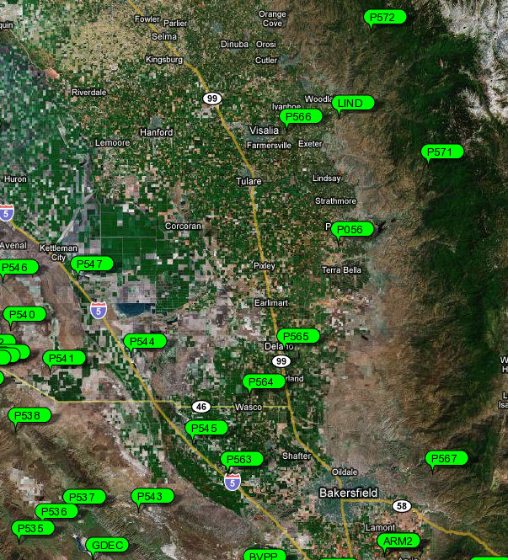
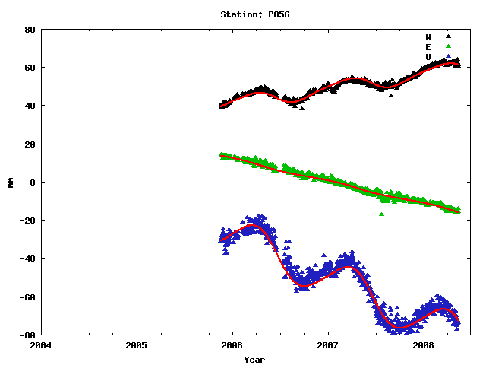
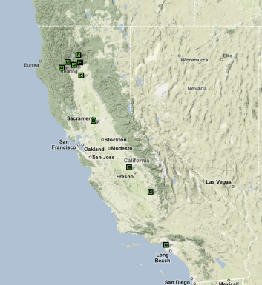
Ground Water Effects
P056 Site in Sediments in San Joaquin Valley
- Shows rapid secular subsidence
- Annual Cycle peaks in March
Notes:
Station is moving north and west and DOWN.
The height measurement also has a annual cycle related to seasonal rains that inflate the surface during the wettest times.
However, the overall height signal is still down.

Slide 35

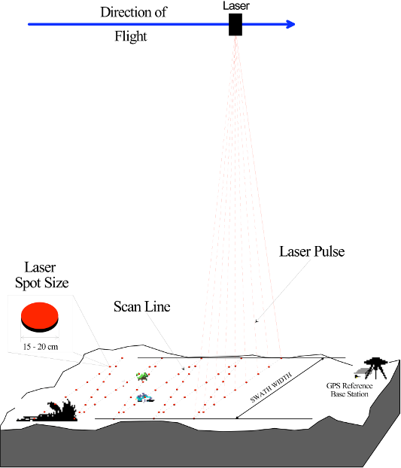
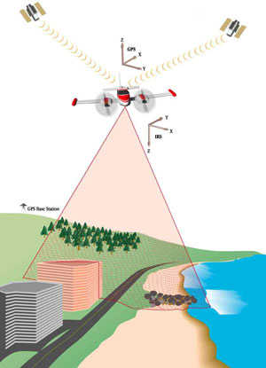
Airborne Laser Swath Mapping (ALSM)

Slide 36
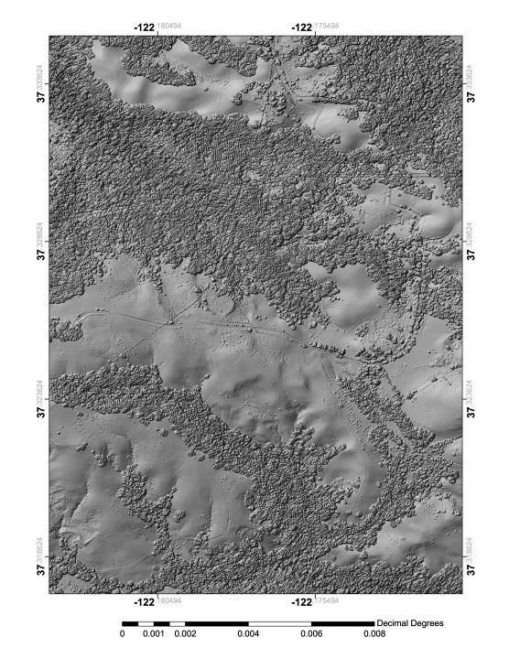
LiDAR Image: Unfiltered
Landscape content
Notes:
Landscape content slide example

Slide 37
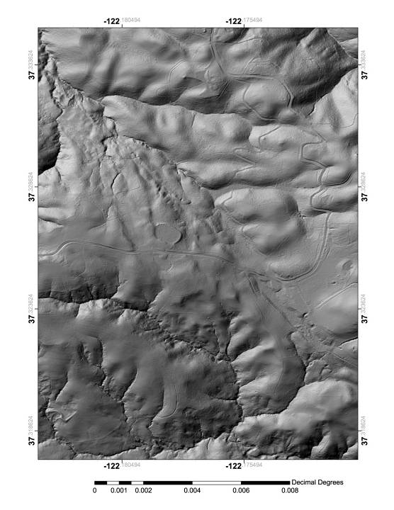
LiDAR Image: Filtered
Notes:
Landscape content slide example

Slide 38
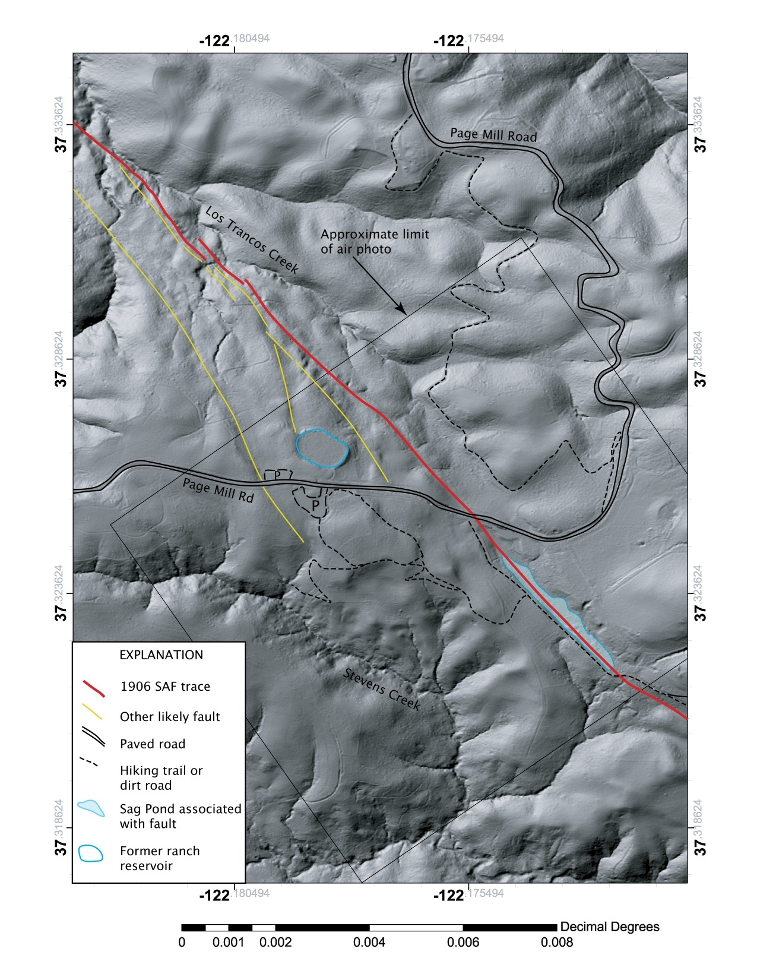

Slide 39
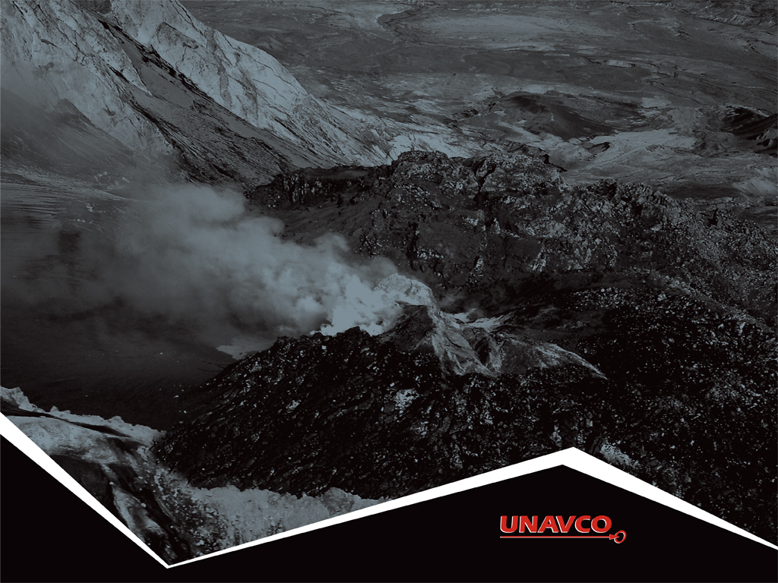
Reading GPS
Time Series Plots: Using GPS to study tectonic plates move, twist, and crumple
Roger Groom and Cate Fox-Lent, UNAVCO Master Teachers-in-Residence, and Shelley Olds, UNAVCO

Slide 40
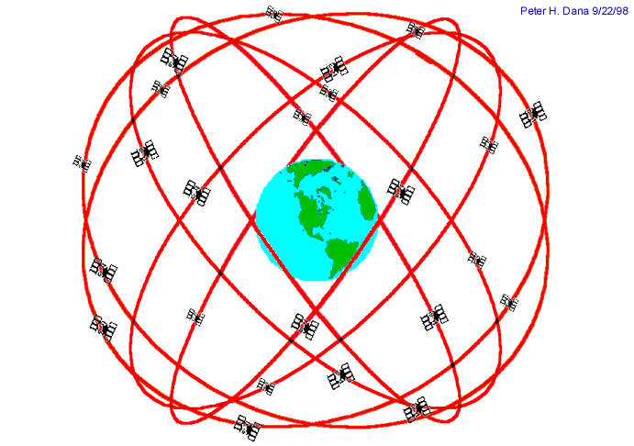

Introduction: GPS Basics
Three satellite signals are needed to locate the receiver in 3D space.
The fourth satellite is used for time accuracy.
Position can be calculated within a sub-centimeter.
Ground control and time quality key to accuracy
Notes:
Also note that the GPS stations used for scientific work are more precise for many reasons: the unit uses both of the signals coming from the satellites, two the clocks are atomic rather than crystal, (see slide). These stations can measure the change in position of a location with sub-centimeter accuracy.

Slide 41
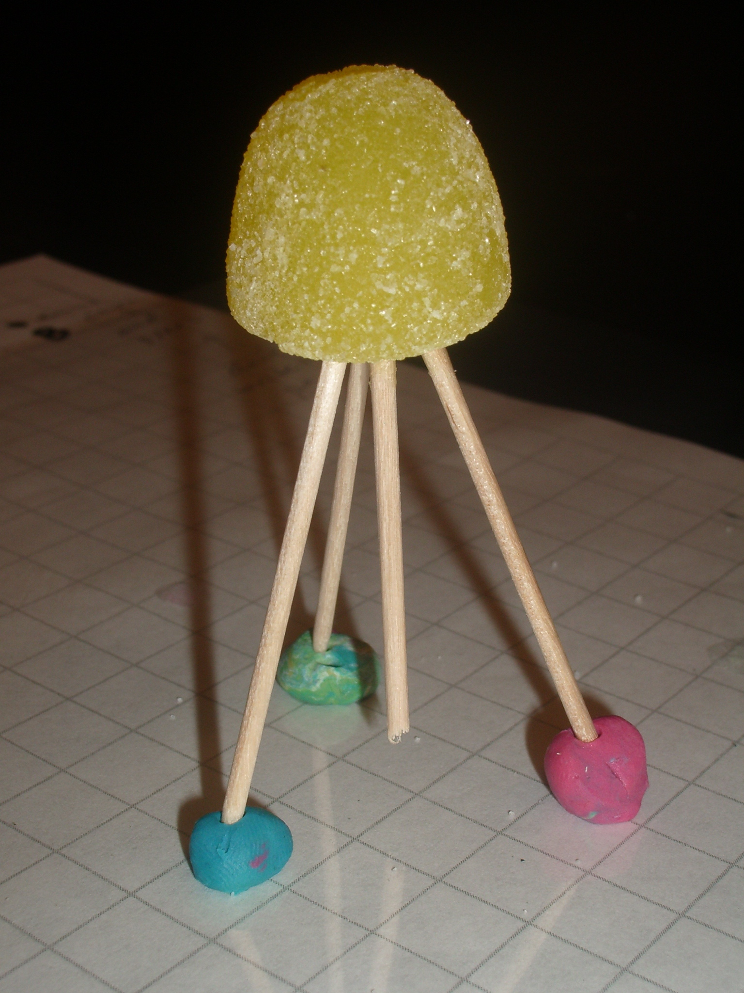

Part 1: Build a Gumdrop GPS Station
To build a gumdrop model of a GPS monument:
  Use one gumdrop as the receiver (GPS monument).
  Use toothpicks as three legs and one center post (monument braces).
  Form feet from three small amounts of clay (Cement).
  Use small piece of transparency paper (‘see-through’ Earth’s plate).
Notes:
Have students write: This is a tectonic plate.

Slide 42
Demonstration
Pinpoint Location With GPS

Slide 43
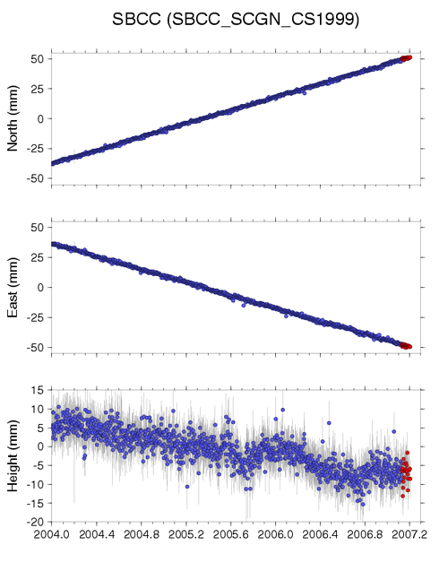
Starting With the Basics:
GPS Time Series Plot
Y-axis:
North (N/S)
East (E/W)
Height (up/down) (sometimes called Vertical)
In millimeters
Red data points are rapid position estimates.
X-axis:
Date of the measurement expressed in tenths of a year or in months.
Notes:
After processing, the data is provided in a coordinate system (latitude and longitude) then converted to millimeters of offset
The beginning of the data is not at zero because the offset is measured from a data point in the middle of the dataset

Slide 44

Units of Measurement
X-axis - Typically expressed in tenths of a year
Y-axis - Usually expressed in millimeters (but always check)
Notes:
Note that the examples we do in this activity use months of the year.

Slide 45
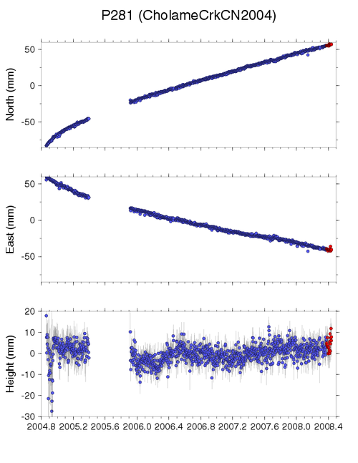
Gaps in Data
Causes:
Power outages
Snow coverage
Equipment failure
Vandalism
Wildlife
Etc.

Slide 46
Determine the direction of movement of high-precision GPS Monument A
GPS Monument A
Year | North (mm) | East (mm) | Height (mm)
2000 | 0 | 0 | 0
2001 | 1 | 1 | 0
2002 | 2 | 2 | 0
2003 | 3 | 3 | 0
2004 | 4 | 4 | 0
2005 | 5 | 5 | 0
… | … | …
Notes:
Leave on screen while students work. Or do so a class
This is slide builds per click – first click shows the points; second click shows the arrow

Slide 47
Plotting the GPS Position Over Time: North
GPS Monument A
North vs Time
Year | North Position (mm)
2000 | 0
2001 | 1
2002 | 2
2003 | 3
2004 | 4
2005 | 5
… | …
5
4
3
2
1
0
North (mm)
2000 2001 2002 2003 2004 2005
Time (years)

Slide 48
Plotting the GPS Position Over Time: East
GPS Monument A
East vs Time
Year | East Position (mm)
2000 | 0
2001 | 1
2002 | 2
2003 | 3
2004 | 4
2005 | 5
… | …
5
4
3
2
1
0
East (mm)
2000 2001 2002 2003 2004 2005
Time (years)

Slide 49
Which way are we going?
Moving North and East
Positive slope (numbers getting larger):
  North-south time series: The station is moving north.
  East-west time series: The station is moving east.
  Height time series: The station is moving up.
North (mm)
East (mm)
Height (mm)
Time

Slide 50
Plot North and East Together
GPS Monument A
Year | North (mm) | East (mm)
2000 | 0 | 0
2001 | 1 | 1
2002 | 2 | 3
2003 | 3 | 3
2004 | 4 | 4
2005 | 5 | 5
5
4
3
2
1
0
North
1 2 3 4 5
East
Notes:
Leave on screen while students work. Or do so a class
This is slide builds per click – first click shows the points; second click shows the arrow

Slide 51
What Direction Is GPS Monument A Moving?
Plot the location of the GPS station each year.
Draw an arrow from the first data point to the last data point.
Move your gum-drop GPS monument from year 2000’s position toward 2005’s position.
What direction is your GPS monument moving?
5
4
3
2
1
5
4
3
2
1
5
4
3
2
1
0
North
North
North
1 2 3 4 5
1 2 3 4 5
1 2 3 4 5
East
East
East
Notes:
Leave on screen while students work. Or do as a class
This is slide builds per click – first click shows the points; second click shows the arrow

Slide 52
Part 3: What Direction Is GPS Monument B Moving?
GPS Monument B
Year | North (mm) | East (mm)
2000 | 0 | 0
2001 | -1 | -2
2002 | -2 | -4
2003 | -3 | -6
2004 | -4 | -8
2005 | -5 | -10
Focus on the North data:
Is monument B moving in a more positive or negative direction?
What direction is GPS monument B moving? North or South?
Now, focus on the East data:
Is monument B moving in a more positive or negative direction?
What direction is GPS monument B moving? East or West?
Notes:
Leave overhead while students plot points
This is slide builds per click – first click shows the points; second click shows the arrow

Slide 53
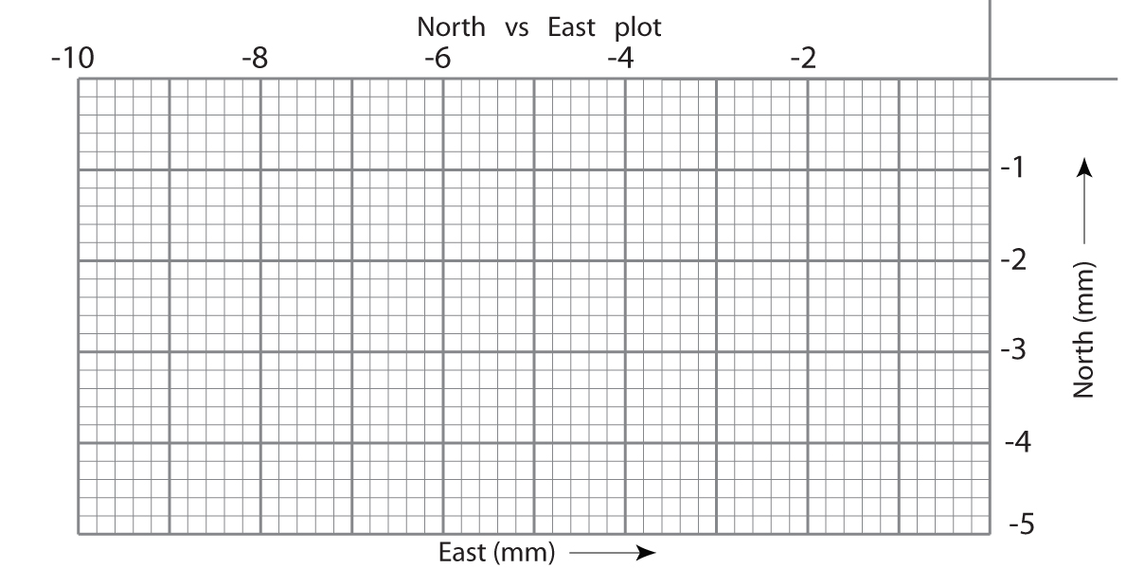
Plotting North and East Positions Together
GPS Monument B
Year | North (mm) | East (mm)
2000 | 0 | 0
2001 | -1 | -2
2002 | -2 | -4
2003 | -3 | -6
2004 | -4 | -8
2005 | -5 | -10
Notes:
Leave overhead while students plot points
This is slide builds per click – first click shows the points; second click shows the arrow

Slide 54
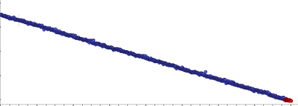
Which way are we going?
Moving South and West
Negative slope:
  North-south time series: The station is moving south.
  East-west time series: The station is moving west.
  Height time series: The station is moving down.
North (mm)
East (mm)
Height (mm)
Time

Slide 55
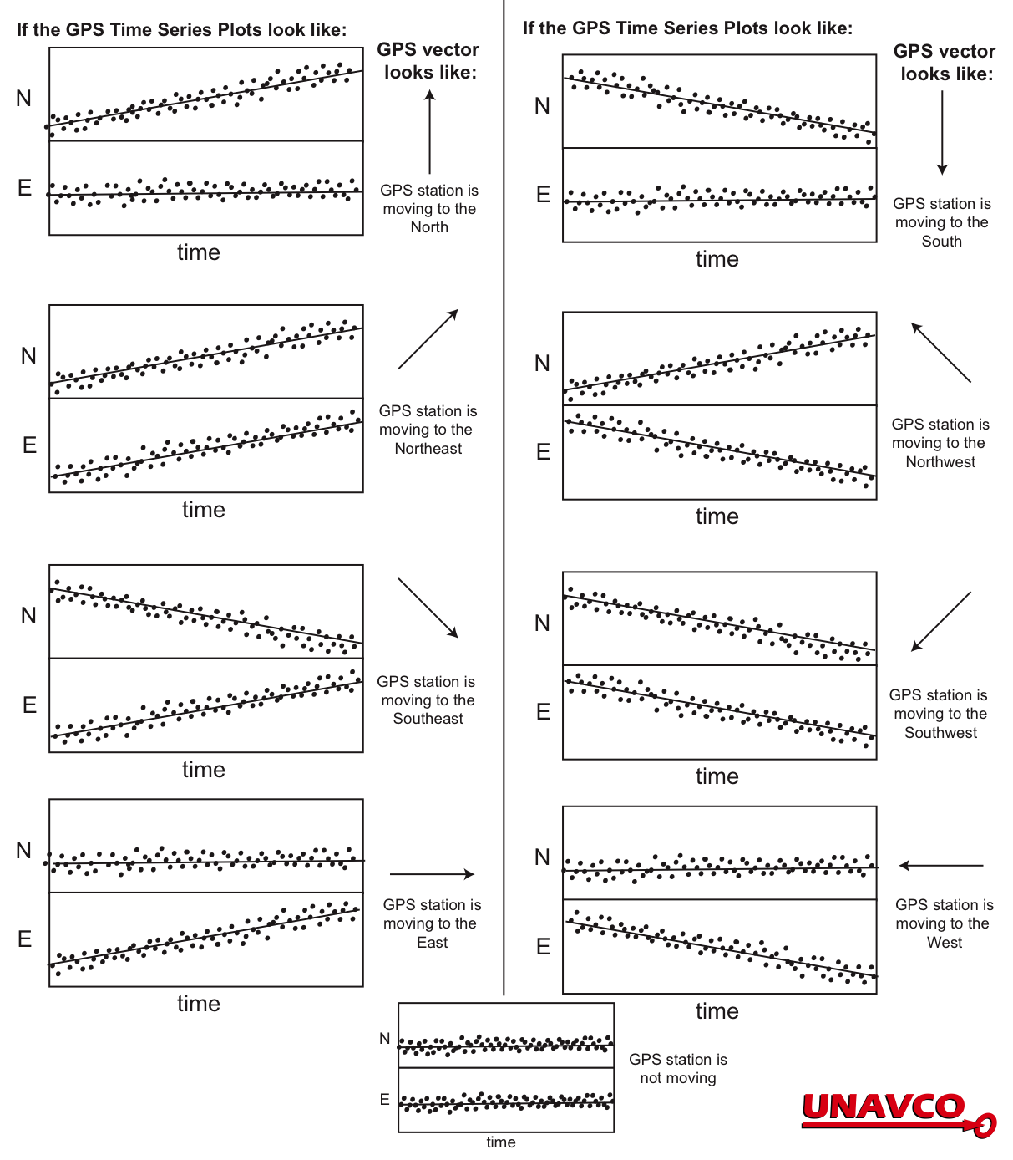
Time Series Plot
Reference Key

Slide 56







Part 3: Apply Your Knowledge: Which Car Matches the Graphs?
A
North
B
E
C
D

Slide 57
Which Car Matches the Graphs?
i)
What
Direction?
North-Northeast
Which car?
(letter)
Car A
North
East
North (miles)
East (miles)
Time (Hours)
Time (Hours)
A
North
B
E
C
D

Slide 58
Which Car Matches the Graphs? ii
ii)
What
Direction?
________
Which car?
(letter)
________
North
East
North (miles)
East (miles)
Time (Hours)
Time (Hours)
A
North
B
E
C
D

Slide 59
Which Car Matches the Graphs?
ii)
What
Direction?
South
Which car?
(letter)
Car C
North
East
North (miles)
East (miles)
Time (Hours)
Time (Hours)
A
North
B
E
C
D

Slide 60
Exploring Plate Motion and Deformation in California Using GPS Time Series Plots
Cate Fox-Lent, UNAVCO Master Teacher; Andy Newman, Georgia Institute of Technology;
Shelley Olds, UNAVCO

Slide 61
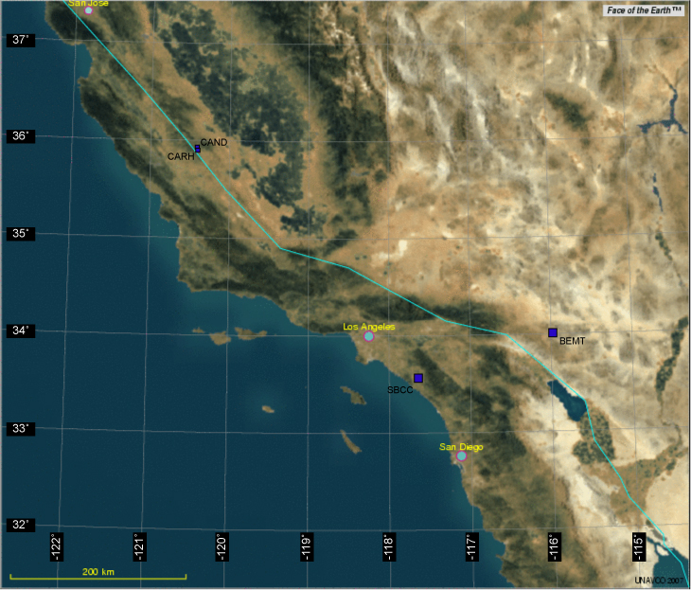

Parts of the Activity
Part 1: Analyze authentic GPS data at two stations to determine plate tectonic motions
Part 2: Investigate deformation at two GPS stations in California
Extension: Explore More GPS locations
BEMT
SBCC

Slide 62
Activity Outcomes
Learners should be able to
Discuss high-precision GPS and its application to plate tectonics.
Interpret GPS time series plots to determine regional plate velocity
Describe the plate motions along the San Andreas
Access resources to support classroom implementation

Slide 63
Processed Data
SBCC GPS STATION
The station is located near Mission Viejo, CA.
Position data are collected every 30 seconds.
One position estimate is developed for each day:
  North
  East
  Vertical
Date | North (mm) | East (mm) | Vertical (mm)
1/1/2004 | -37.67 | 36.57 | 2.33
1/2/2004 | -38.04 | 35.73 | 5.63
1/3/2004 | -37.16 | 35.83 | 4.69
1/4/2004 | -37.34 | 36.34 | 5.36
1/5/2004 | -37.59 | 36.44 | 9.11
… | … | … | …
1/1/2005 | -9.43 | 9.63 | 2.36
1/1/2006 | 16.48 | -18.09 | 7.35
1/1/2007 | 45.98 | -43.42 | -6.43
Notes:
The data from the GPS stations run by UNAVCO's Plate Boundary Observatory (which is one of the EarthScope projects) is freely available to the public. Each GPS station has a data file which contains the daily change in position.
UNAVCO began providing processed data since Jan 1, 2004… Although some GPS stations were installed prior to this date, currently only data after January 1, 2004 is available.

Slide 64
Position Time Series Plot
The time series plot shows the GPS station’s change in position over time.
X-axis:
  Date of the measurement
  In 10ths of year or months
Y-axis:
  North (N/S)
  East (E/W)
  Height (up/down) (sometimes called Vertical)
  In millimeters

Slide 65
Units of Measurement
X-axis is typically shown in 10ths of year.
Y-axis is typically shown in millimeters (but always check).
Notes:
Note that the examples we do in this activity use months of the year.

Slide 66

Part 1: Analyze Authentic
Time Series Data of Two GPS Stations
Go to: http://www.unavco.org/
Click on Data for Educators

Slide 67


Data for Educators Website
2. Zoom in near Southern California – BEMT and SBCC

Slide 68

Station information
3. Click on the green balloon labeled SBCC or BEMT (near Los Angeles)
Click on the link for PBO Station Page
Notice:
Station information pages
Time Series Plot
Link to download data

Slide 69

Overview Page
4. Use the information to retrieve the station information and time series plot graph

Slide 70

Overview Page
5. Work with a partner to answer questions 4 – 5 about BEMT and SBCC
Hints:
Elevation: use the elevation listed under SNARF
Use the Station Position plot titled: Most Recent Raw Data Times Series Plot.

Slide 71

How Quickly is BEMT moving?
How quickly is BEMT moving in the North-South direction?
Let’s look at 2005 and 2010
Average position on 1/1/2010 = ______ mm
Average position on 1/1/2005 = ______ mm
Hint: sketch in light vertical lines from 2005 and 2010 up to the plot, then a horizontal line from the plot to the y-axis
Notes:
Do the North motion as a class.
Have students follow along on their worksheet – drawing the lines across and down seem to help.

Slide 72
How Quickly is BEMT moving?
How quickly is BEMT moving in the North-South direction?
Let’s look at 2005 and 2010. What general direction is BEMT moving?
Average position on 1/1/2010 = __14 __ mm
Average position on 1/1/2005 = __-10 _ mm
Annual speed of BEMT north = (13 - ⁻9 mm)/5 years = 24 mm/5yrs
= 4.8 mm/yr to the North for BEMT (+/- 0.2?)
Notes:
Do the North motion as a class.
Have students follow along on their worksheet – drawing the lines across and down seem to help.

Slide 73
How Quickly is BEMT moving?
How quickly is BEMT moving in the East-West direction?
Let’s look at 2005 and 2010. What general direction is BEMT moving?
Average position on 1/1/2010 = ______ mm
Average position on 1/1/2005 = ______ mm
Hint: sketch in light vertical lines from 2005 and 2010 up to the plot, then a horizontal line from the plot to the y-axis
Notes:
Do the North motion as a class.
Have students follow along on their worksheet – drawing the lines across and down seem to help.

Slide 74
How Quickly is BEMT moving?
How quickly is BEMT moving in the North-South direction?
Let’s look at 2005 and 2010
Average position on 1/1/2010 = __-9 __ mm
Average position on 1/1/2005 = __17 _ mm
Annual speed of BEMT north = ( ⁻9 - 17 mm)/5 years = -26 mm/5yrs
= -5.2 mm/yr. BEMT is moving to the West
Notes:
Do the North motion as a class.
Have students follow along on their worksheet – drawing the lines across and down seem to help.

Slide 75

How Quickly is SBCC moving?
Now do SBCC
Annual speed of SBCC
= 27 mm/yr to the North
= ~28 mm/yr to the West
Notes:
Do the North motion as a class.
Have students follow along on their worksheet – drawing the lines across and down seem to help.

Slide 76

How do we show the movement of plates on a map?
… with Vectors!

Slide 77

Graph paper as a map
Each axis uses the same scale.
X-axis: East in millimeters
Y-axis: North in millimeters
On your graph paper, each block represents 1 mm.
Where is the origin on this graph paper?
Notes:
It is very important that both the North and East axis use the same scale so that the two vectors can be added together.
Have students work in pairs – check each other’s work.

Slide 78

Plotting Vectors: North
Vector: magnitude and direction
  Tail is the GPS monument location.
  Length of arrow is the magnitude.
  Shows direction on a map
Notes:
It is very important that both the North and East axis use the same scale so that the two vectors can be added together.
Have students work in pairs – check each other’s work.

Slide 79
Plotting Vectors: North
Step 1. Draw the first vector arrow along the North axis with the tail at 0,0.
GPS Monument BEMT has moved 4.8 mm to the North per year
Draw a vector arrow 4.8 blocks along the north axis.
Notes:
It is very important that both the North and East axis use the same scale so that the two vectors can be added together.
Have students work in pairs – check each other’s work.

Slide 80
Plotting Vectors: East
Step 2. Draw the east vector from the end point of the North arrow.
(Remember to draw vectors with negative values in the opposite direction.)
Draw the vector arrow ⁻5.2 blocks (mm)
Notes:
It is very important that both the North and East axis use the same scale so that the two vectors can be added together.
Have students work in pairs – check each other’s work.

Slide 81
Adding the Vectors Together
Step 3. Add the vectors together by drawing a new vector from the origin (0,0) to the end point of the East arrow.
This final vector shows the overall annual direction and distance of motion of the GPS station and the land beneath it.
Notes:
It is very important that both the North and East axis use the same scale so that the two vectors can be added together.
Have students work in pairs – check each other’s work.

Slide 82
Adding the Vectors Together
To add the vectors together, mathematically:
  GPS Monument moves at: √x² + ⁻y² = 7.1 mm/yr to the _Northwest_
Notes:
Students can move their gum-drop GPS stations along the final vector (in red) to get the feel of the movement of the GPS.
Reiterate that the GPS is moving because the Earth’s plate is moving.
Talk through this.

Slide 83
Velocity of Plates:
Adding the Vectors
BEMT:
  4.8 mm N
  -5.2 mm E
  = 7.1 mm/yr to the northwest
SBCC:
  27.2 mm N
  -27.8 mm E
  = 38 mm/yr to the northwest
BEMT
SBCC
SBCC is moving ~5 times more quickly than BEMT.

Slide 84
Wait a minute!
This Is a Transform Fault!
Why are the vectors pointing in the same direction?
BEMT
SBCC
SBCC is moving ~5 times more quickly than BEMT.
SBCC is moving ~5 times more quickly than BEMT.

Slide 85
This Is a Transform Fault!
Huh? Remember, these velocities are relative to the North American Reference Frame:
BEMT = ~7.1 mm/yr to the northwest
SBCC = ~38 mm/yr to the northwest
Imagine you are driving in the middle lane
on a three-lane highway… what do you see?
BEMT
SBCC
SBCC is moving ~5 times more quickly than BEMT.

Slide 86

Animation: Modeling the
Past and Future
+3 million yrs
Now
-3 million yrs
Press space bar to start animation.
Source: http://rock.geo.sunysb.edu/~holt/Education/vel6Ma.html

Slide 87

Questions
Contact: Shelley Olds
educationandoutreach unavco.org
http://www.unavco.org/
Follow UNAVCO on facebook
Facebook Twitter
Notes:
Visit UNAVCO’’s Education site more geodesy-related teaching resources (www.unavco.org/edu_outreach/data/data.html)
Another great source for secondary level teaching materials related to earthquakes, hazards, and geodesy is Teachers on the Leading Edge (TOTLE ; http://orgs.up.edu/totle/).

Slide 88


Slide 89


Slide 90

Notes:
This and many more great animations related to GPS (http://www.iris.edu/hq/programs/education_and_outreach/animations/14) and much has been developed by IRIS (Integrated Research Institutes for Seismology).
http://www.iris.edu/hq/programs/education_and_outreach/animations
Another great source for secondary level teaching materials related to earthquakes, hazards, and geodesy is Teachers on the Leading Edge (TOTLE ; http://orgs.up.edu/totle/)

Slide 91


Slide 92


Slide 93


Slide 94


Slide 95


Slide 96


Slide 97
Further questions contact Jamie McCaughey
  jmccaughey@ntu.edu.sg

Slide 98
Almanac & Ephemeris data
GPS satellites include almanac and ephemeris data in the signals they transmit
Almanac data are coarse orbital parameters for all GPS satellites
Ephemeris data are very precise orbital and clock correction for that particular GPS satellite--necessary for precise positioning
http://gpsinformation.net/main/almanac.txt
Notes:
A receiver that has recently (last several months) downloaded almanac data will know which satellites to expect in the sky for a given region and time. It helps a receiver “lock” into the satellite constellation more quickly. Think of the almanac as a catalog with general locations for all the GPS satellites
Ephemeris data is critical to precise positioning. When ephemeris data is encrypted (selective availability), real-time GPS positions become significantly less accurate. In all cases ephemeris data can be obtained several weeks later so that non-real time applications can achieve full accuracy. Each satellite only broadcasts its own ephemeris data.

Slide 99

How satellite-receiver distance is measured
Radio signal from satellite tells GPS receiver the satellite-clock time and provides the most recent corrections to the satellite’s position relative to Earth (ephemeris)
GPS receiver compares the satellite-times to receiver-time to determine the distance to each satellite

Slide 100

Sources of Error
Some GPS Error Sources
Selective Availability
Satellite orbits
Satellite and receiver clock errors
Atmospheric delays
  Ionosphere
  Troposphere
Multi-path
Human errors
The New Yorker, Roz Chast
Notes:
There is a complex field of engineering and science behind post processing GPS data to reduce error sources.
In addition to those mentioned above, specific sites may measure movements not associated with the parameter the researcher wants to measure. For instance, seasonal ground water fluctuations may cause the ground to rise and fall annually, in a way that is not related to plate motion at all. It is best to collect multiple years of data before trying to draw conclusions.

Slide 101



What’s Happening Here?

Slide 102
Anyone Have a Calculator?
How much slip on the fault occurred during the event using the CAND time series plot?
  ~ 75 mm south and ~ 60 mm east resulting in 96 mm combined slip to the southeast
How does the CAND GPS station’s position change?
  During the earthquake.
  After the earthquake.
What was the magnitude* of the Parkfield earthquake based on the slip that you calculated?
Sudden change in position to SE…
Continued SE until ~Jan 2005, then resumed NW movement
M = log₁₀(D) + 6.32
0.9
where M = magnitude
D = average slip in meters
[1000 mm = 1 meter]
M = log₁₀(.096) + 6.32
0.9
M = 5.9
(according to the USGS, the Parkfield earthquake was a magnitude 6.0 Mw)
Notes:
Answers appear after each click
Note: Moment magnitude is the most widely used method for calculating the size of an earthquake by seismologists, and is proportional to the energy released by the earthquake. A common misconception is that the Richter Scale is still in use – it has been replaced. Richter Scale was developed only for earthquakes in California within a specific range.

Slide 103

Reoccurring Earthquakes
Observed frequency of M6 earthquakes during the 20th century?
  ~every 20 years
Predicted frequency:
  96mm / 22 mm per year = ~4.4 years
Why are these numbers different?
  Smaller earthquakes release some of the strain.
  There are interactions with nearby faults, etc.

Slide 104



REYK and HOFN
There has to be an easier way to show this!
North: 20.5 mm/yr
East: -11 mm/yr
North: 15 mm/yr
East: 13 mm/yr
HOFN
REYK
REYK
HOFN
North (mm)
North (mm)
REYK North = 20.5 mm/year
HOFN North = 15.0 mm/year
East (mm)
East (mm)
REYK EAST = ⁻11.0 mm/year
HOFN EAST = 13.0 mm/year
Notes:
Are they moving…
Now think about a map that had many GPS stations on it. And each one had the two numbers for north and east on there… it would get very complicated. There has to be a better way!

Slide 105

What Is Happening to Iceland?

Slide 106



And what happens when plates move apart? Lava…
Icelandic rift eruption
(Photo: National Geographic Magazine)
Sites of surface eruptions
Vestmanneyjar, Heimaey, Iceland January 1973
Source: USGS

Slide 107

Iceland and the Mid-Atlantic Ridge
ICELAND
Mid-Atlantic
Ridge

