Slide 1


The Next Generation Science Standards: Opportunities for Earth Science Educators
Professor Michael Wysession
Department of Earth and Planetary Sciences
Washington University, St. Louis, MO
michael@seismo.wustl.edu

Slide 2



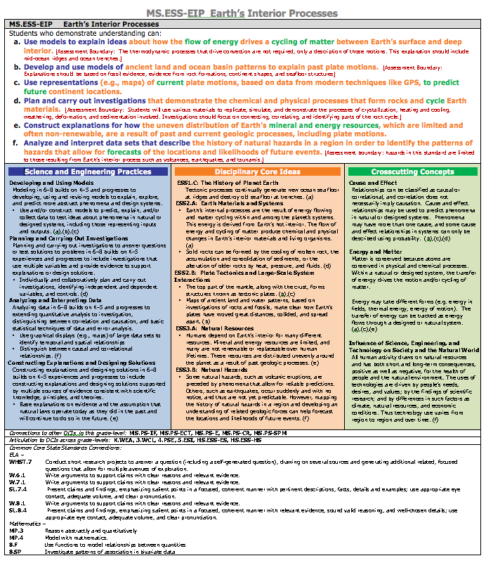
The NGSS are the result of a multi-step process
Teacher Development
Curricula
Instructional Materials
Instruction
Assessment

Slide 3


The NGSS are NOT a Curriculum
  The NRC Framework is the Skeleton
  The NGSS are the fleshed-out organs
  Curricula will be the clothes.

Slide 4

The NGSS are NOT a Curriculum
  The NRC Framework is the Skeleton
  The NGSS are the fleshed-out organs
  Curricula will be the clothes.
  You can dress up the NGSS
  any way that you want!

Slide 5

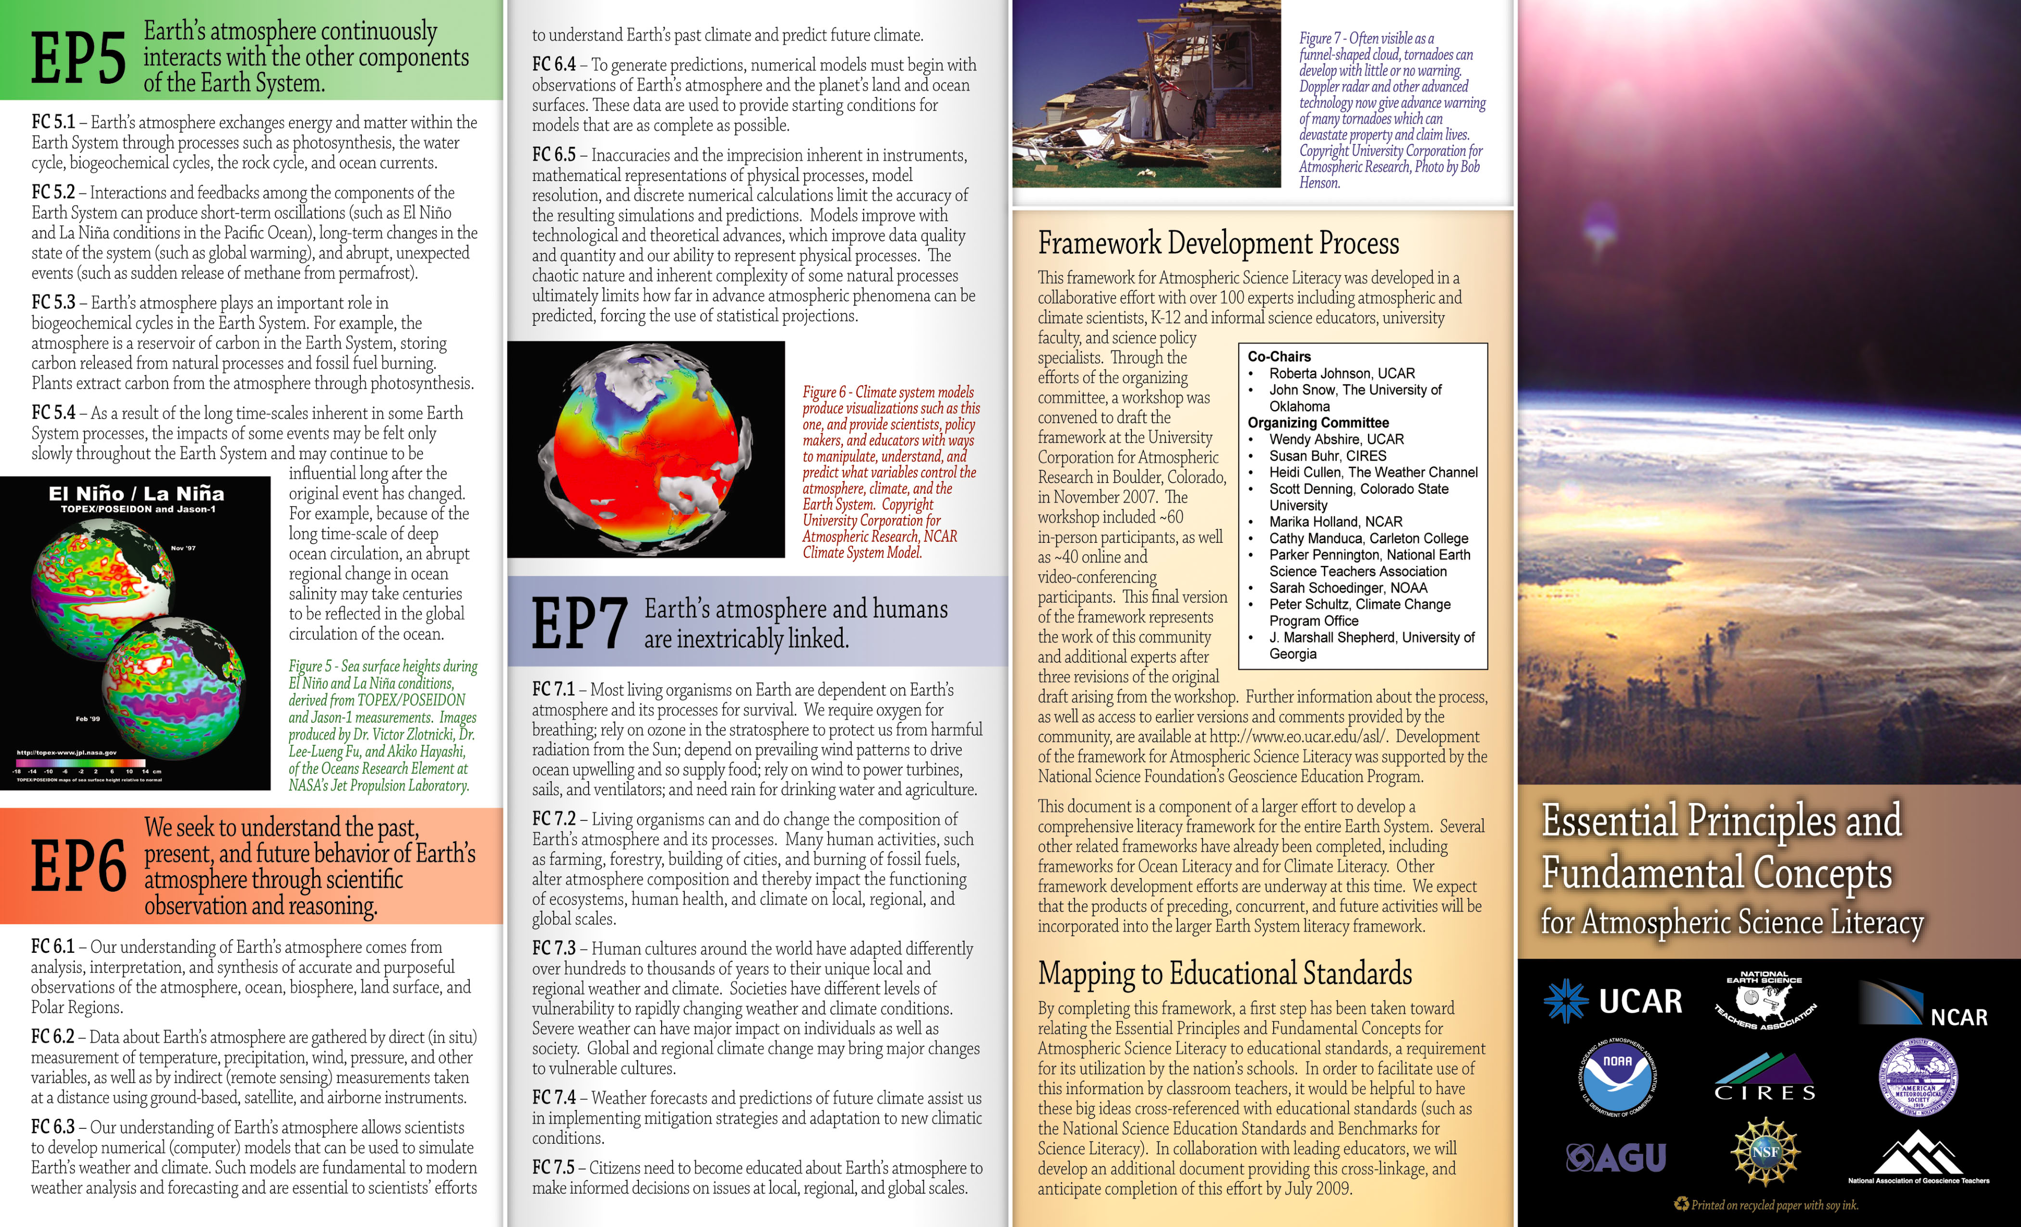

Geoscience content informed by recent community-based literacy efforts

Slide 6
The NRC Framework was a collaborative effort
NRC Conceptual Framework Committee:
1) Science Content:
Helen Quinn, Stanford, Chair (Physics)
Wyatt Anderson, University of Georgia (Biology)
Tanya Atwater, UCSB (Geophysics)
Rodolfo Dirzo, Stanford University (Bioecology)
Phillip Griffiths, Institute for Advanced Study (Mathematics)
Dudley Herschbach, Harvard University (Biology)
Linda Katehi, UC Davis (Engineering)
John Mather, NASA Goddard Space Flight Center (Astrophysics)
Rebecca Richards-Kortum, Rice University (Bioengineering)

Slide 7
The NRC Framework was a collaborative effort
NRC Conceptual Framework Committee
2) Education and Learning
Philip Bell, University of Washington
Thomas Corcoran, Columbia University, Teachers College
Tom Keller, NRC
Brett Moulding, Utah Partnership for Effective Sci Teaching &Learning
Jonathan Osborne, Stanford
James W. Pellegrino, University of Illinois
Stephen L. Pruitt, Georgia Department of Education
Brian Reiser, Northwestern University
Heidi Schweingruber, NRC
Walter Secada, University of Miami
Deborah C. Smith, Pennsylvania State University

Slide 8

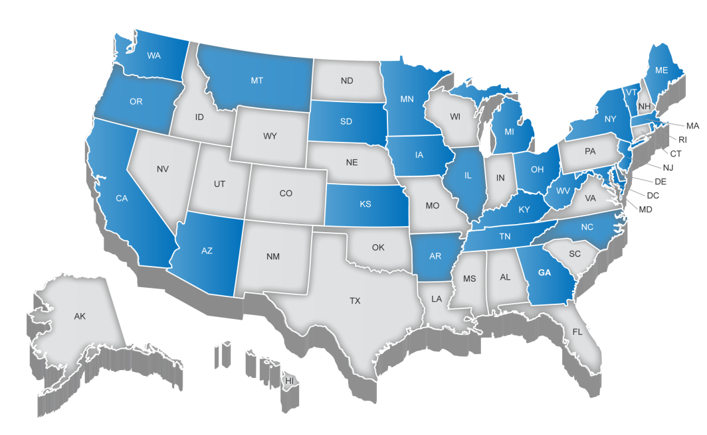
The NGSS were the result of a “states-led” process
26 Partnering States:

Slide 9

The NGSS were the result of a multi-step process
NGSS Writing Team Members:

Slide 10

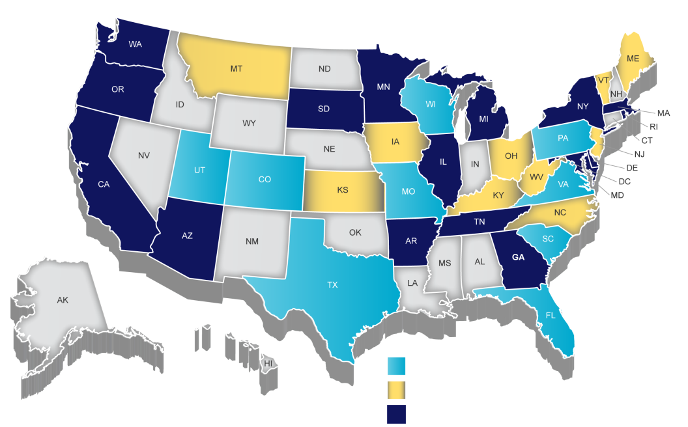
The NGSS were the result of a “states-led” process
Writing Team Only
Lead State Partner Only
Lead State Partner and Writing Team

Slide 11
…with lots of partners.
  Critical Stakeholders :
  Elementary, middle and high school science from both urban and rural communities
  Special education and English language acquisition
  Postsecondary education
  State standards and assessments
  Cognitive science, life science, physical science, earth/space science, and engineering/technology
  Mathematics and Literacy
  Business and industry
  Workforce development
  Education policy

Slide 12





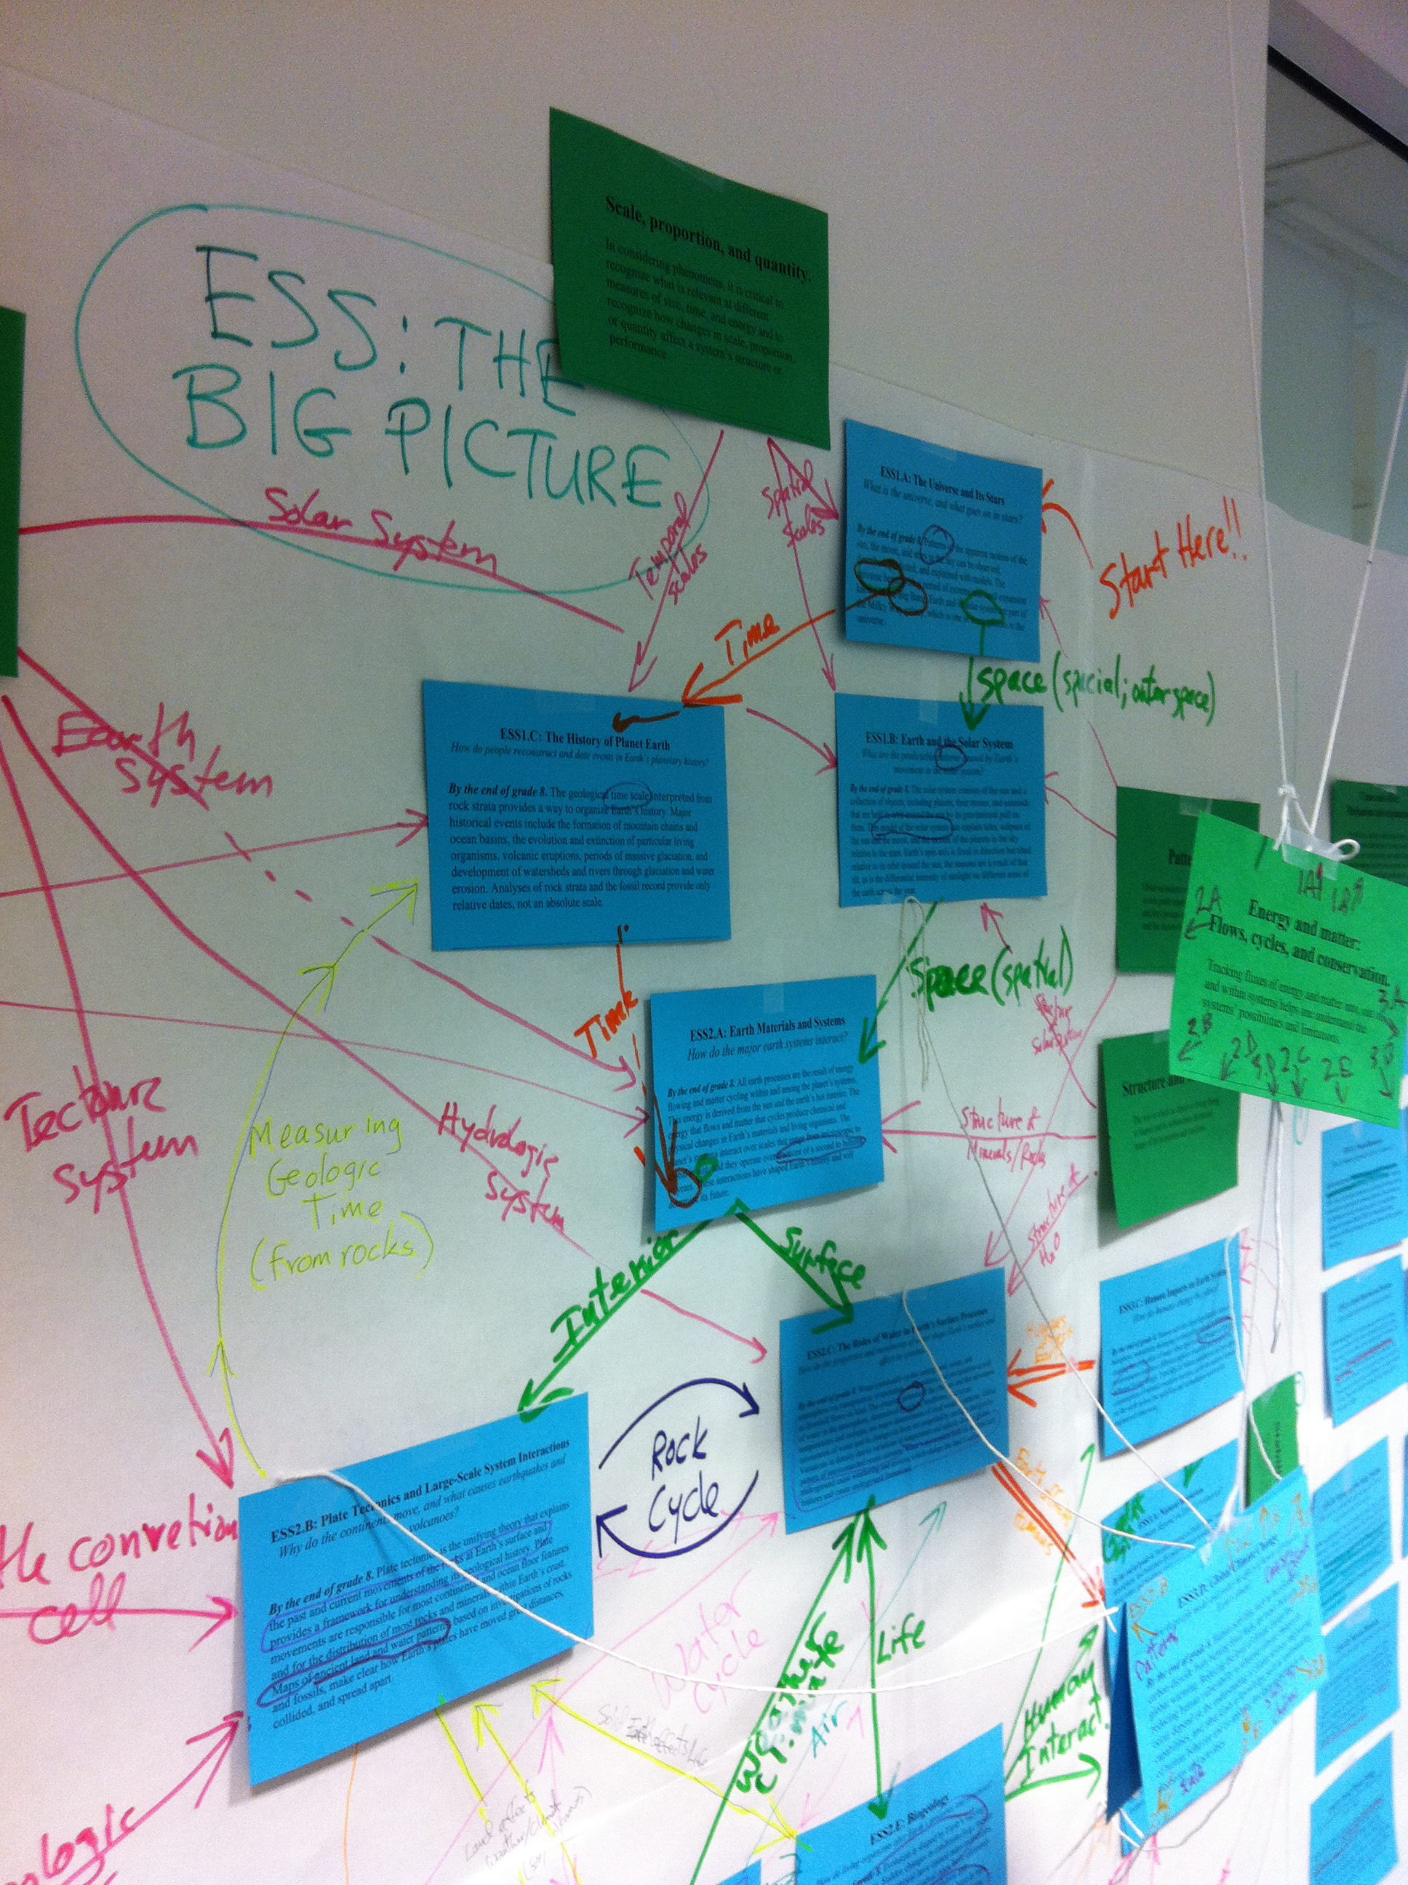
The NGSS were a collaborative effort
NGSS Earth and Space Science Writing Team Members:
Michael Wysession Mary Colson Richard Duschl
Kenneth Huff Paula Mussina Paul Speranza

Slide 13
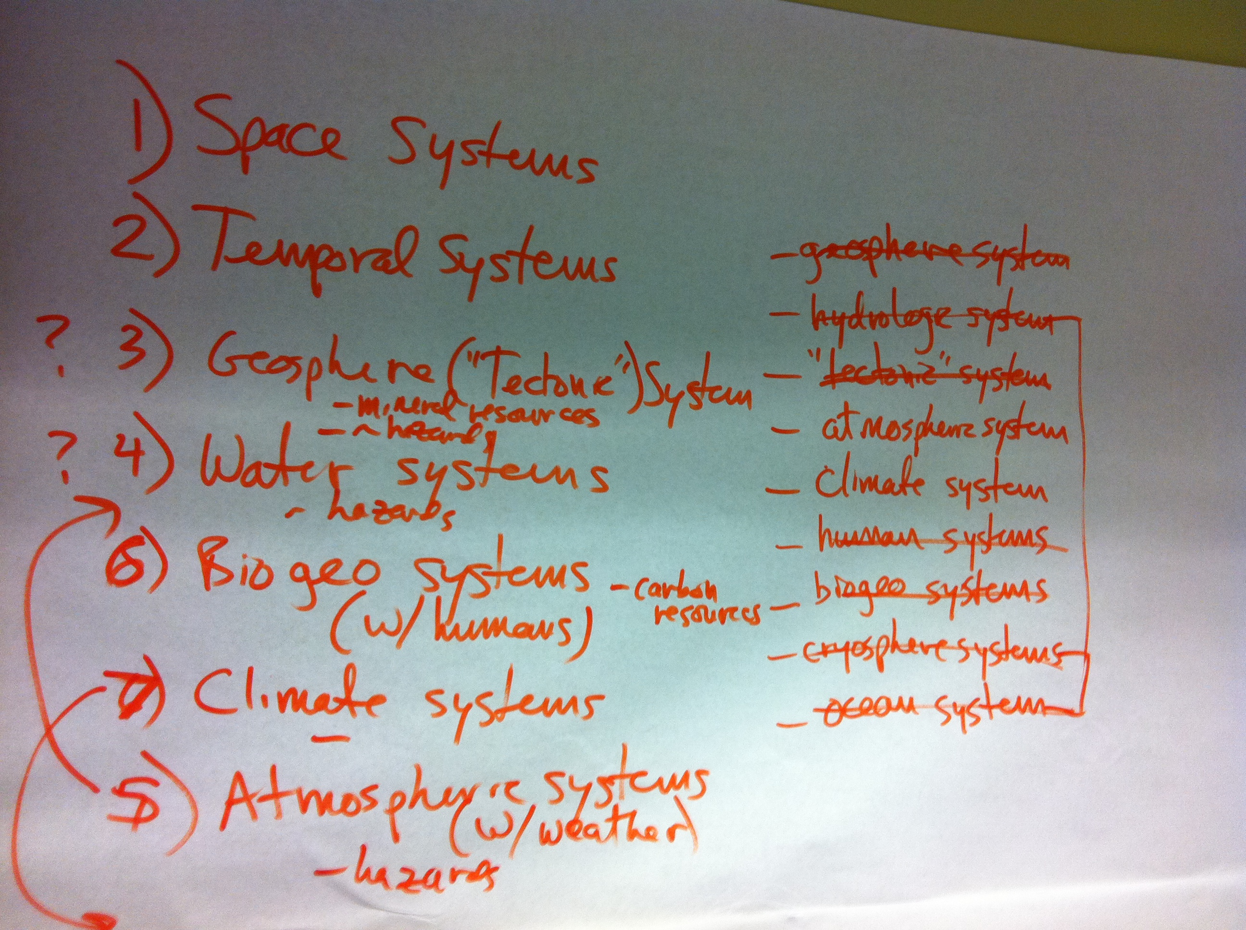
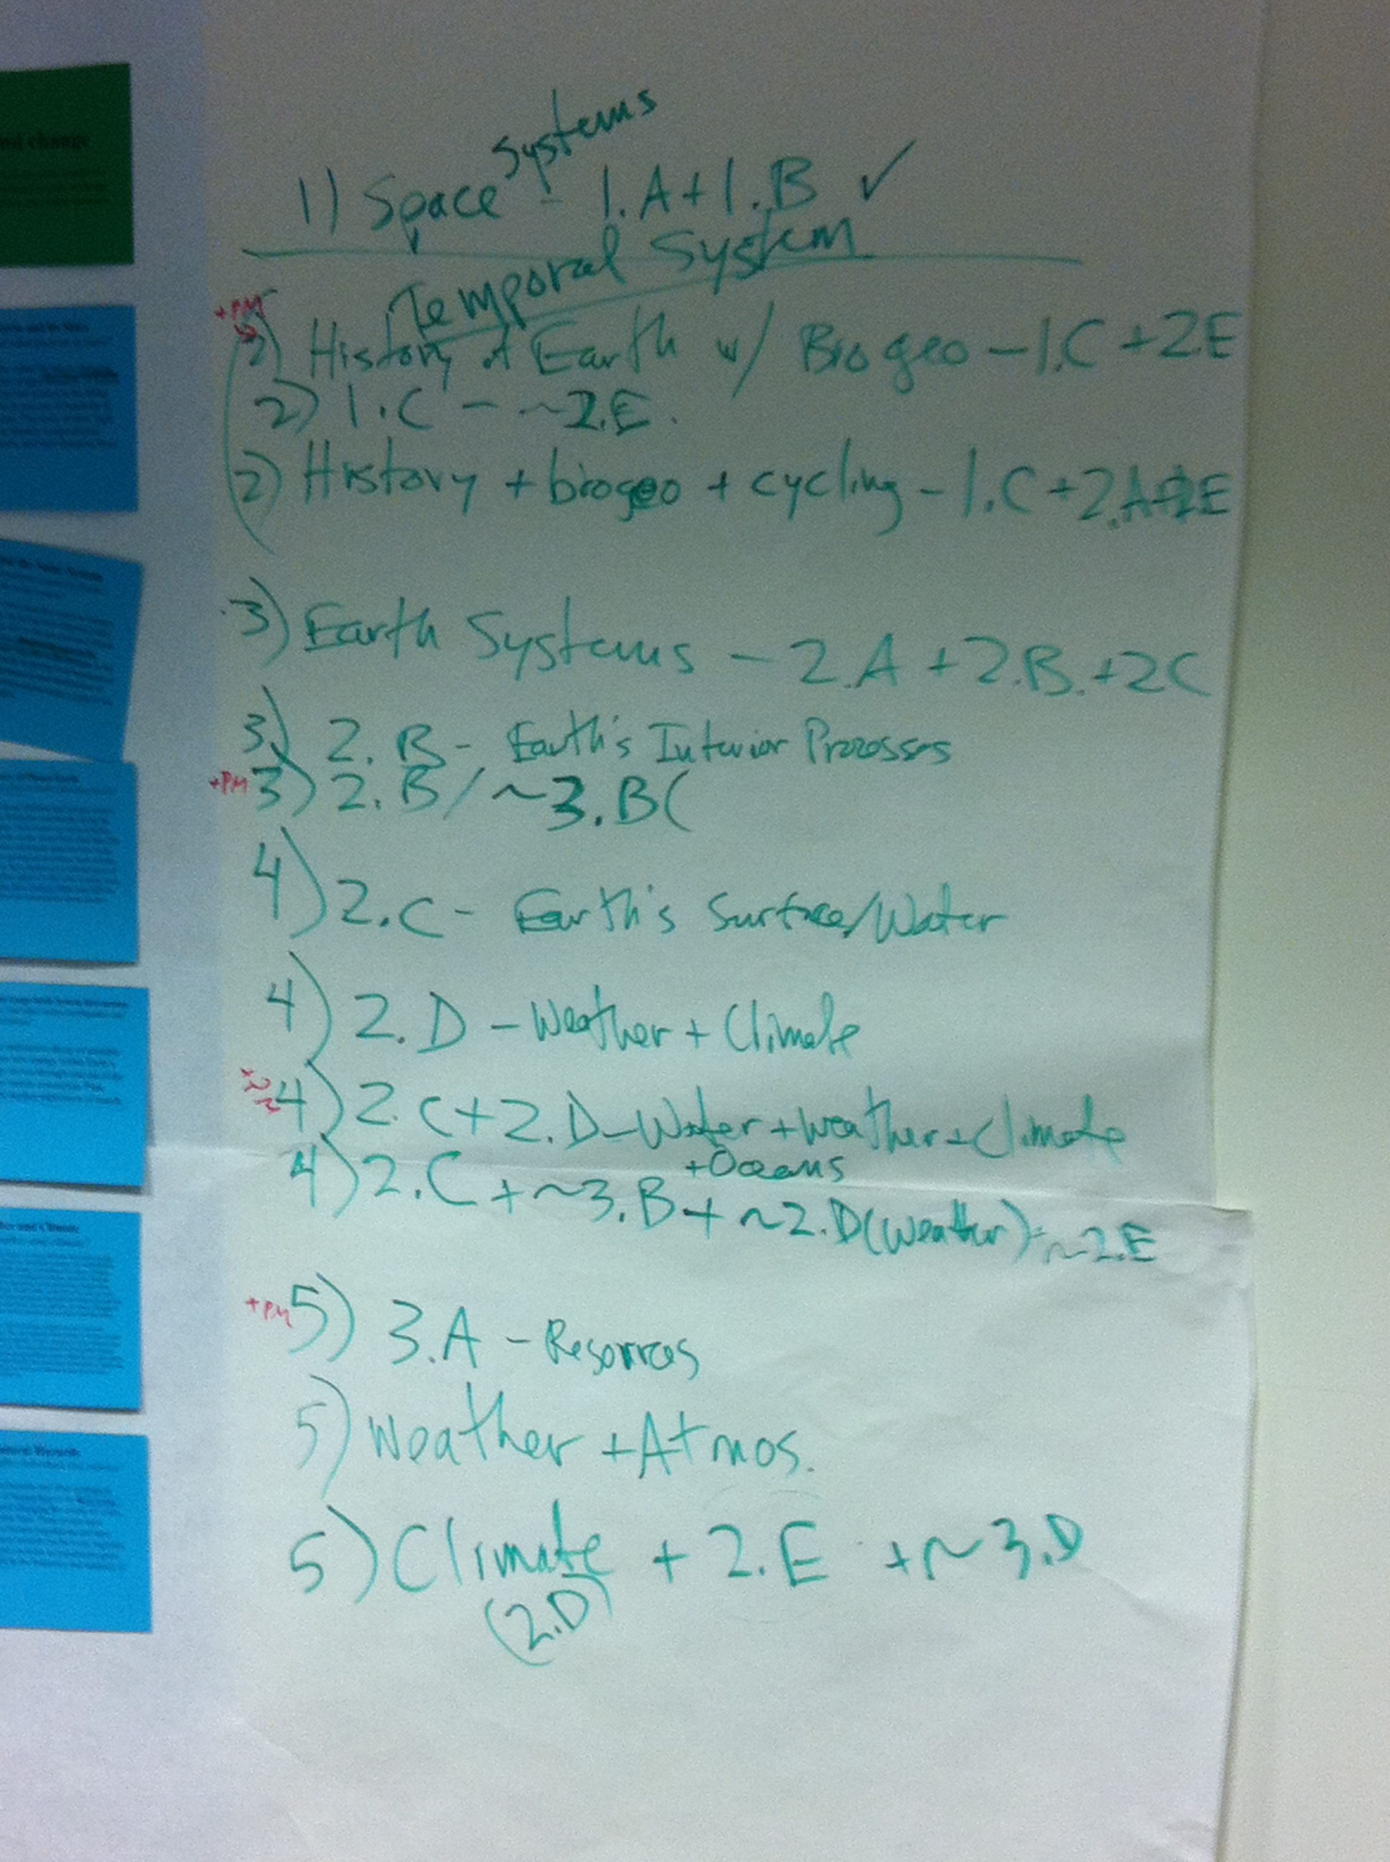

Slide 14
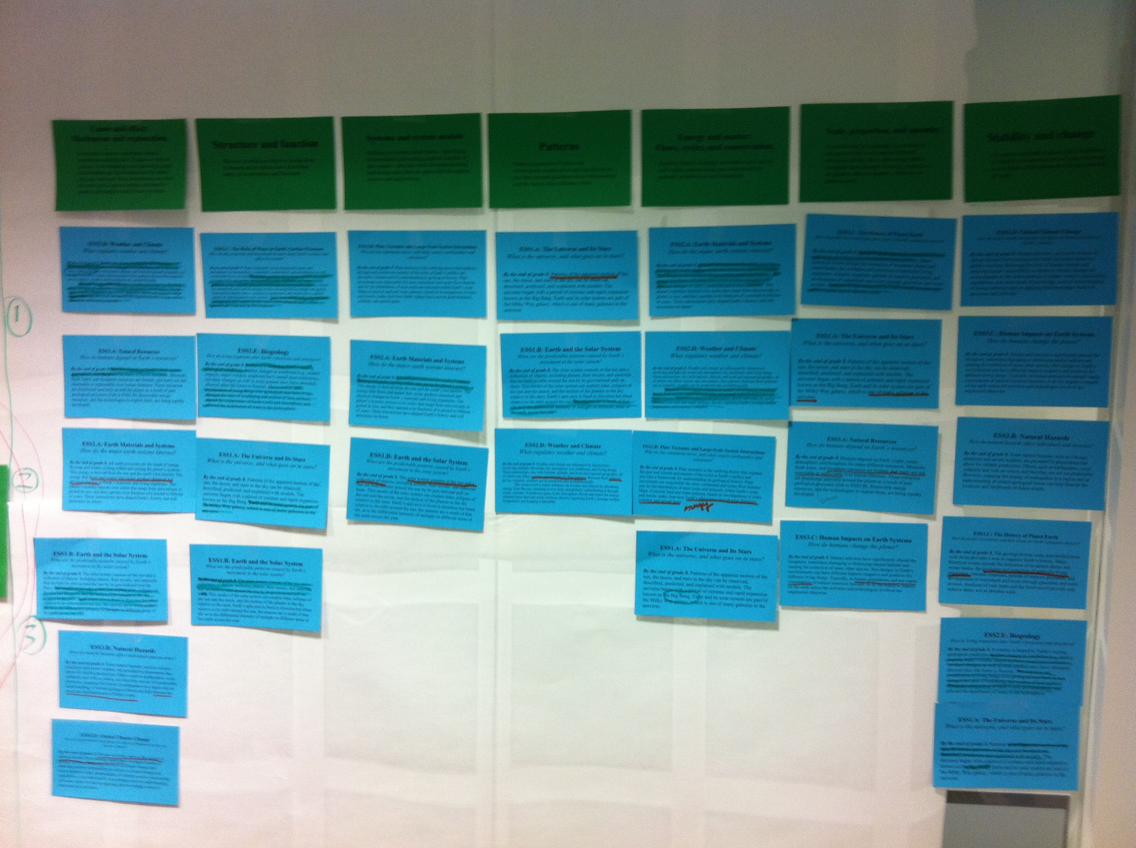
NGSS Process

Slide 15
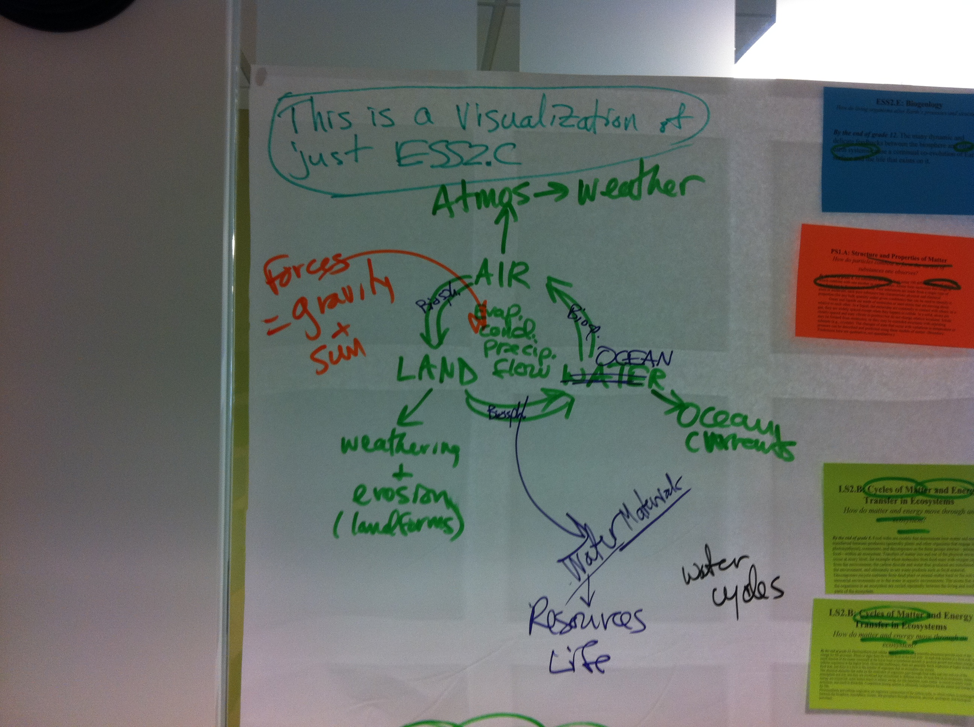
NGSS Process

Slide 16
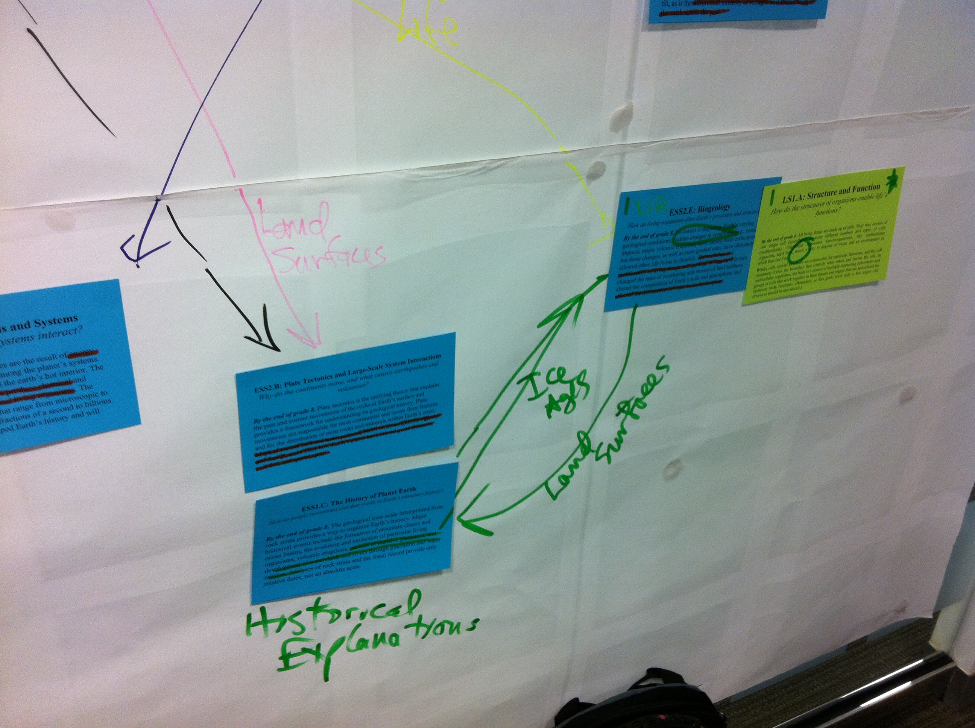
NGSS Process

Slide 17
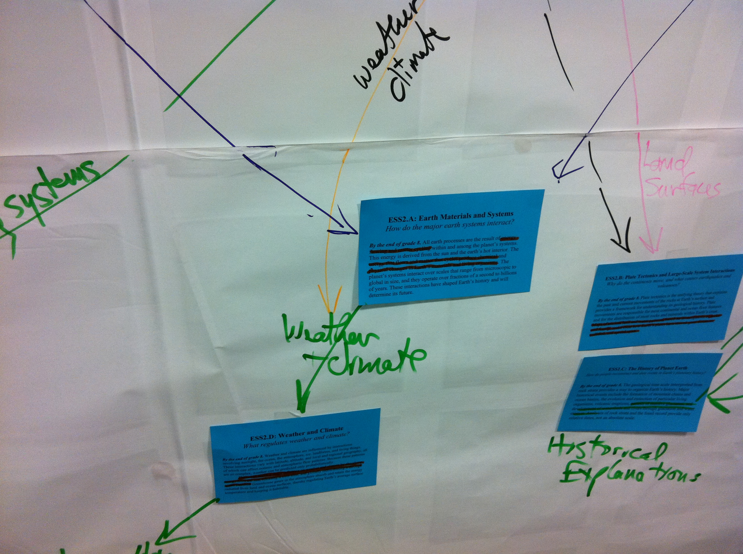
NGSS Process

Slide 18
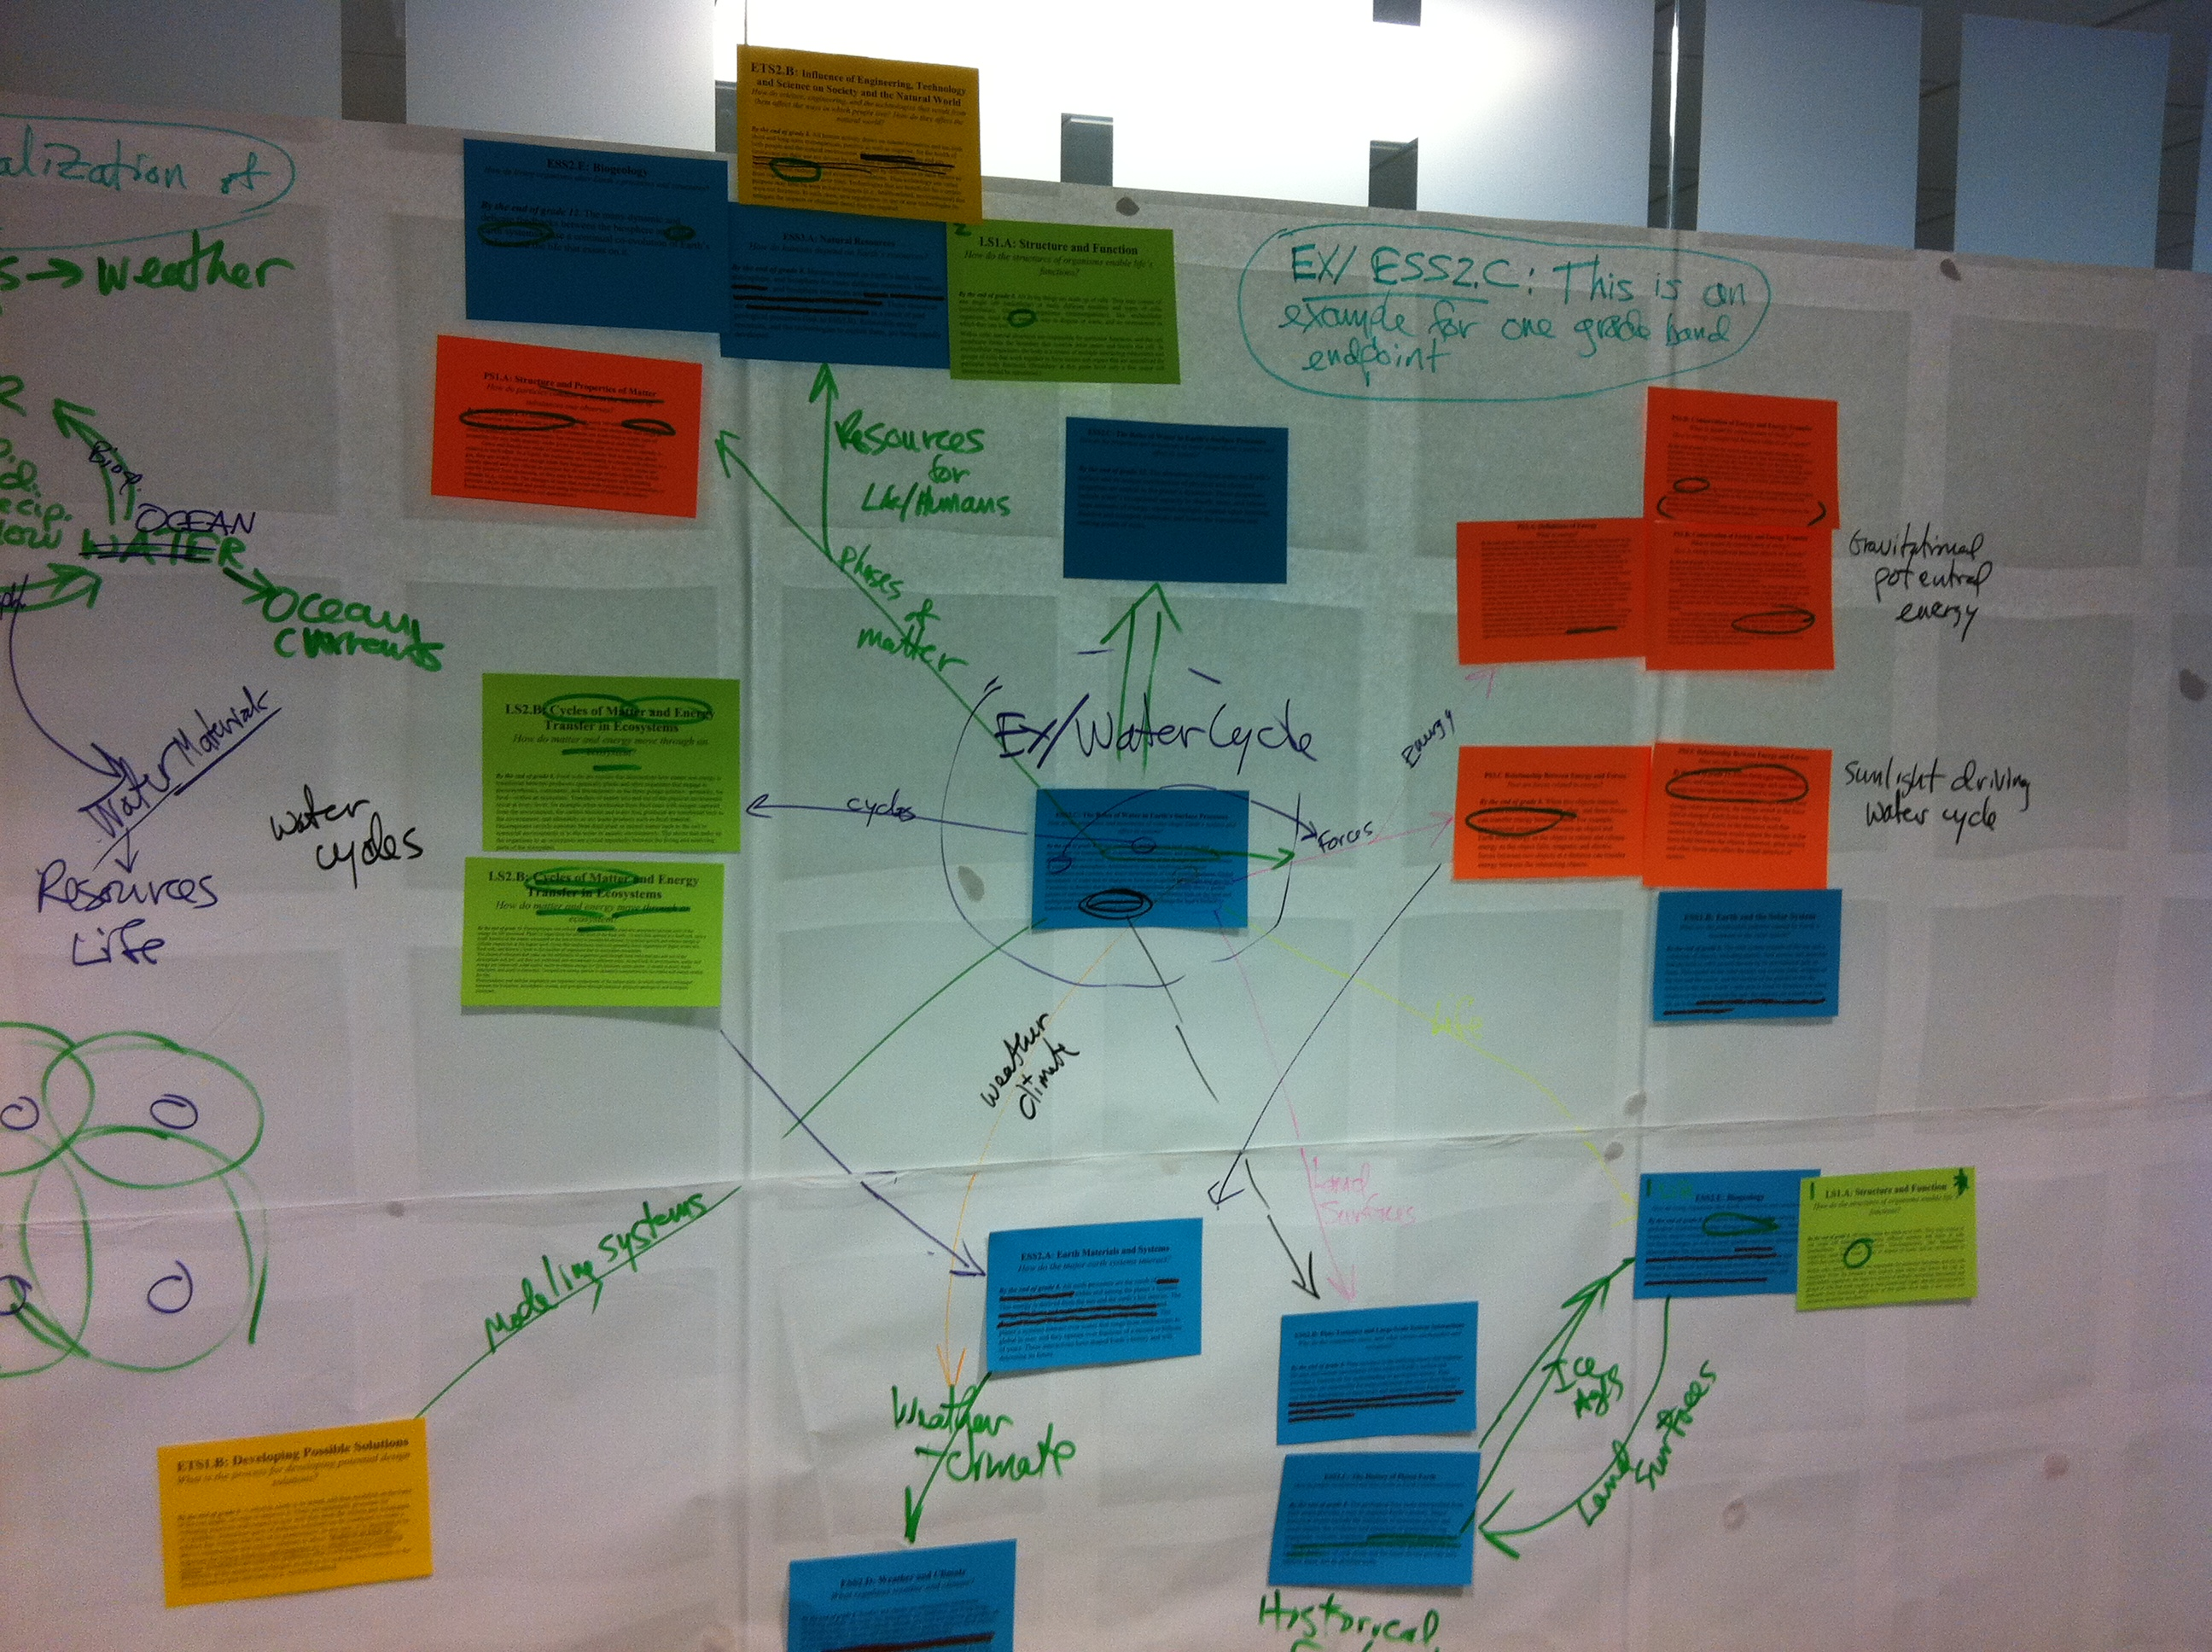
NGSS Process

Slide 19
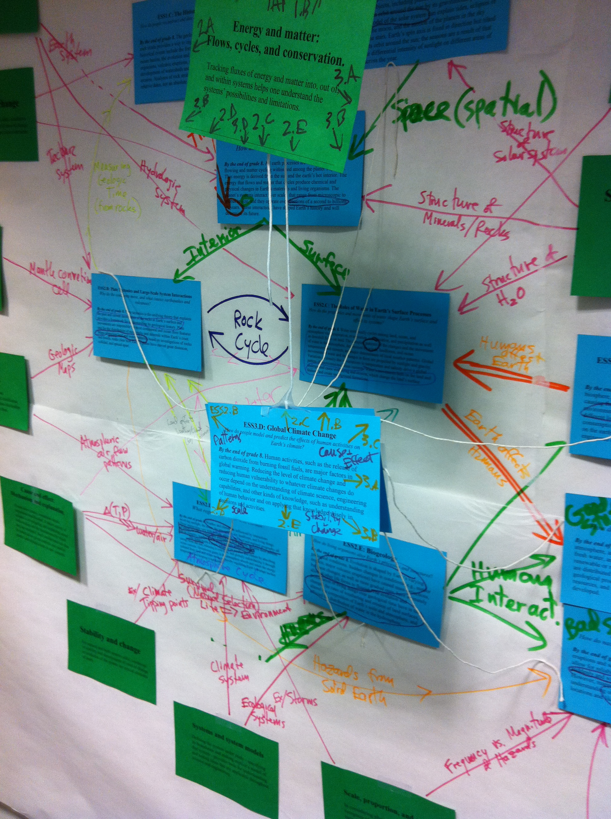

Slide 21
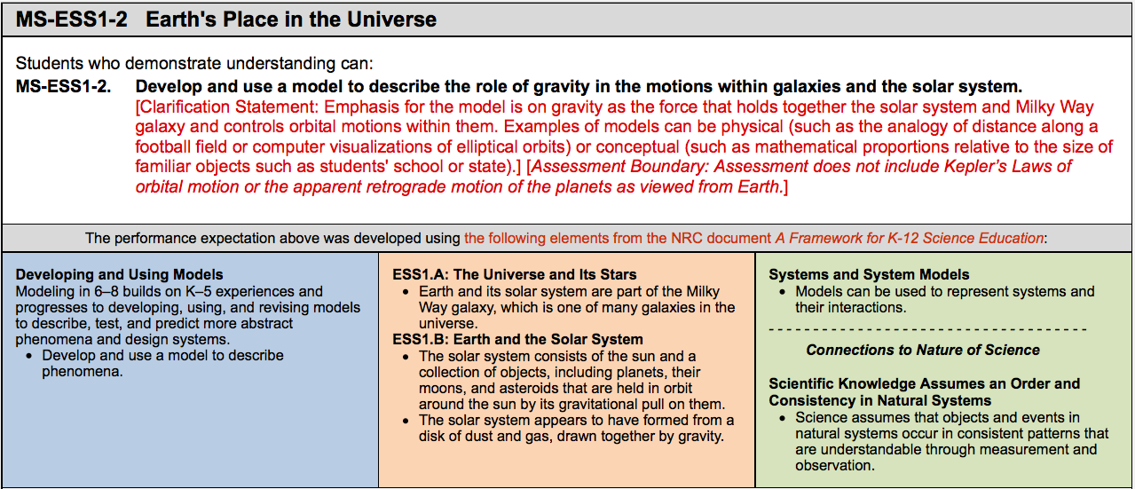
How to Read the Next Generation Science Standards
1) Performance.
a) Prior standards documents listed what students should “know” --- the NGSS list what students should “do.”

Slide 22
How to Read the Next Generation Science Standards
1) Performance.
b) These are presented as “Performance Expectations”

Slide 23
How to Read the Next Generation Science Standards
2) Foundations. Each performance expectation incorporates 3 dimensions from the NRC Framework—a science or engineering practice, a core disciplinary idea, and a crosscutting concept.

Slide 24
The 8 Practices of Science and Engineering
1. Asking questions (for science) and defining problems (for engineering)
2. Developing and using models
3. Planning and carrying out investigations
4. Analyzing and interpreting data
5. Using mathematics and computational thinking
6. Constructing explanations (for science) and designing solutions (for engineering)
7. Engaging in argument from evidence
8. Obtaining, evaluating, and communicating information

Slide 25
Crosscutting Concepts
1. Patterns
2. Cause and effect
3. Scale, proportion, and quantity
4. Systems and system models
5. Energy and matter
6. Structure and function
7. Stability and change

Slide 26
How do you Teach Earth and Space Science with the NGSS?
Start with the NRC “Framework for K-12 Science Education”

Slide 27
How do you Teach Earth and Space Science with the NGSS?
Start with the NRC “Framework for K-12 Science Education”
Work from the Performance Expectations.
  15 at Middle School; 19 at High School

Slide 34
How do you Teach Earth and Space Science with the NGSS?
Start with the NRC “Framework for K-12 Science Education”
Work from the Performance Expectations.
Determine how you will be organizing them
  Use the Appendix K Course Maps as a guide

Slide 35
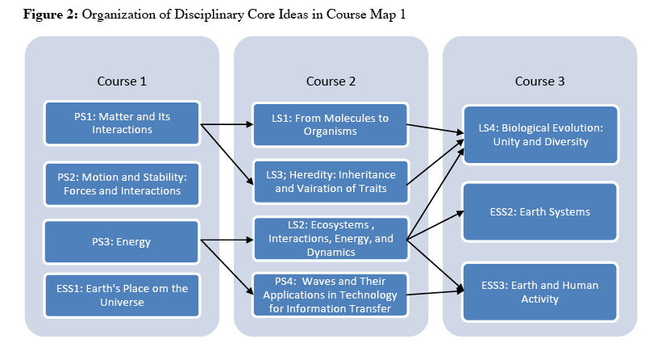
How would you construct a 6-12 curriculum around the NGSS, given the amount and complexity of the Earth and Space Science?
Course Map #1: Conceptual Understanding Model

Slide 36
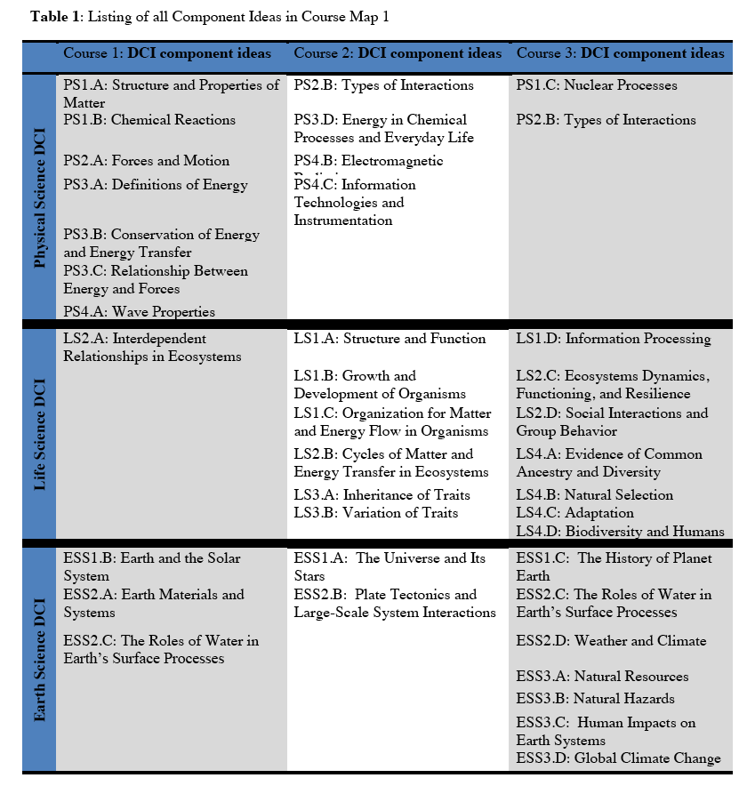
How would you construct a 6-12 curriculum around the NGSS, given the amount and complexity of the Earth and Space Science?
Course Map #1: Conceptual Understanding Model:
Courses constructed based on the most efficient and logical progression of concepts

Slide 37
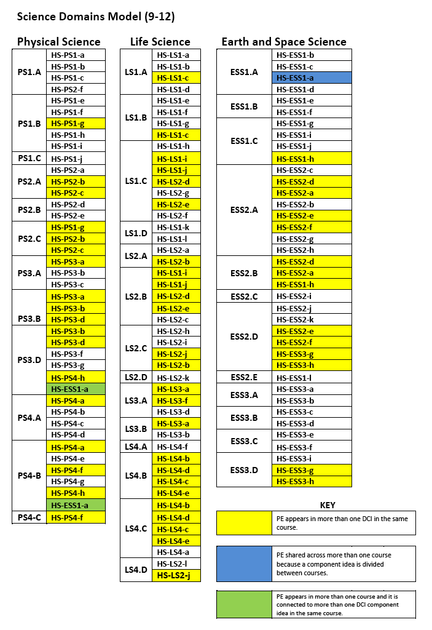
How would you construct a 6-12 curriculum around the NGSS, given the amount and complexity of the Earth and Space Science?
Course Map #2: Science Domains Model:
The 3 courses are Physical Science, Life Science, and Earth and Space Science
(for both middle and high school)

Slide 38
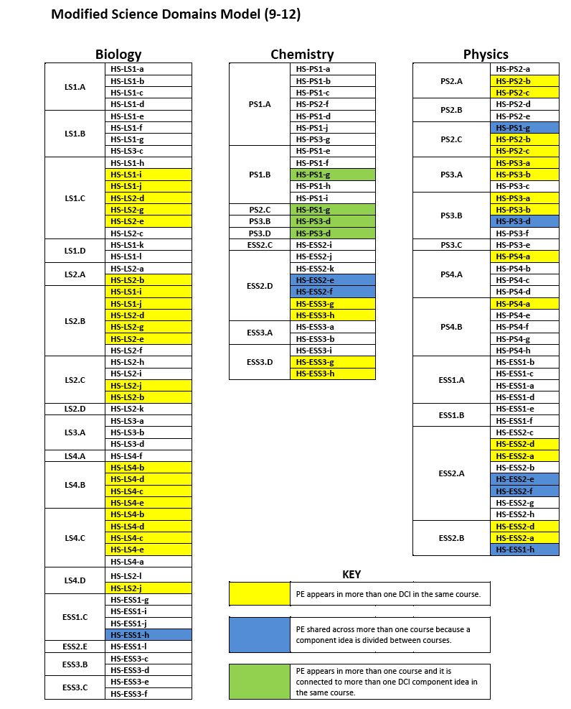
How would you construct a 6-12 curriculum around the NGSS, given the amount and complexity of the Earth and Space Science?
Course Map #3: Modified Science Domains Model (for high school):
Incorporate the Earth and Space Science into existing biology, chemistry, and physics courses.
→ Least efficient in terms of instruction time; concepts taught out of order (without adequate prerequisites)

Slide 39
How do you Teach Earth and Space Science with the NGSS?
Start with the NRC “Framework for K-12 Science Education”
Work from the Performance Expectations.
Determine how you will be organizing them
Determine what you will teach to support the PE’s
  Use the Clarification Statements and Assessment Boundaries as a guide

Slide 40
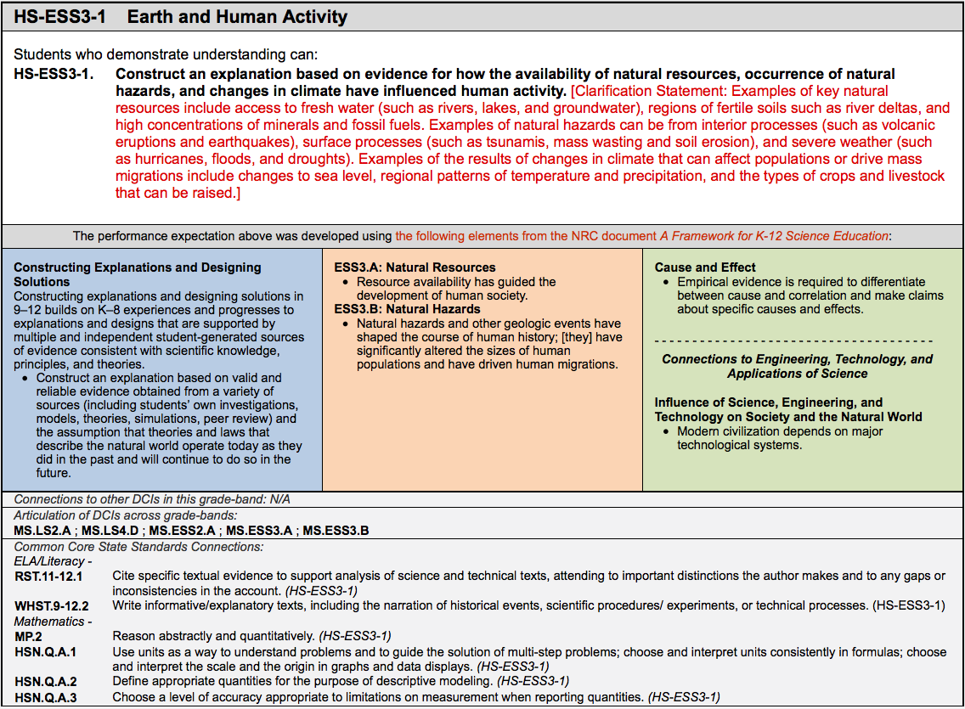
How do you Teach Earth and Space Science with the NGSS?

Slide 41
How do you Teach Earth and Space Science with the NGSS?
Start with the NRC “Framework for K-12 Science Education”
Work from the Performance Expectations.
Determine how you will be organizing them
Determine what you will teach to support the PE’s
  Use the Clarification Statements and Assessment Boundaries as a guide
  Be sure to teach what you love

Slide 42
How do you Teach Earth and Space Science with the NGSS?
Start with the NRC “Framework for K-12 Science Education”
Work from the Performance Expectations.
Determine how you will be organizing them
Determine what you will teach to support the PE’s
Obtain curricular materials (data sets, lab materials, textbooks, media materials, etc.) → see NSTA

Slide 43
How do you Teach Earth and Space Science with the NGSS?
Start with the NRC “Framework for K-12 Science Education”
Work from the Performance Expectations.
Determine how you will be organizing them
Determine what you will teach to support the PE’s
Obtain curricular materials (data sets, lab materials, textbooks, media materials, etc.) → see NSTA
Look for connections to Nature of Science and Engineering, Technology, and Aspects of Science

Slide 44
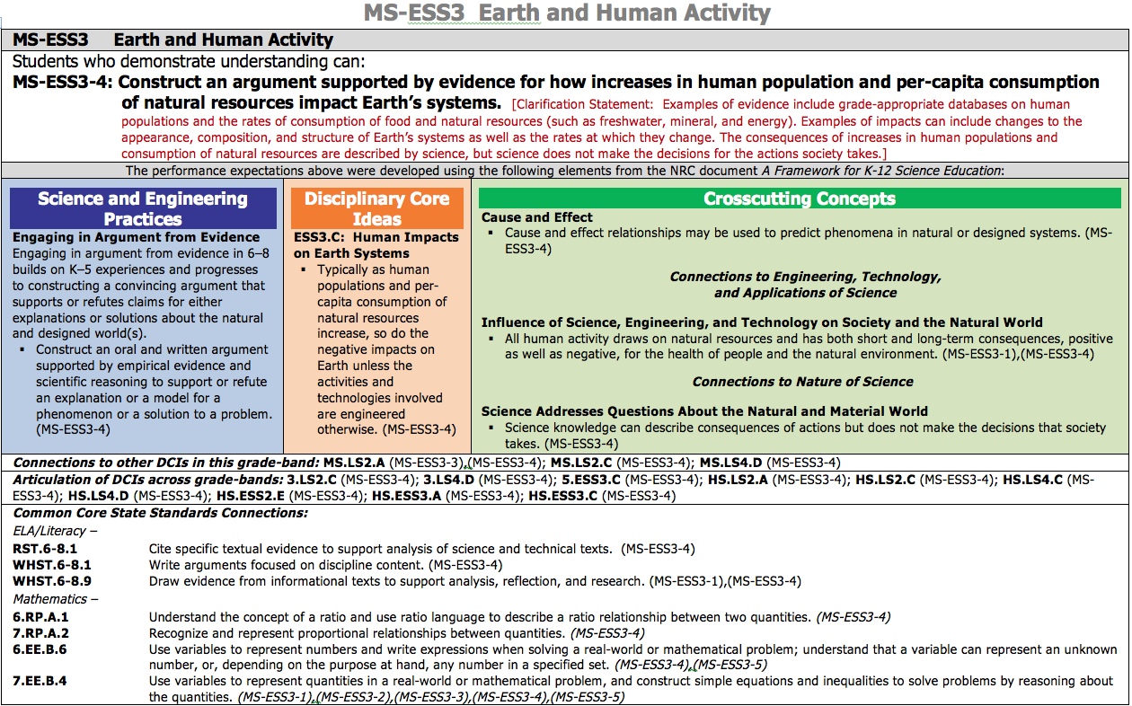

Slide 45
How do you Teach Earth and Space Science with the NGSS?
Start with the NRC “Framework for K-12 Science Education”
Work from the Performance Expectations.
Determine how you will be organizing them
Determine what you will teach to support the PE’s
Obtain curricular materials (data sets, lab materials, textbooks, media materials, etc.) → see NSTA
Look for connections to Nature of Science and Engineering, Technology, and Aspects of Science
Look for connections to Common Core for Math and ELA

Slide 47
How do you Teach Earth and Space Science with the NGSS?
Start with the NRC “Framework for K-12 Science Education”
Work from the Performance Expectations.
Determine how you will be organizing them
Determine what you will teach to support the PE’s
Obtain curricular materials (data sets, lab materials, textbooks, media materials, etc.) → see NSTA
Look for connections to Nature of Science and Engineering, Technology, and Aspects of Science
Look for connections to Common Core for Math and ELA
Continue to look for professional development opportunities

Slide 48
How do you Teach Earth and Space Science with the NGSS?
Lastly, remember the directions for using the Hitchhikers Guide to the Galaxy……..

Slide 49

How do you Teach Earth and Space Science with the NGSS?
Lastly, remember the directions for using the Hitchhikers Guide to the Galaxy……..

