Slide 1

The Next Generation Science Standards: What They Mean for Earth and Space Science
Professor Michael Wysession
Department of Earth and Planetary Sciences
Washington University, St. Louis, MO
michael@seismo.wustl.edu

Slide 2
In what year were the first science standards used for secondary education in the US?
1852
1893
1965
1995
2013

Slide 3
In what year were the first science standards used for secondary education in the US?
1852 ←
1893
1965
1995
2013
Notes:
Horace Mann Adopts Prussian standards in Massachusetts

Slide 4
Following what year did high school science primarily consist of biology, chemistry, and physics, omitting geology and astronomy?
1852
1893
1965
1995
2013

Slide 5
Following what year did high school science primarily consist of biology, chemistry, and physics, omitting geology and astronomy?
1852
1893 ←
1965
1995
2013

Slide 6
In what year were the first US national science K-12 standards adopted?
1893
1965
1995
2013
Never
Notes:
Johnson’ Elementary and Secondary Education Act “War on Poverty”

Slide 7
In what year were the first US national science K-12 standards adopted?
1893
1965
1995
2013
Never ←
Notes:
Johnson’ Elementary and Secondary Education Act “War on Poverty”

Slide 8
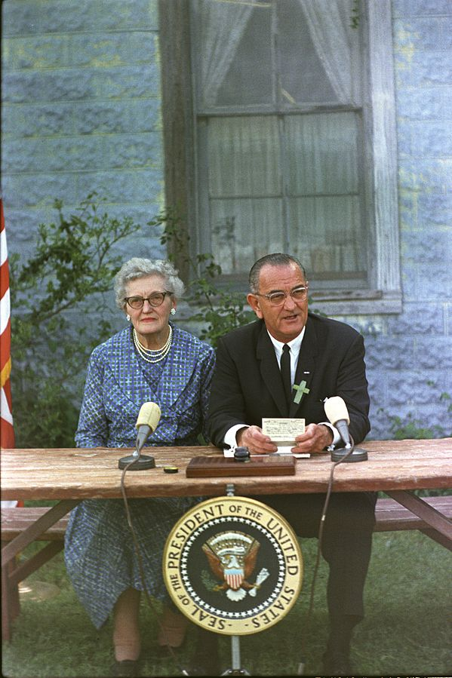
Math/Science Education Legislation
1965, Elementary and Secondary Education Act, signed by President Lyndon Johnson as part of his “War on Poverty.”
→ Expressly forbids a national curriculum.
Notes:
Democrats don’t like some implications of standards. Republicans don’t like “National” (state’s rights)

Slide 9
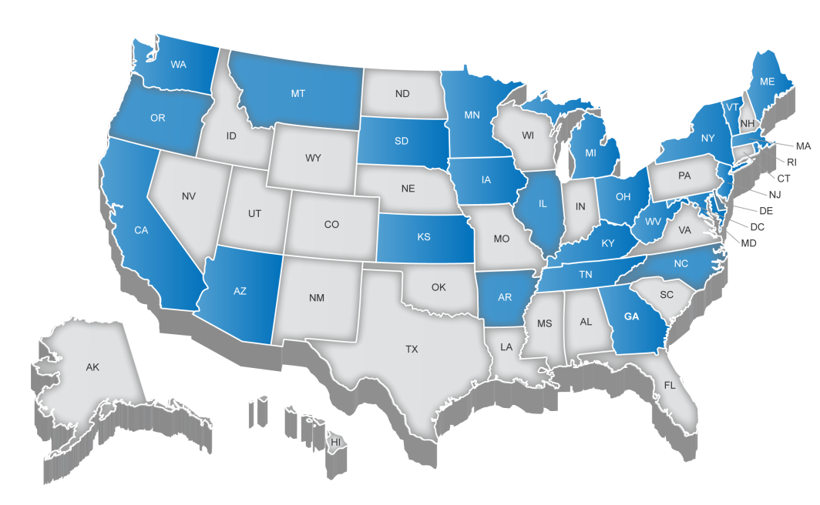
The NGSS were a “states-led” process
“States” that have already adopted the NGSS:
Arkansas, California, Delaware, Illinois, Kansas, Kentucky, Maryland, Nevada, Oregon, Rhode Island, Vermont, Washington State, Washington DC, West Virginia
(But also Oklahoma, Massachusetts, and many schools and districts in other states and countries….)

Slide 10


The NGSS are the result of a multistep process
Teacher Development
Curricula
Instructional Materials
Instruction
Assessment

Slide 11
NRC Framework: Three Dimensions of
(1) Disciplinary Core Ideas (DCIs), (2) Science and Engineering Practices (SEPs), and Crosscutting Concepts (CCCs)
Completed 2011
Published 2012

Slide 12


[NRC, 2007] [NRC, 2007]

Slide 13
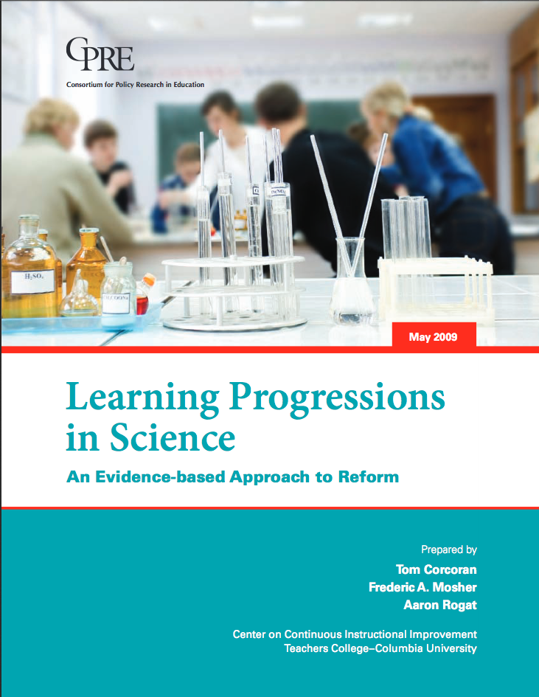
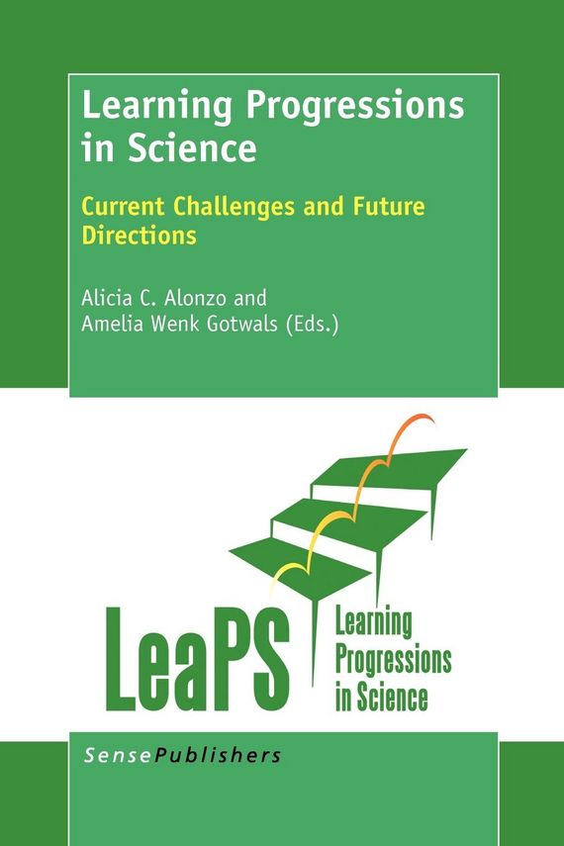
[Center on Continuous Instructional Improvement, 2009]
[NRC, 2012]

Slide 14
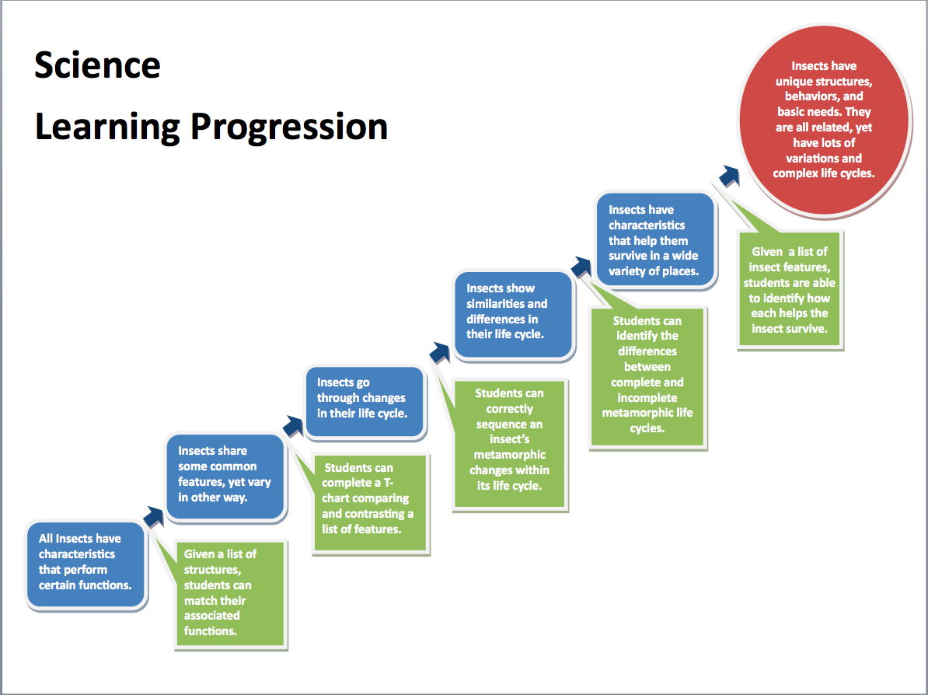

Slide 15
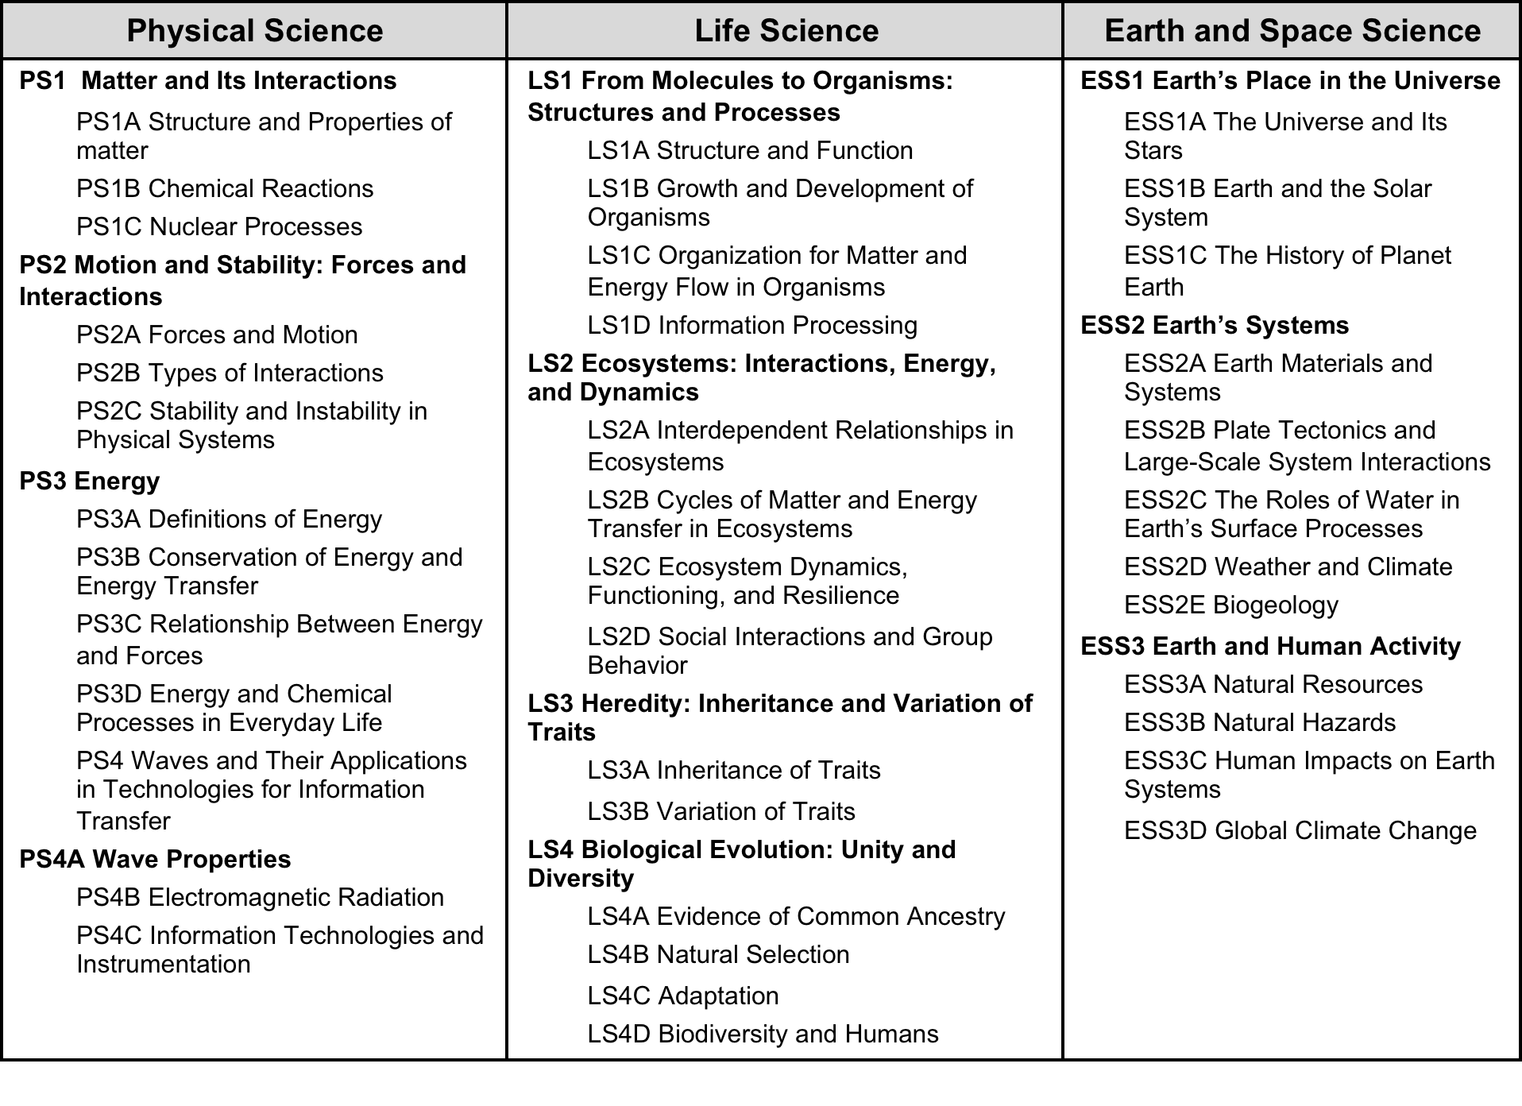
NRC Framework: The Content of Science (“Disciplinary Core Ideas”) is Organized into Three Areas

Slide 16

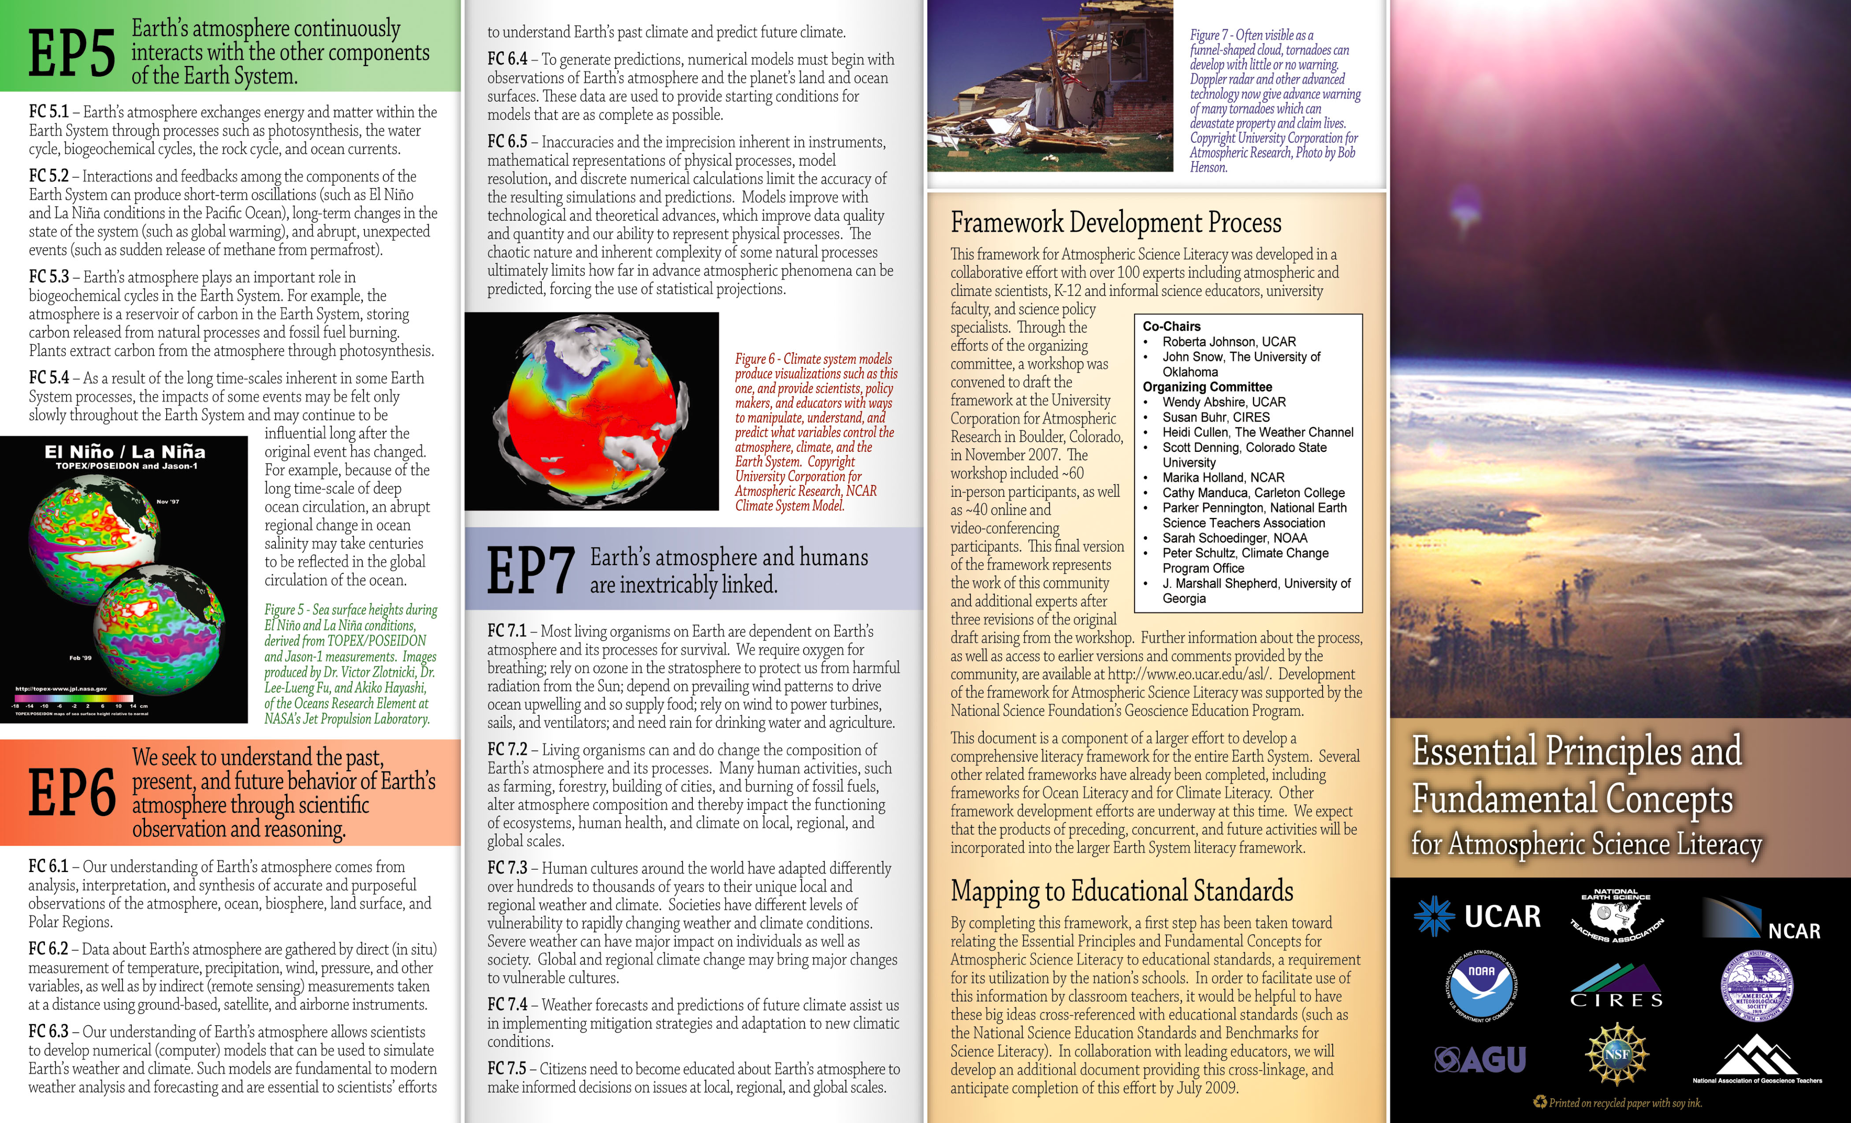

Geoscience content informed by recent
community-based literacy efforts

Slide 17
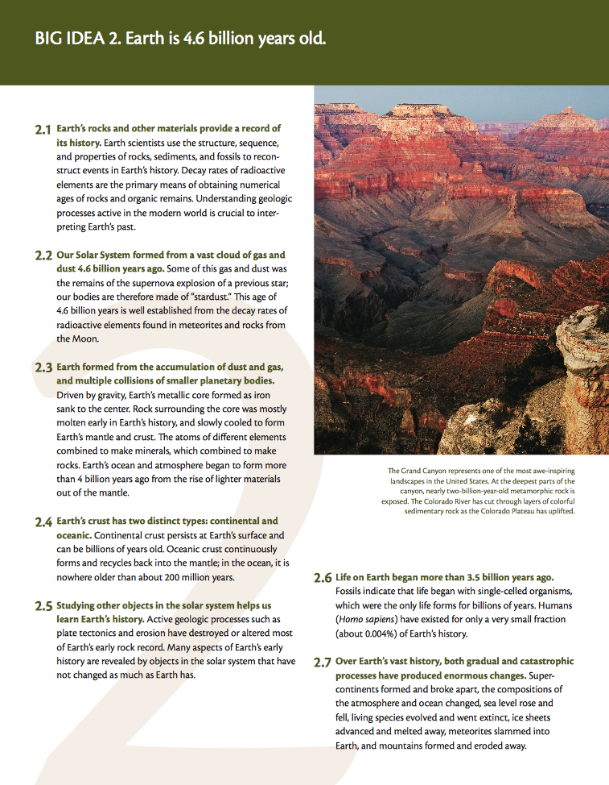
www.earthscienceliteracy.org
Free copies of the brochure available

Slide 18
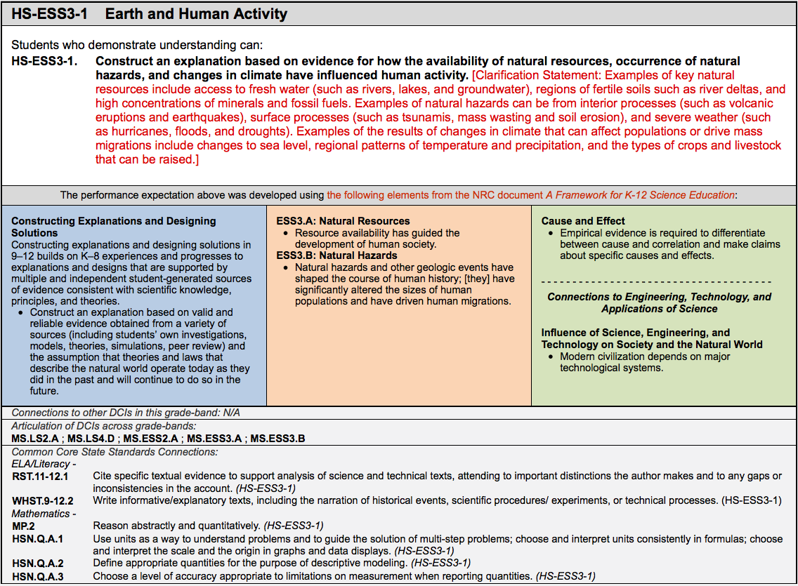


How do you Teach Earth and Space Science with the NGSS?
PRACTICES CONTENT X-CUTTING CONCEPTS

Slide 19
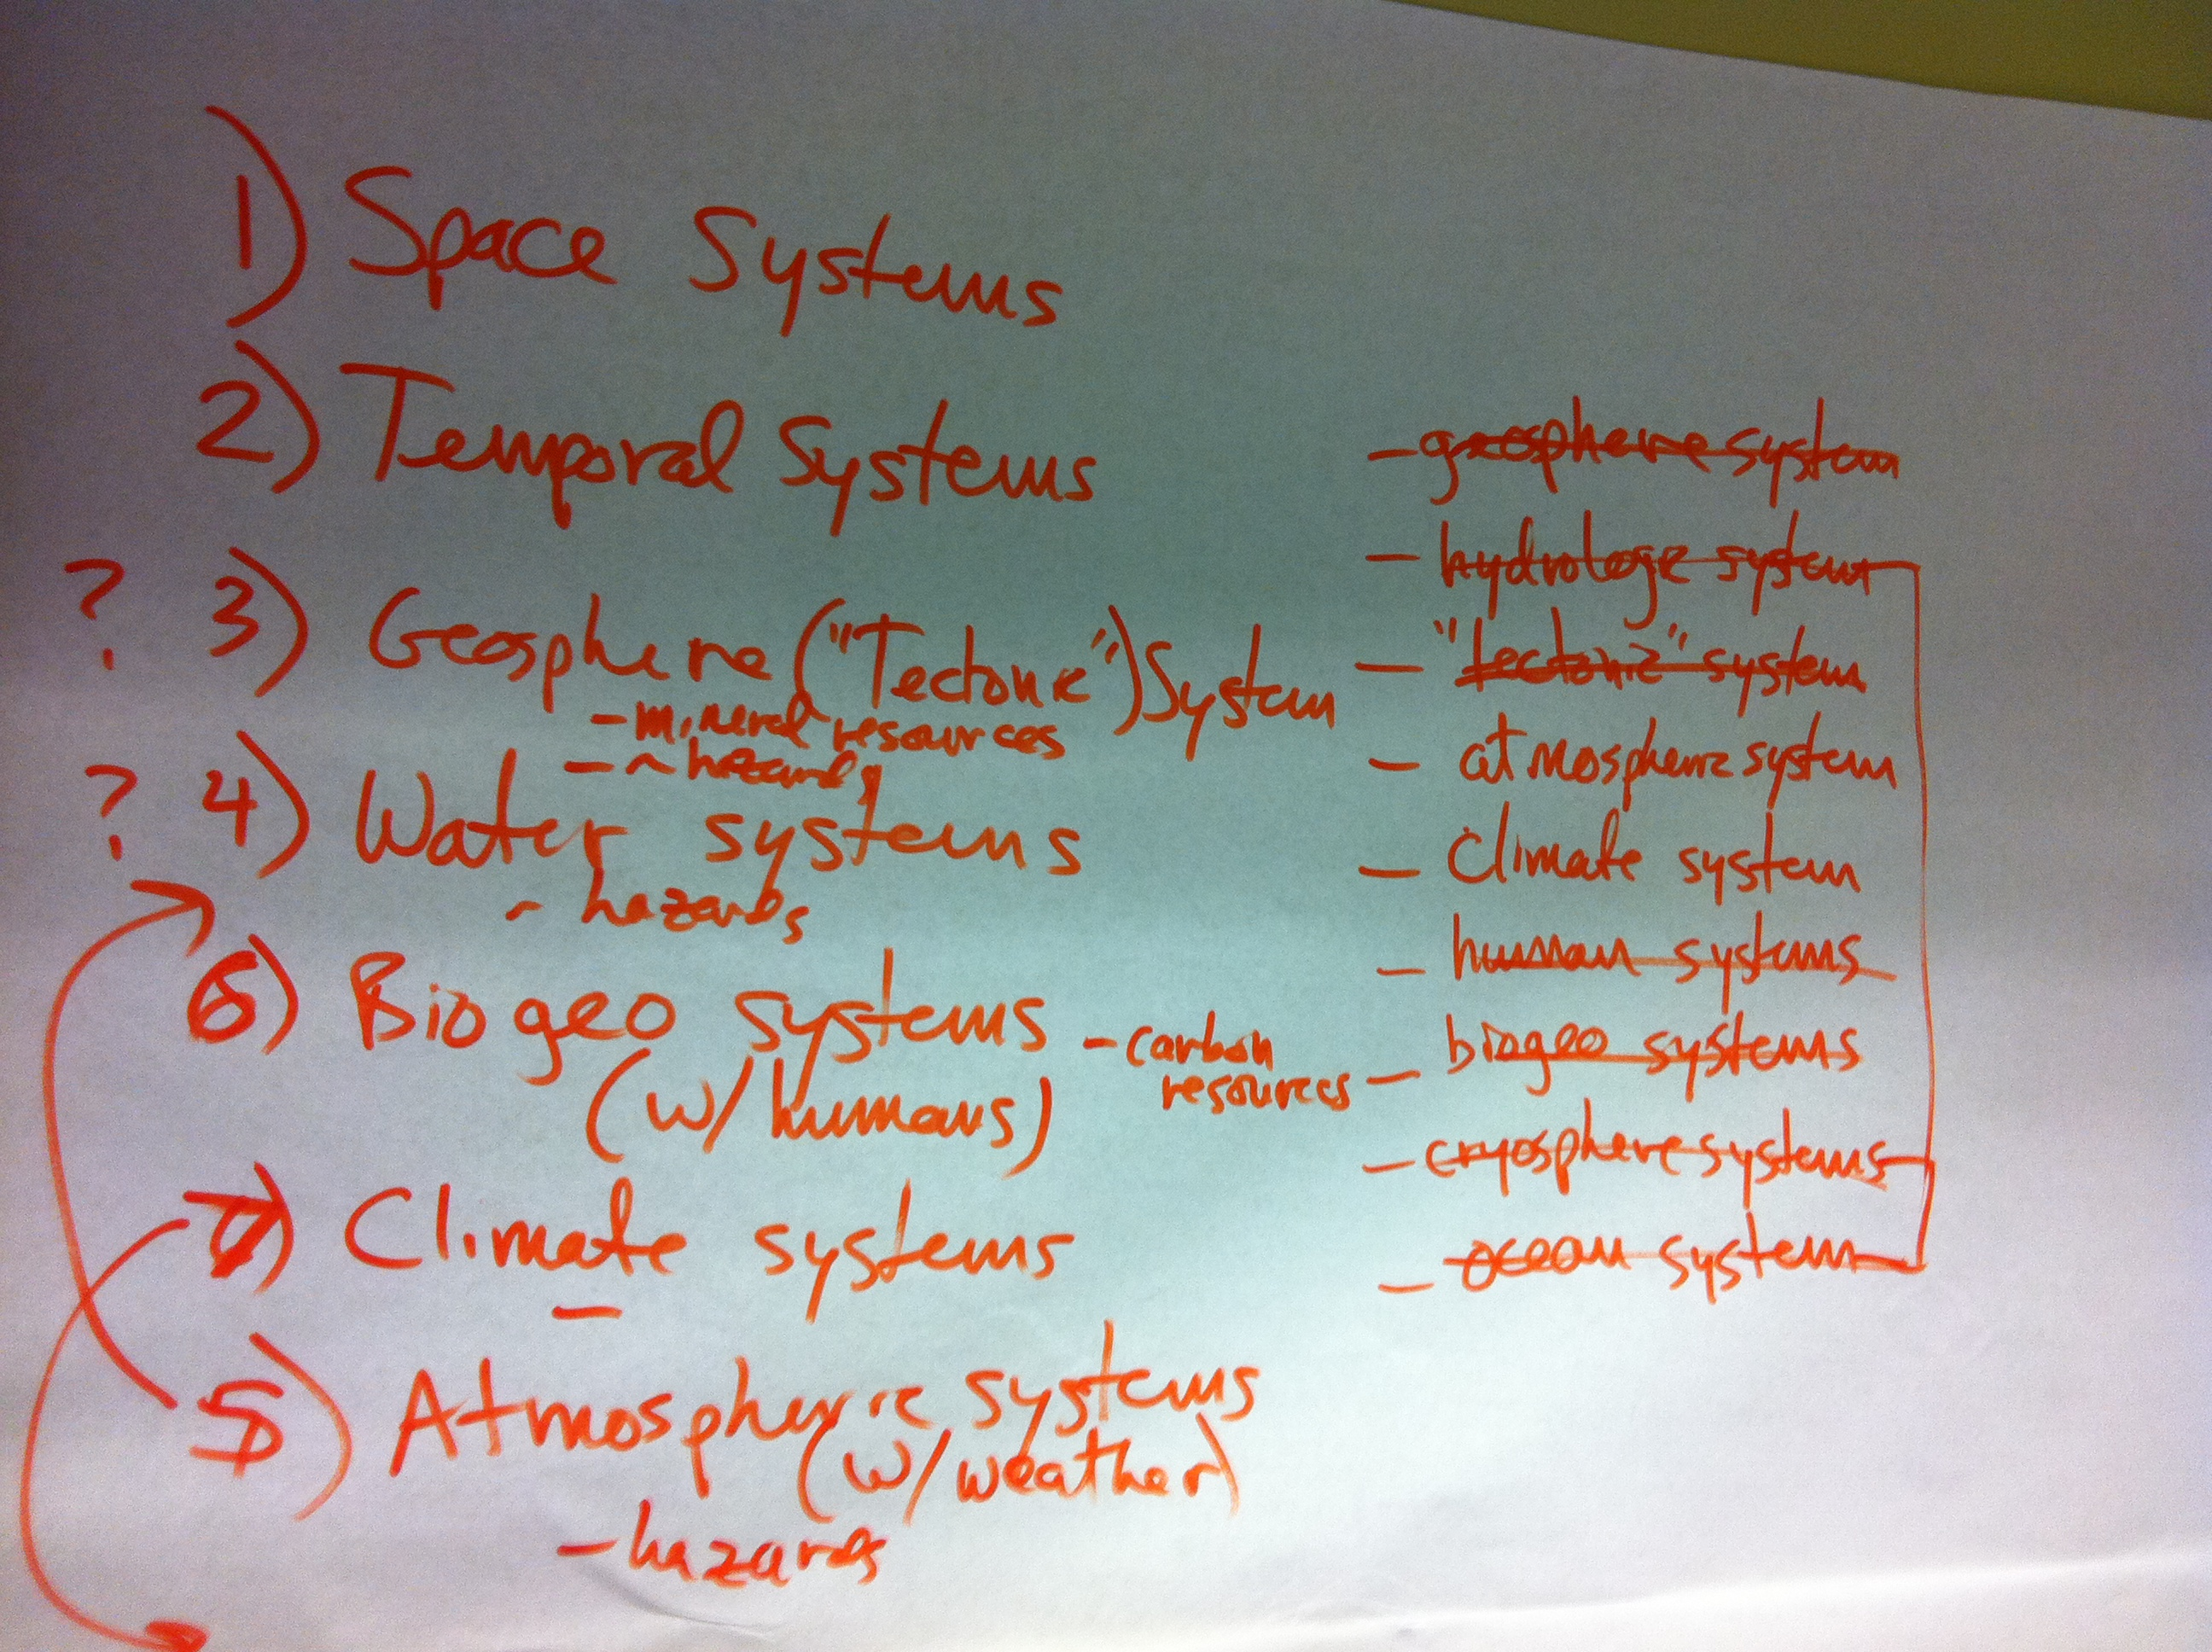
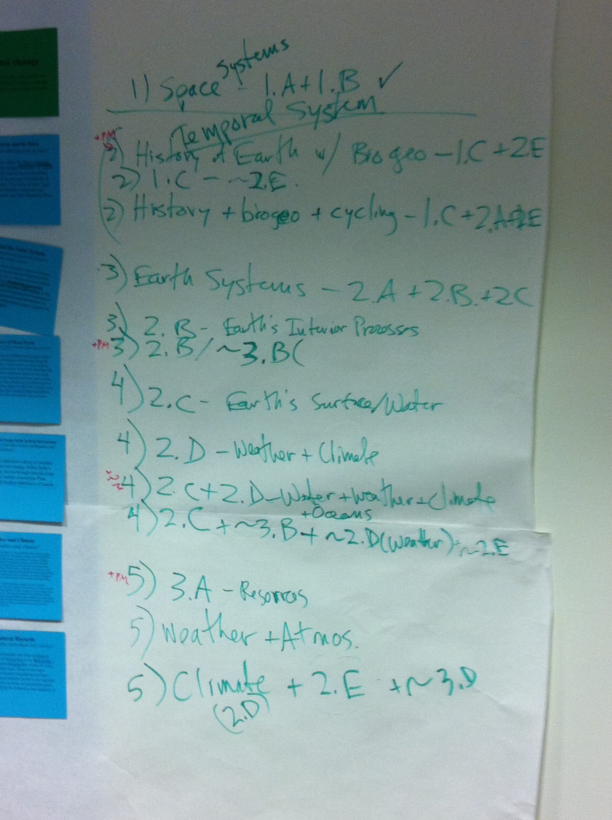

Slide 20
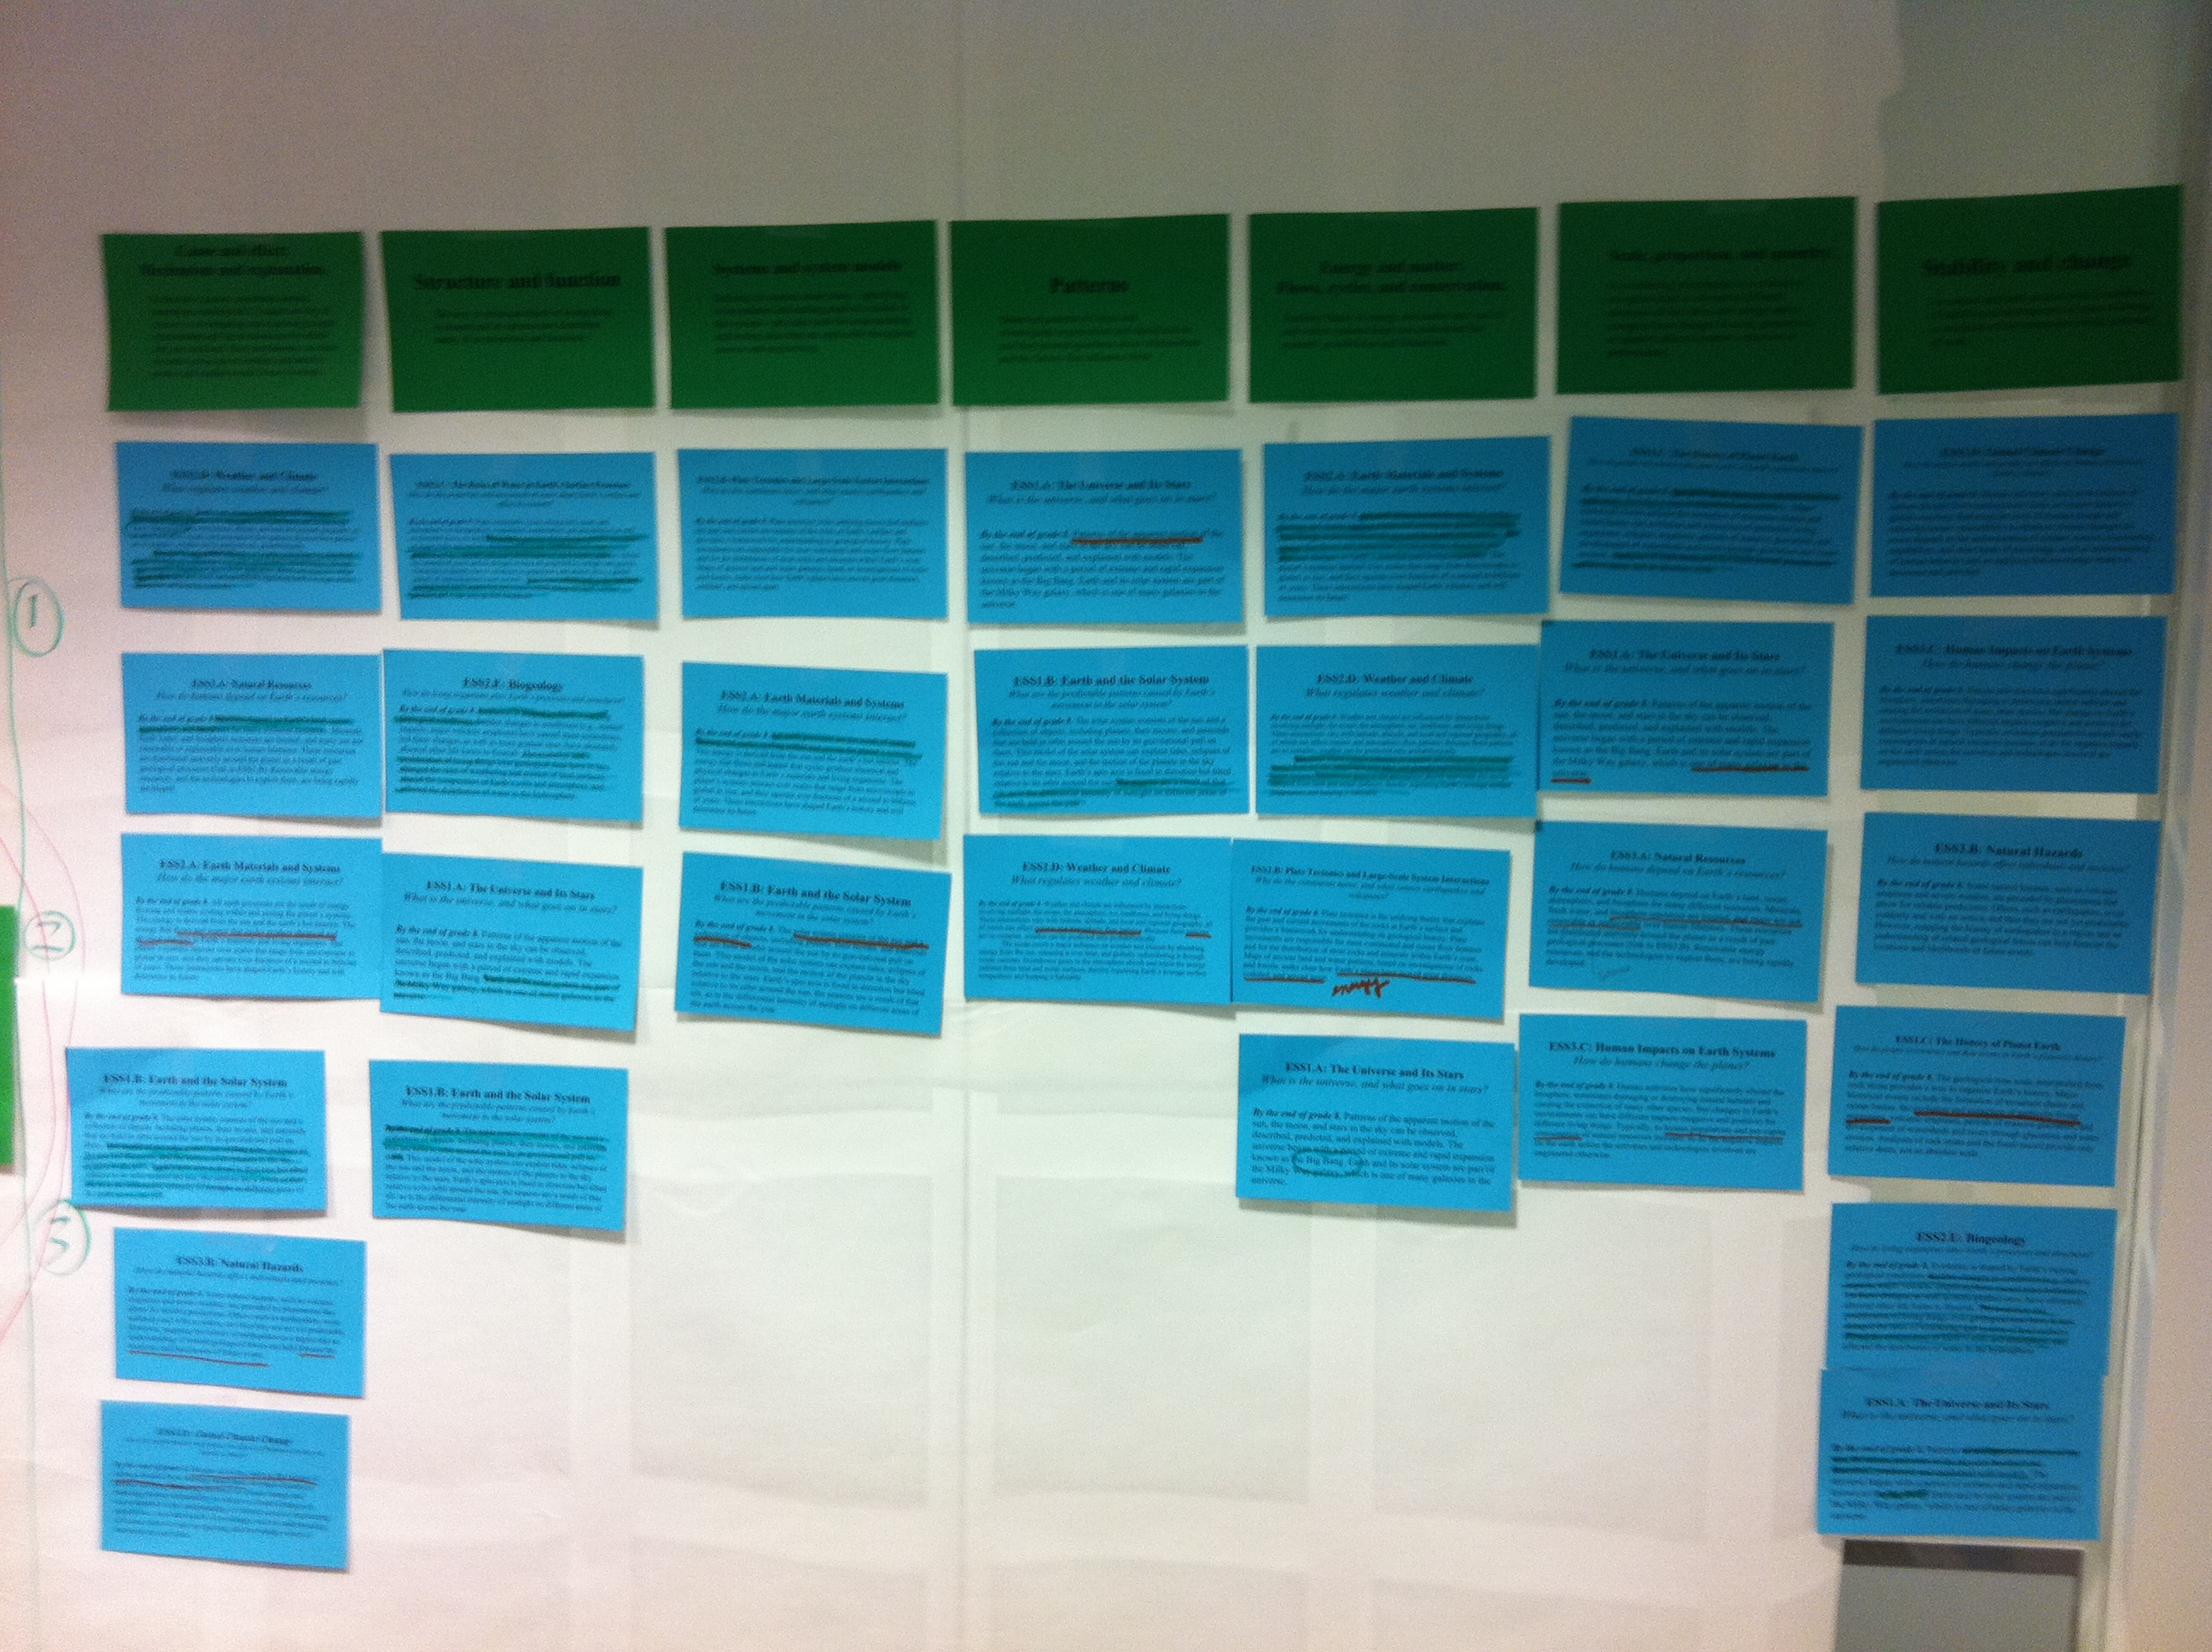
NGSS Process

Slide 21
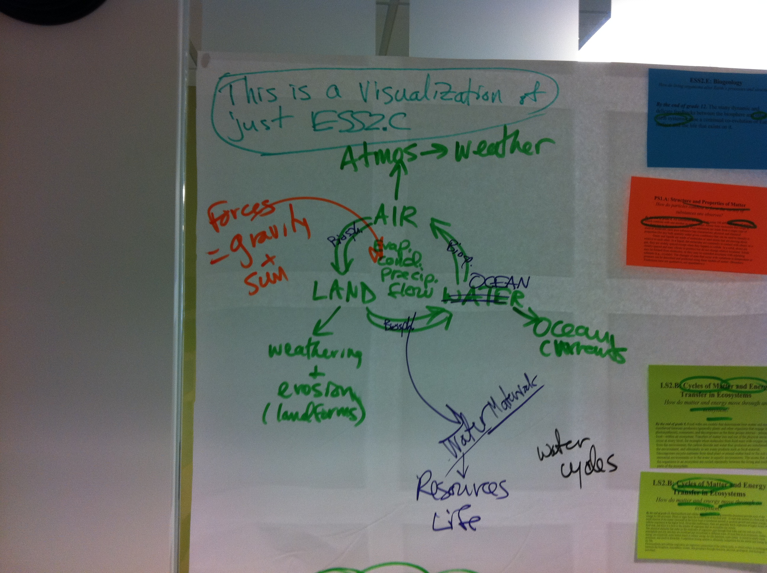
NGSS Process

Slide 22
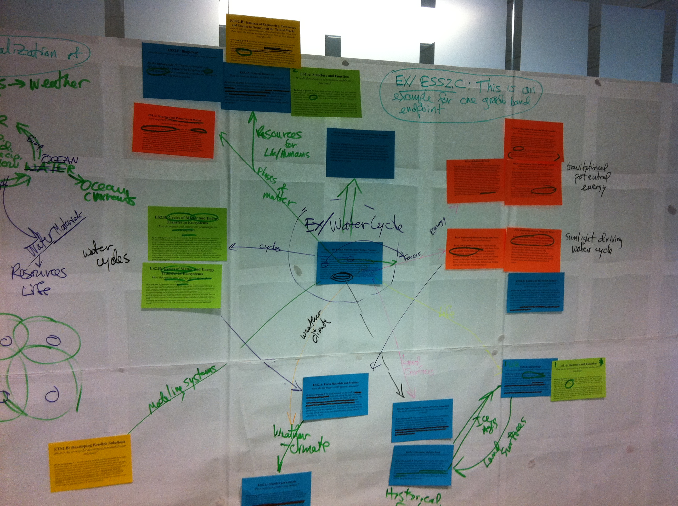
NGSS Process

Slide 23
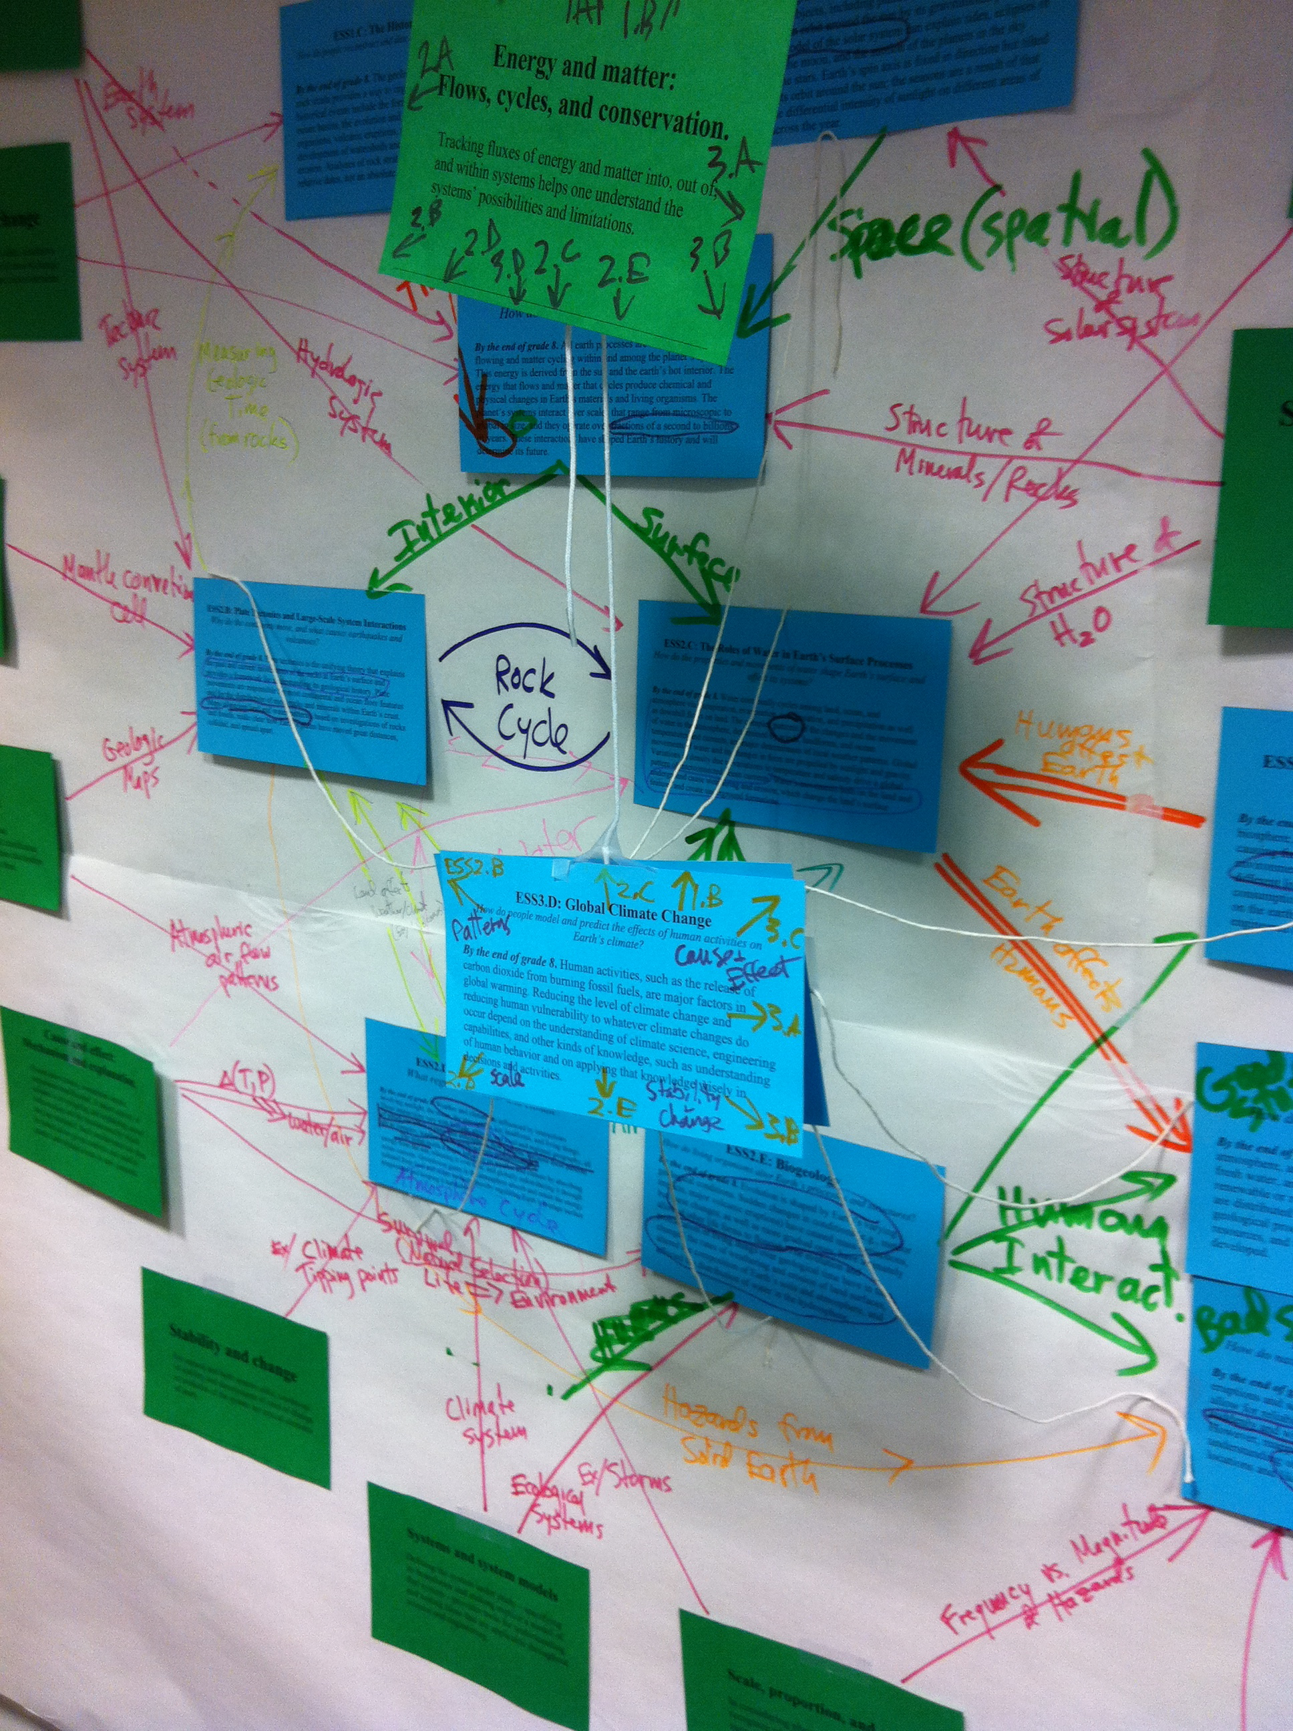
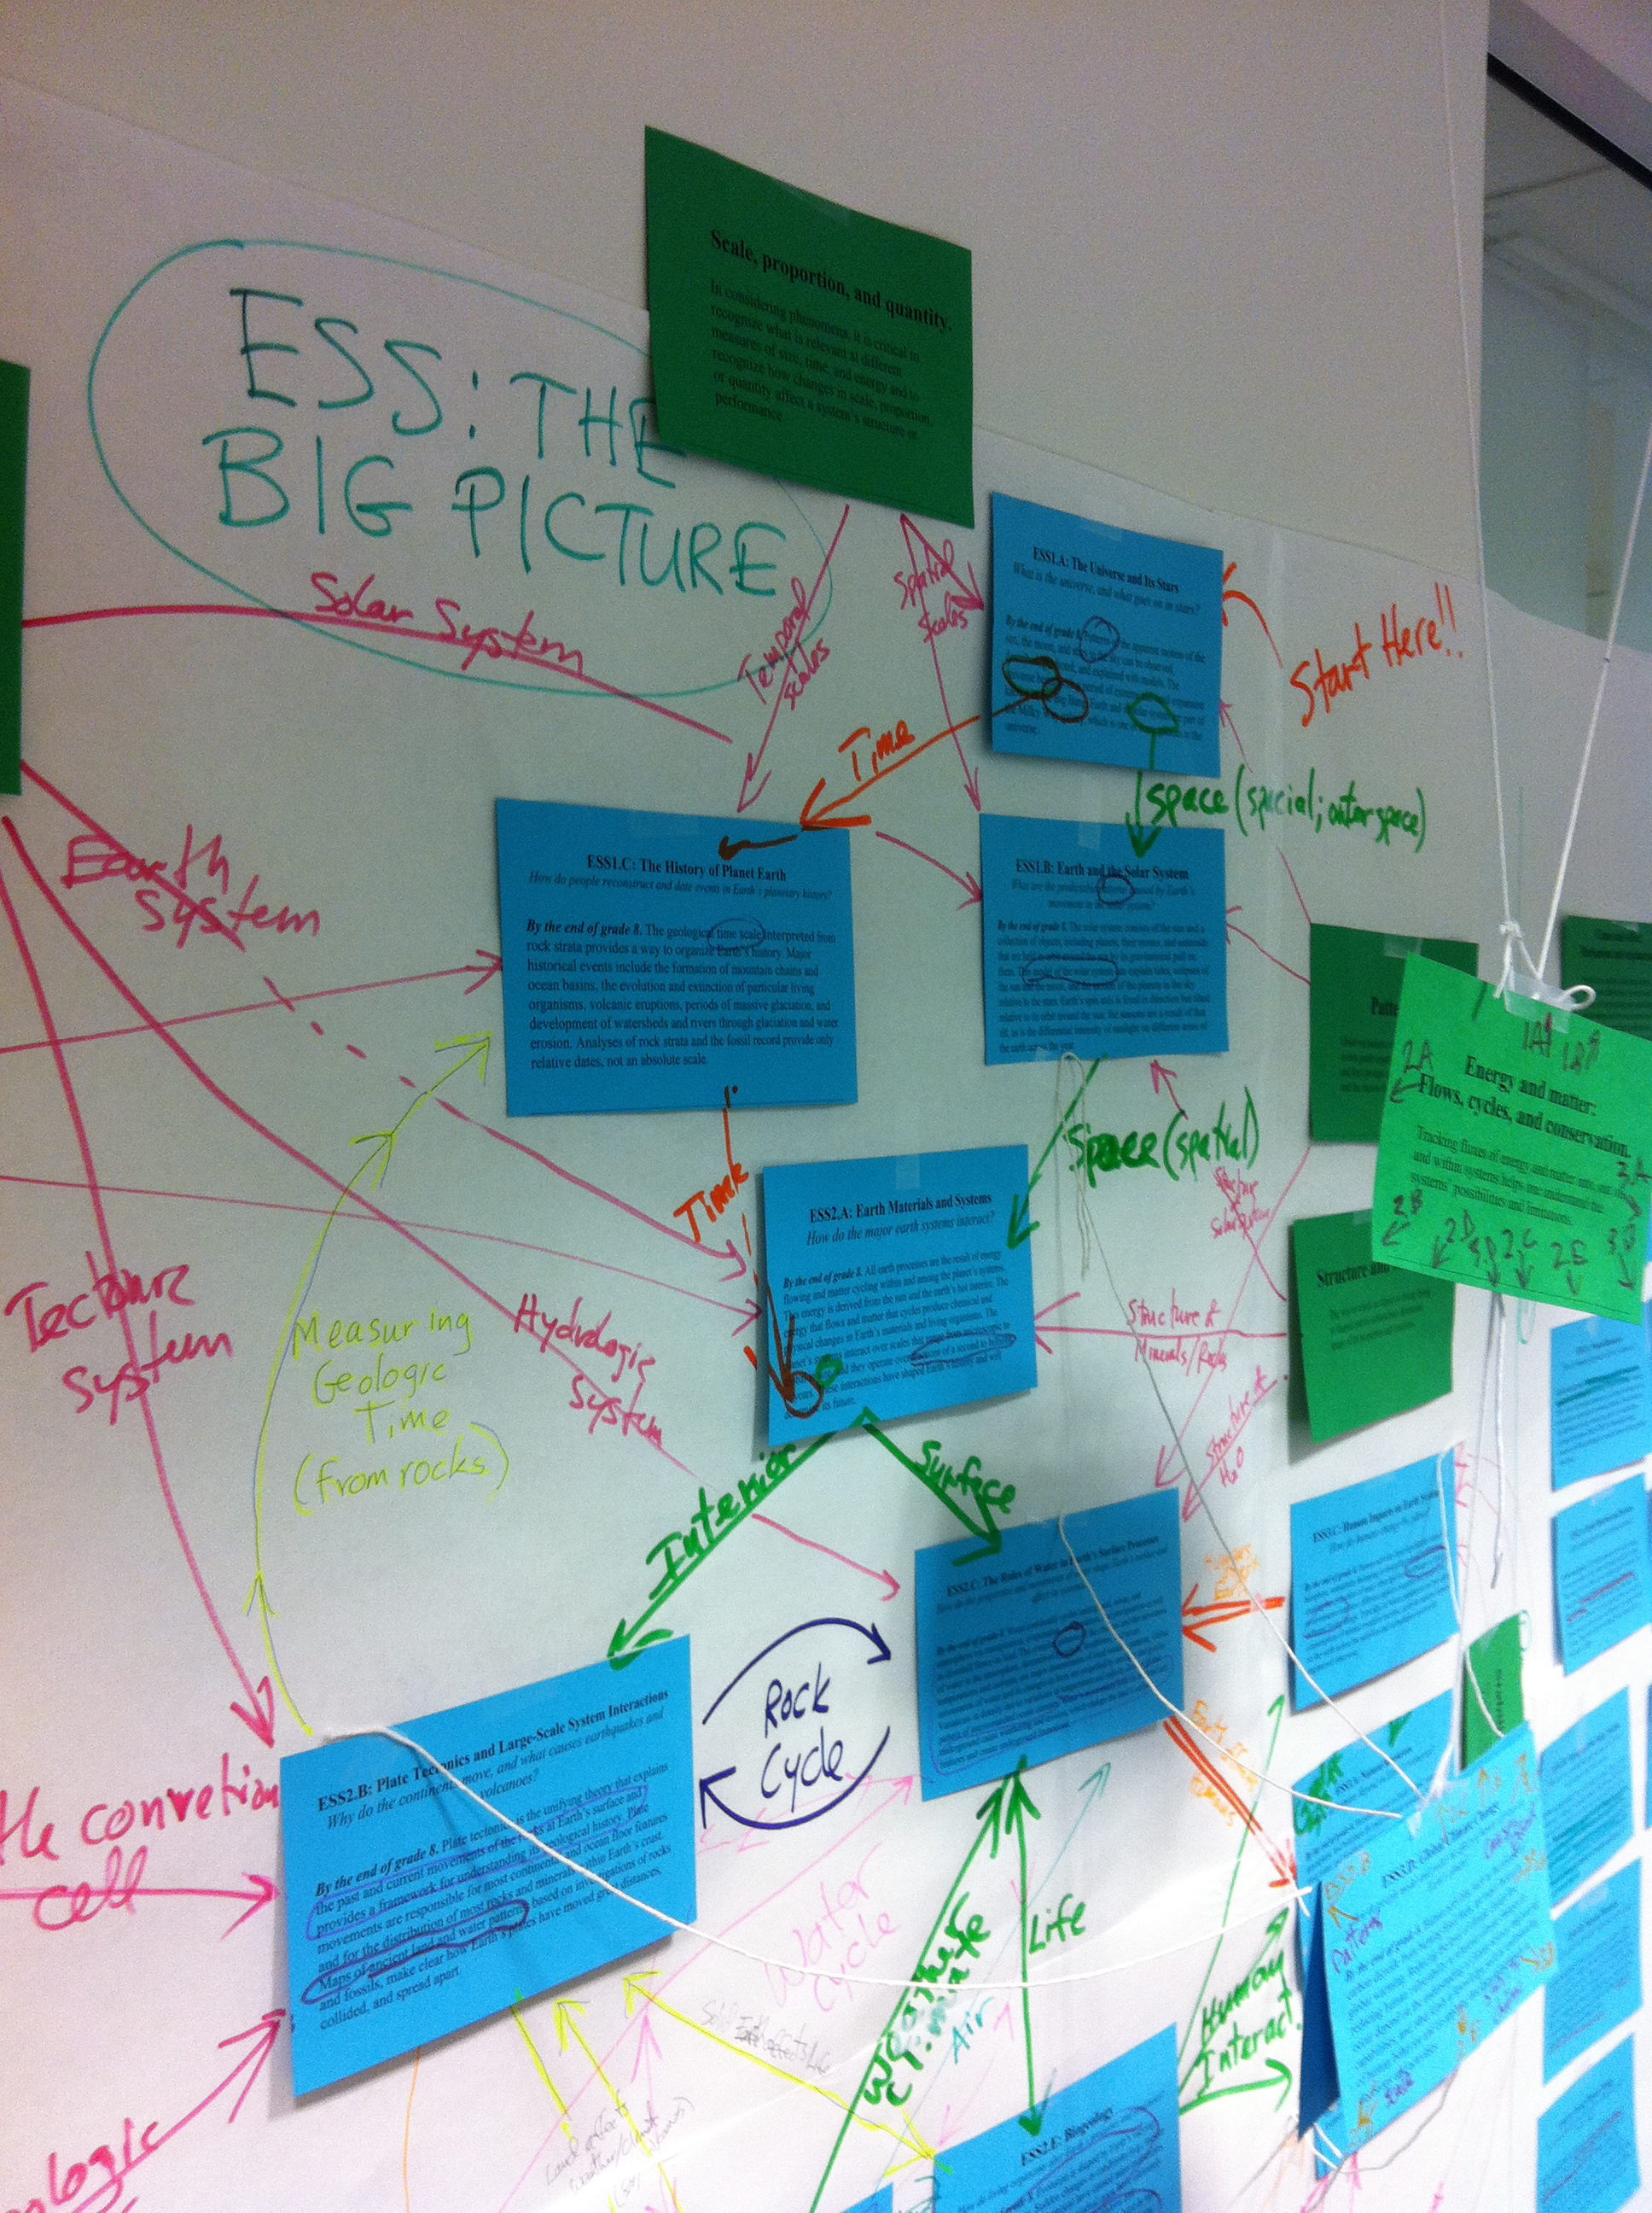

Slide 24
Performance Expectations
Middle School:
1 year of Life Science
1 year of Physical Science (Chemistry & Physics)
1 year of Earth and Space Science

Slide 25
Performance Expectations
Middle School:
1 year of Life Science
1 year of Physical Science (Chemistry & Physics)
1 year of Earth and Space Science
High School:
1 year of Life Science
1 year of Physical Science (Chemistry & Physics)
1 year of Earth and Space Science

Slide 26
The 8 Practices of
Science and Engineering
1. Asking questions (for science) and defining problems (for engineering)
2. Developing and using models
3. Planning and carrying out investigations
4. Analyzing and interpreting data
5. Using mathematics and computational thinking
6. Constructing explanations (for science) and designing solutions (for engineering)
7. Engaging in argument from evidence
8. Obtaining, evaluating, and communicating information

Slide 27
The 8 Practices of
Science and Engineering
1. Asking questions (for science) and defining problems (for engineering)
2. Developing and using models
3. Planning and carrying out investigations
4. Analyzing and interpreting data
5. Using mathematics and computational thinking
6. Constructing explanations (for science) and designing solutions (for engineering)
7. Engaging in argument from evidence
8. Obtaining, evaluating, and communicating information

Slide 28
The 8 Practices of
Science and Engineering
1. Asking questions (for science) and defining problems (for engineering)
2. Developing and using models
3. Planning and carrying out investigations → data
4. Analyzing and interpreting data
5. Using mathematics and computational thinking
6. Constructing explanations (“from data”) and designing solutions (for engineering)
7. Engaging in argument from evidence
8. Obtaining, evaluating, and communicating information
Significant for Earth and Space Science!!!

Slide 29
The Crosscutting Concepts
1. Patterns
2. Cause and effect
3. Scale, proportion, and quantity
4. Systems and system models
5. Energy and matter
6. Structure and function
7. Stability and change

Slide 30
The Crosscutting Concepts
Structure and Dimension:
Both “Patterns” and “Scale, Proportion, and Quantity” are ways of observing, categorizing, and classifying information, whether about physical objects or phenomena.

Slide 31

The Crosscutting Concepts
Structure and Dimension:
Both “Patterns” and “Scale, Proportion, and Quantity” are ways of observing, categorizing, and classifying information, whether about physical objects or phenomena.

Slide 32
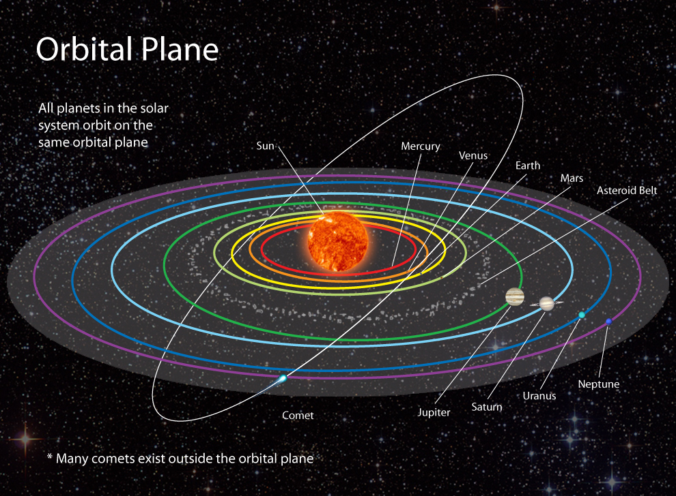
The Crosscutting Concepts
Structure and Dimension:
Both “Patterns” and “Scale, Proportion, and Quantity” are ways of observing, categorizing, and classifying information, whether about physical objects or phenomena.

Slide 33

The Crosscutting Concepts
Structure and Dimension:
Both “Patterns” and “Scale, Proportion, and Quantity” are ways of observing, categorizing, and classifying information, whether about physical objects or phenomena.

Slide 34
The Crosscutting Concepts
Structure and Dimension:
Both “Patterns” and “Scale, Proportion, and Quantity” are ways of observing, categorizing, and classifying information, whether about physical objects or phenomena.
Causality of Components:
“Structure and Function” and “Cause and Effect” take a reductionist view, focusing on processes of individual system components.

Slide 35

Understanding how a radio works:
Notes:
Columbia River

Slide 36
Understanding how a radio works:
But will you hear any music?
Notes:
Columbia River

Slide 37
The Crosscutting Concepts
Structure and Dimension:
Both “Patterns” and “Scale, Proportion, and Quantity” are ways of observing, categorizing, and classifying information, whether about physical objects or phenomena.
Causality of Components:
“Structure and Function” and “Cause and Effect” take a reductionist view, focusing on processes of individual system components.
Systems:
A holistic approach to science is exemplified by the crosscutting concepts of “Systems and System Models,” “Energy and Matter,” and “Stability and Change.” These all deal with understanding nature by examining how components of a system function together.

Slide 38
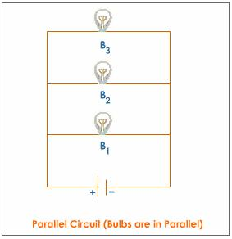
The Crosscutting Concepts
Systems:

Slide 39
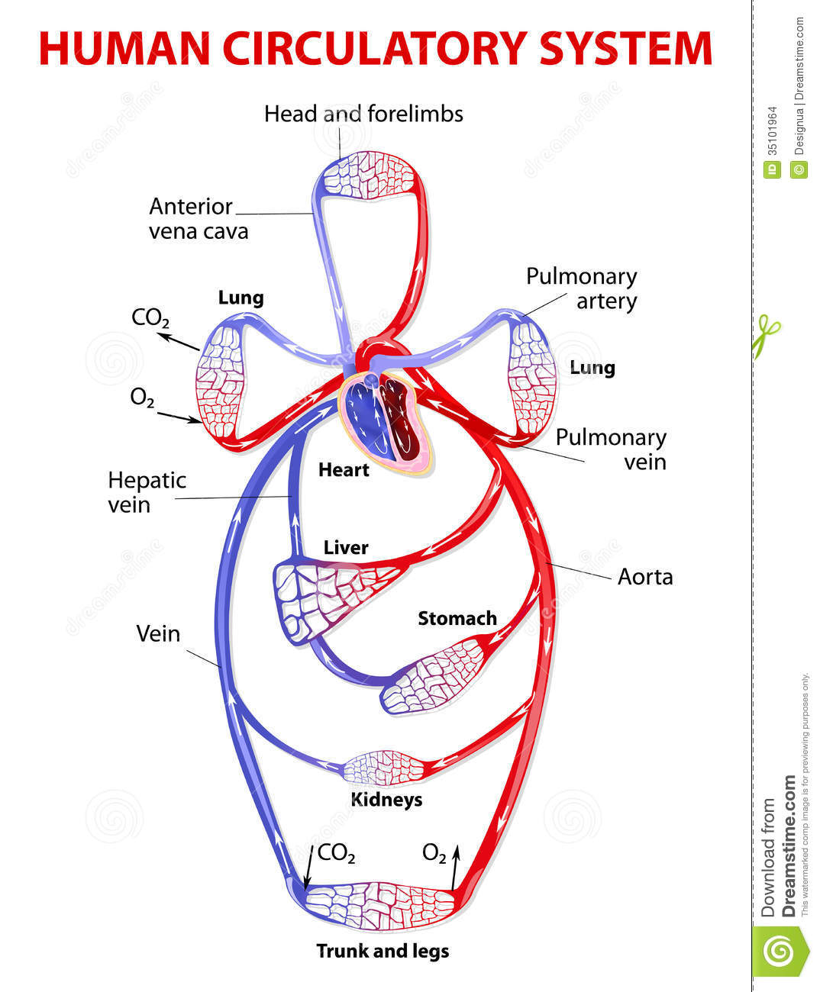
The Crosscutting Concepts
Systems:

Slide 40
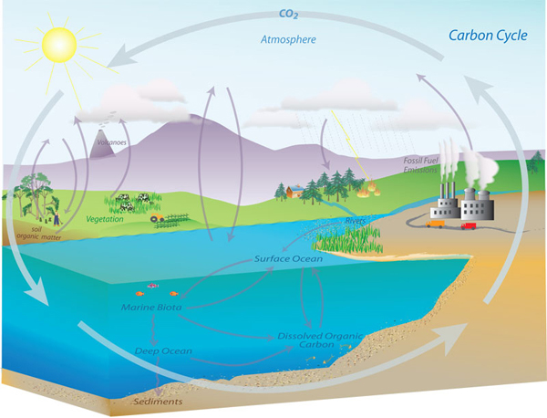
The Crosscutting Concepts
Systems:

Slide 41
NRC Framework: The Content of Science (“Disciplinary Core Ideas”) is Organized into Three Areas
(and also Science, Technology, and Engineering)

Slide 42

NRC Framework: The Content of Science (“Disciplinary Core Ideas”) is Organized into Three Areas
(and also Science, Technology, and Engineering)

Slide 43

NRC Framework: The Content of Science (“Disciplinary Core Ideas”) is Organized into Three Areas
(and also Science, Technology, and Engineering)

Slide 44

NRC Framework: The Content of Science (“Disciplinary Core Ideas”) is Organized into Three Areas
(and also Science, Technology, and Engineering)

Slide 45

NRC Framework: The Content of Science (“Disciplinary Core Ideas”) is Organized into Three Areas
(and also Science, Technology, and Engineering)

Slide 46

NRC Framework: The Content of Science (“Disciplinary Core Ideas”) is Organized into Three Areas
(and also Science, Technology, and Engineering)

Slide 47

NRC Framework: The Content of Science (“Disciplinary Core Ideas”) is Organized into Three Areas
(and also Science, Technology, and Engineering)

Slide 48

NRC Framework: The Content of Science (“Disciplinary Core Ideas”) is Organized into Three Areas
(and also Science, Technology, and Engineering)

Slide 49

NRC Framework: The Content of Science (“Disciplinary Core Ideas”) is Organized into Three Areas
(and also Science, Technology, and Engineering)

Slide 50

NRC Framework: The Content of Science (“Disciplinary Core Ideas”) is Organized into Three Areas
(and also Science, Technology, and Engineering)

Slide 51

NRC Framework: The Content of Science (“Disciplinary Core Ideas”) is Organized into Three Areas
(and also Science, Technology, and Engineering)

Slide 52

NRC Framework: The Content of Science (“Disciplinary Core Ideas”) is Organized into Three Areas
(and also Science, Technology, and Engineering)

Slide 53

NRC Framework: The Content of Science (“Disciplinary Core Ideas”) is Organized into Three Areas
(and also Science, Technology, and Engineering)

Slide 54

NRC Framework: The Content of Science (“Disciplinary Core Ideas”) is Organized into Three Areas
(and also Science, Technology, and Engineering)

Slide 55

NRC Framework: The Content of Science (“Disciplinary Core Ideas”) is Organized into Three Areas
(and also Science, Technology, and Engineering)

Slide 56
Engineering
Engineering Concepts are fully integrated throughout the NGSS
They appear in all 3 Foundation Boxes (Practices, Disciplinary Core Ideas, Crosscutting Concepts)
Engineering and Technology concepts are important components of ESS-3 (Earth and Human Activity)

Slide 57
How do you teach Earth and Space Science in alignment with the NGSS?
Start with the Performance Expectations.
  15 at Middle School; 19 at High School

Slide 58
How do you teach Earth and Space Science in alignment with the NGSS?
Start with the Performance Expectations.
  15 at Middle School; 19 at High School
  3 Big Ideas:
  Earth’s Place in the Universe
  Earth’s Systems
  Earth and Human Activity

Slide 59
How do you teach Earth and Space Science in alignment with the NGSS?
Start with the Performance Expectations.
  15 at Middle School; 19 at High School
Determine how you will be organizing them
  Use the Appendix K Course Maps as a guide

Slide 60
The NGSS are NOT a Curriculum
  The NRC Framework is the Skeleton
  The NGSS are the fleshed-out organs
  Curricula will be the clothes.

Slide 61

The NGSS are NOT a Curriculum
  The NRC Framework is the Skeleton
  The NGSS are the fleshed-out organs
  Curricula will be the clothes.
  You can dress up the NGSS
  any way that you want!

Slide 62
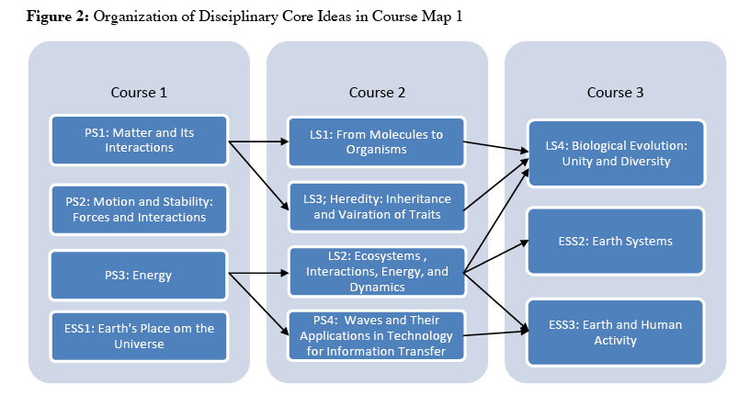
How would you construct a 6-12 curriculum around the NGSS, given the amount and complexity of Earth and Space Science?
Course Map #1: Conceptual Understanding Model

Slide 63
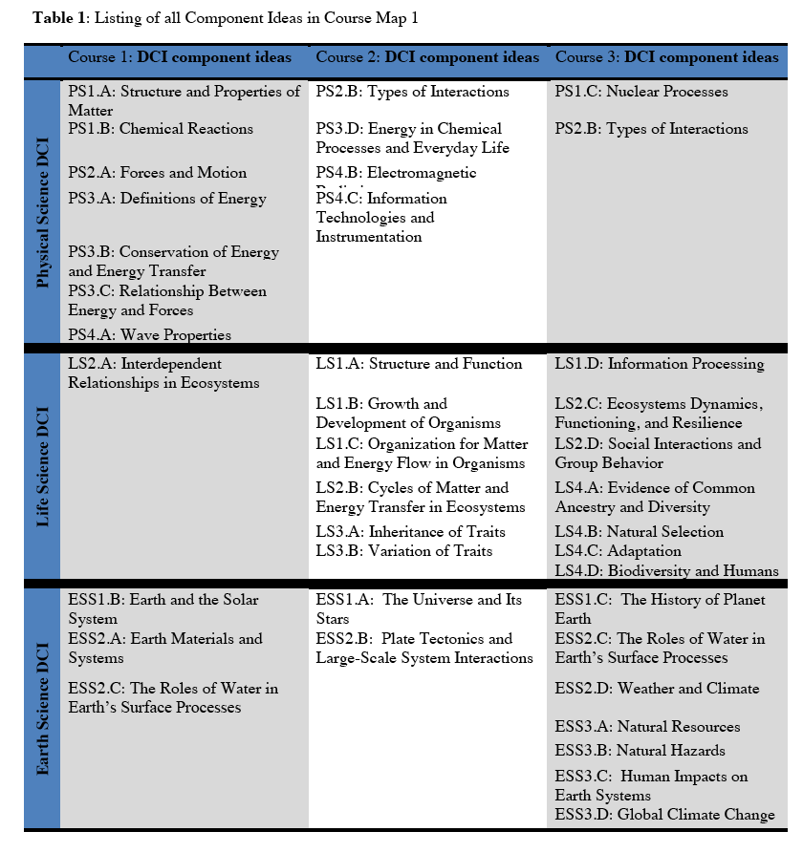
Course Map #1: Conceptual Understanding Model:
Courses constructed based on the most efficient and logical progression of concepts

Slide 64
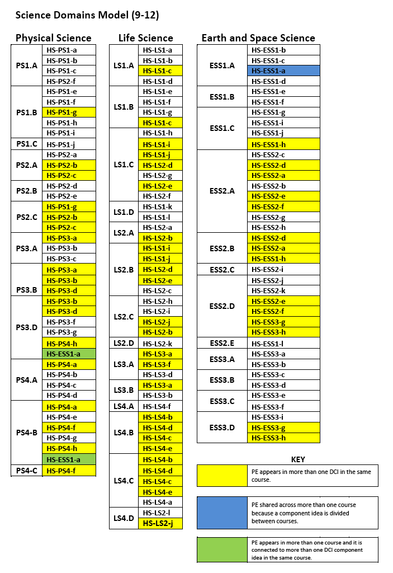
Course Map #2: Science Domains Model:
The 3 courses are Physical Science, Life Science, and Earth and Space Science
(for both middle and high school)

Slide 65
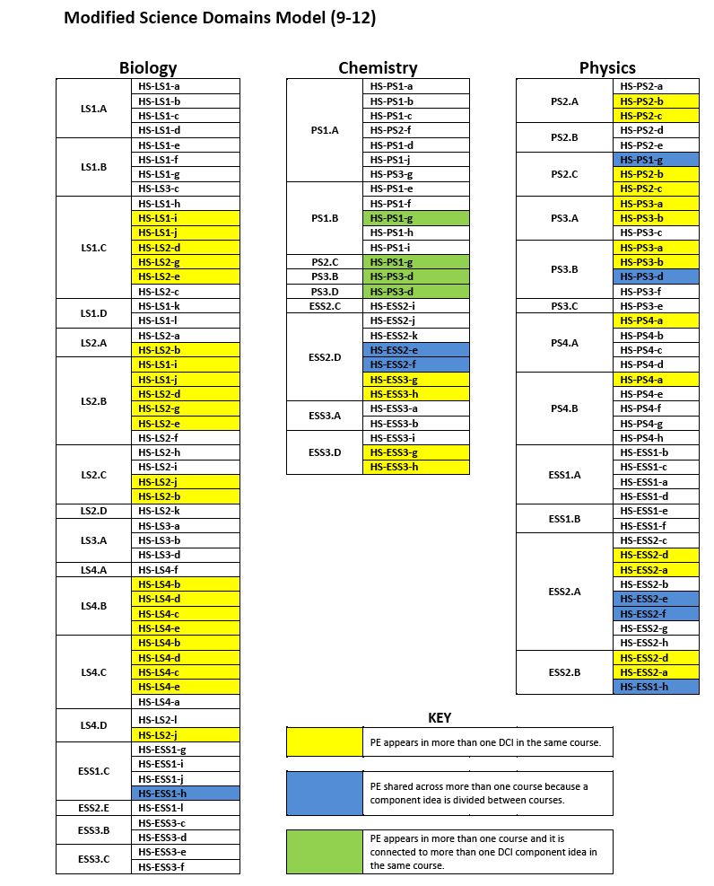
Course Map #3: Modified Science Domains Model (for high school):
Incorporate the Earth and Space Science into existing biology, chemistry, and physics courses.
→ Least efficient in terms of instruction time; concepts taught out of order (without adequate prerequisites)

Slide 66
Number of Years of High School Science
Required by Different States
Number of Years of High School Science Required:
1987 1996 2006 2011
Local Decision 6 7 8 5
1 – 2 Years 40 33 20 15
3 Years 3 8 21 30
4 Years 0 2 1 2
1987 – leaves off Vermont and Arkansas, which both required 5 total math or science years
1996 – still leaves off Vermont for the same reason; includes DC
2006, 2011 – all 50 states and DC
Notes:
1987 – leaves off Vermont and Arkansas, which both required 5 total math or science years
1996 – still leaves off Vermont for the same reason; includes DC
2006 – all 50 states

Slide 67
How do you teach Earth and Space Science in alignment with the NGSS?
Start with the Performance Expectations.
  15 at Middle School; 19 at High School
Determine how you will be organizing them
  Use the Appendix K Course Maps as a guide
  Bundle Performance Expectations where possible

Slide 68
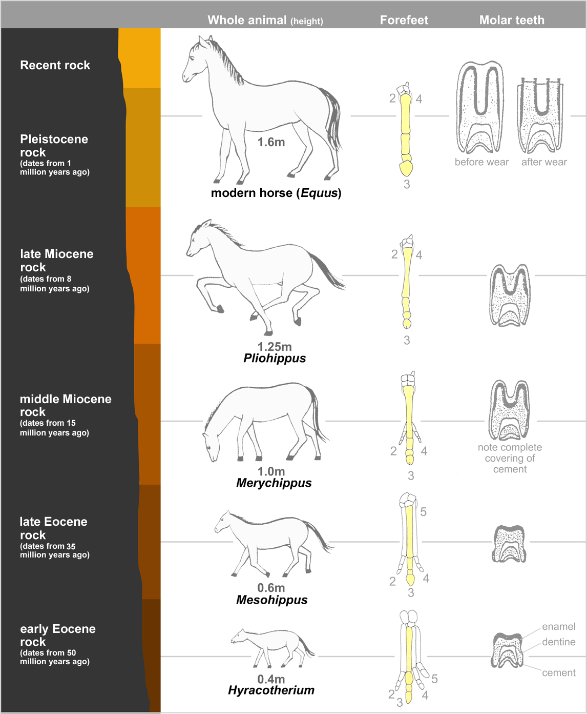
Example of Bundling PEs: (High School) - Fossils and Evolution

Slide 69
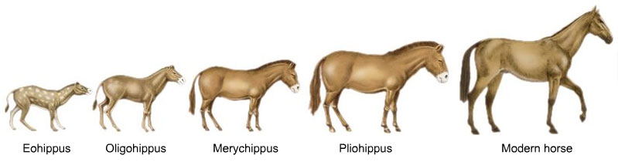
Example of Bundling PEs: (High School) - Fossils and Evolution
Life Science:
HS-LS4-1: Communicate scientific information that common ancestry and biological evolution are supported by multiple lines of empirical evidence.
HS-LS4-5: Evaluate the evidence supporting claims that changes in environmental conditions may result in: (1) increases in the number of individuals of some species, (2) the emergence of new species over time, and (3) the extinction of other species.
Example of Bundling PEs: (High School) - Fossils and Evolution

Slide 70
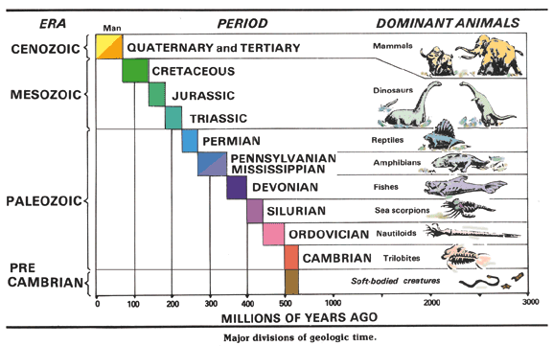
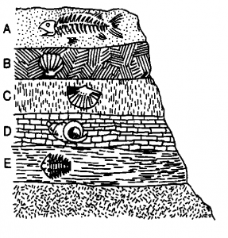
Example of Bundling PEs: (High School) - Fossils and Evolution
Earth Science:
MS-ESS1-4: Construct a scientific explanation based on evidence from rock strata for how the geologic time scale is used to organize Earth’s 4.6-billion-year-old history.
HS-ESS1-6: Apply scientific reasoning and evidence from ancient Earth materials, meteorites, and other planetary surfaces to construct an account of Earth’s formation and early history.
Example of Bundling PEs: (High School) - Fossils and Evolution

Slide 71
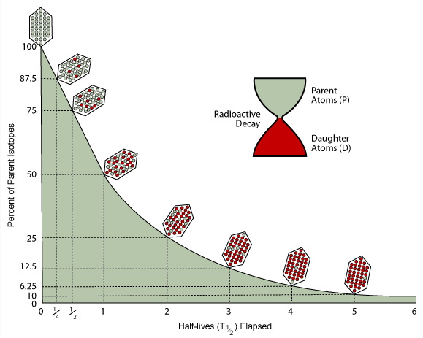
Example of Bundling PEs: (High School) - Fossils and Evolution
Physical Science:
HS-PS1-8: Develop models to illustrate the changes in the composition of the nucleus of the atom and the energy released during the processes of fission, fusion, and radioactive decay.
Example of Bundling PEs: (High School) - Fossils and Evolution

Slide 72
How do you teach Earth and Space Science in alignment with the NGSS?
Start with the Performance Expectations.
  15 at Middle School; 19 at High School
Determine how you will be organizing them
  Use the Appendix K Course Maps as a guide
Determine what you will teach to support the PE’s
  Use the Clarification Statements and Assessment Boundaries as a guide

Slide 73
How do you Teach Earth and Space Science with the NGSS?

Slide 74
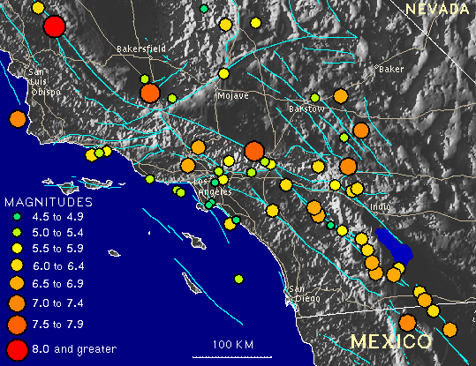
Example of ESS Place-Based Learning: Natural Hazards
HS-ESS3-1: Construct an explanation based on evidence for how the availability of natural resources, occurrence of natural hazards, and changes in climate have influenced human activity.
California

Slide 75
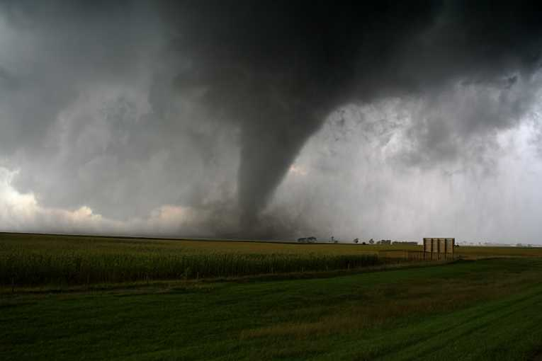
Example of ESS Place-Based Learning: Natural Hazards
HS-ESS3-1: Construct an explanation based on evidence for how the availability of natural resources, occurrence of natural hazards, and changes in climate have influenced human activity.
St. Louis
Oklahoma
California

Slide 76
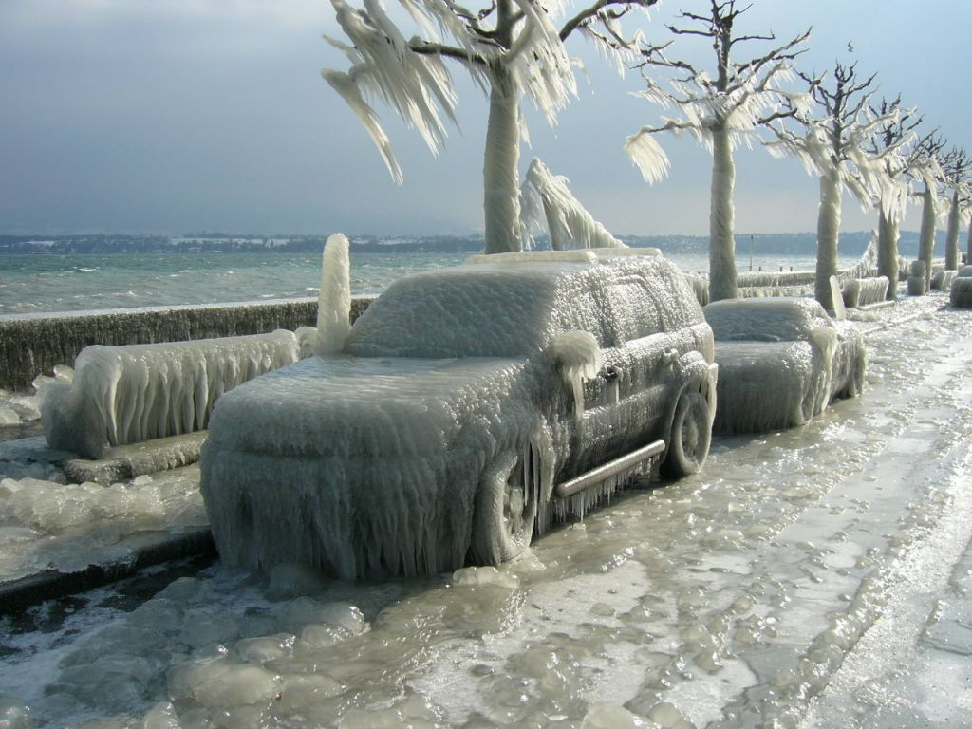
Example of ESS Place-Based Learning: Natural Hazards
HS-ESS3-1: Construct an explanation based on evidence for how the availability of natural resources, occurrence of natural hazards, and changes in climate have influenced human activity.
St. Louis
California
Chicago

Slide 77
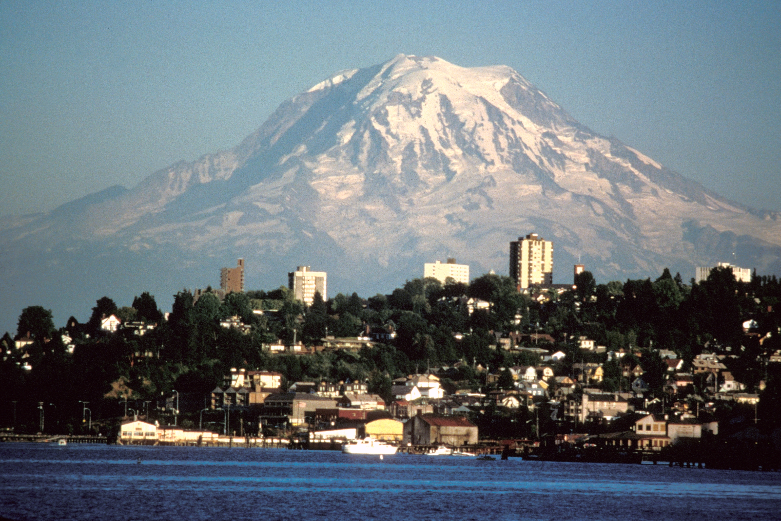
Example of ESS Place-Based Learning: Natural Hazards
HS-ESS3-1: Construct an explanation based on evidence for how the availability of natural resources, occurrence of natural hazards, and changes in climate have influenced human activity.
Seattle
St. Louis
California

Slide 78
Example of ESS Place-Based Learning: Natural Hazards
HS-ESS3-1: Construct an explanation based on evidence for how the availability of natural resources, occurrence of natural hazards, and changes in climate have influenced human activity.
St. Louis
California
Florida

Slide 79
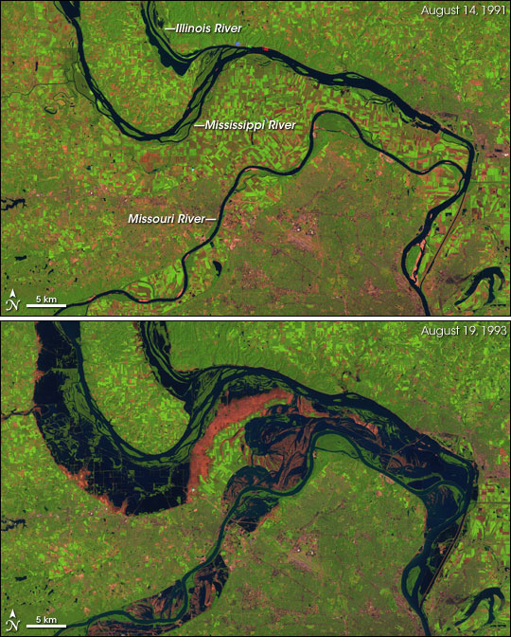
Example of ESS Place-Based Learning: Natural Hazards
HS-ESS3-1: Construct an explanation based on evidence for how the availability of natural resources, occurrence of natural hazards, and changes in climate have influenced human activity.
FLORIDA
St. Louis
St. Louis
California

Slide 80
How do you teach Earth and Space Science in alignment with the NGSS?
Start with the Performance Expectations.
  15 at Middle School; 19 at High School
Determine how you will be organizing them
  Use the Appendix K Course Maps as a guide
Determine what you will teach to support the PE’s
  Use the Clarification Statements and Assessment Boundaries as a guide
  Be sure to teach what you love

Slide 81
Achieve: Science and Math Tasks
Middle School ESS: “Four Cities” (Climate)
Middle School ESS: “Watershed Study” (Water Cycle)
High School ESS: “Analyzing Floods” (Flood Hazards)
High School ESS: “Early Earth” (Geologic Time)

Slide 82
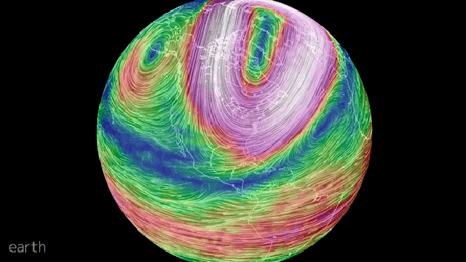
Middle School ESS: “Four Cities” (Climate)

Slide 83
Middle School ESS: “Four Cities” (Climate)
Four Cities: Using Data to Model Variations in Regional Climate in the Western United States – Middle School Sample Classroom Assessment
Performance Expectation (ESS):
MS-ESS2-6 Develop and use a model to describe how unequal heating and rotation of the Earth cause patterns of atmospheric and oceanic circulation that determine regional climates.
Designed to take 4-8 class periods (45-50 min each)

Slide 84
Common Core (Math – 7th grade):
MP.2 Reason abstractly and quantitatively.
MP.3 Construct viable arguments and critique the reasoning of others.
6.SP.A.2 Understand that a set of data collected to answer a statistical question has a distribution which can be described by its center, spread, and overall shape.
6.SP.A.3 Recognize that a measure of center for a numerical data set summarizes all of its values with a single number, while a measure of variation describes how its values vary with a single number.
6.SP.B.4 Display numerical data in plots on a number line, including dot plots, histograms, and box plots.
6.SP.B.5c Summarize numerical data sets in relation to their context, by: Giving quantitative measures of center (median and/or mean) and variability (interquartile range and/or mean absolute deviation), as well as describing any overall pattern and any striking deviations from the overall pattern with reference to the context in which the data were gathered.
7.SP.A.1 Understand that statistics can be used to gain information about a population by examining a sample of the population; generalizations about a population from a sample are valid only if the sample is representative of that population. Understand that random sampling tends to produce representative samples and support valid inferences.
7.SP.B.4 Use measures of center and measures of variability for numerical data from random samples to draw informal comparative inferences about two populations.

Slide 85
Common Core (ELA – 7th grade):
W.7.2 Write informative/explanatory texts to examine a topic and convey ideas, concepts, and information through the selection, organization, and analysis of relevant content.
W.7.2.a Introduce a topic clearly, previewing what is to follow; organize ideas, concepts, and information, using strategies such as definition, classification, comparison/contrast, and cause/effect; include formatting (e.g., headings), graphics (e.g., charts, tables), and multimedia when useful to aiding comprehension.
W.7.2.b Develop the topic with relevant facts, definitions, concrete details, quotations, or other information and examples.
W.7.2.c Use appropriate transitions to create cohesion and clarify the relationships among ideas and concepts.
WHST.6-8.2 Write informative/explanatory texts, including the narration of historical events, scientific procedures/ experiments, or technical processes.
WHST.6-8.2.a Introduce a topic clearly, previewing what is to follow; organize ideas, concepts, and information into broader categories as appropriate to achieving purpose; include formatting (e.g., headings), graphics (e.g., charts, tables), and multimedia when useful to aiding comprehension.
WHST.6-8.2.b Develop the topic with relevant, well-chosen facts, definitions, concrete details, quotations, or other information and examples.
WHST.6-8.2.c Use appropriate and varied transitions to create cohesion and clarify the relationships among ideas and concepts.

Slide 86
How do you Teach Earth and Space Science with the NGSS?

Slide 87
Context:
“You have friends who live in different cities around the United States: (1) Seattle, Washington; (2) San Francisco, California; (3) Minneapolis, Minnesota; (4) and Las Vegas, Nevada. When you talk with your friends, you often wonder why the climate patterns seem so different across the country at given times of the year. For example, your friend in Minneapolis talks about getting time off from school for snow days in the winter, while your friend in Las Vegas tells you how high the temperatures reach in the summer. Your friend in Seattle tells you that it is often rainy, although the temperatures never seem to get too extreme. Your friend in San Francisco tells you about the fog that can blanket the city in spring and summer. In this task, you will look at climate data taken from each of these cities to determine what causes the climate variations you and your friends experience in your respective locations.
For this task, you are going to consider what climate means for your school’s location (town), consider the climates of the cities in which your friends live, consider reasons for the differences in climate between the cities, and then make a model that predicts the types of regional climates in the western half of the United States.”

Slide 88
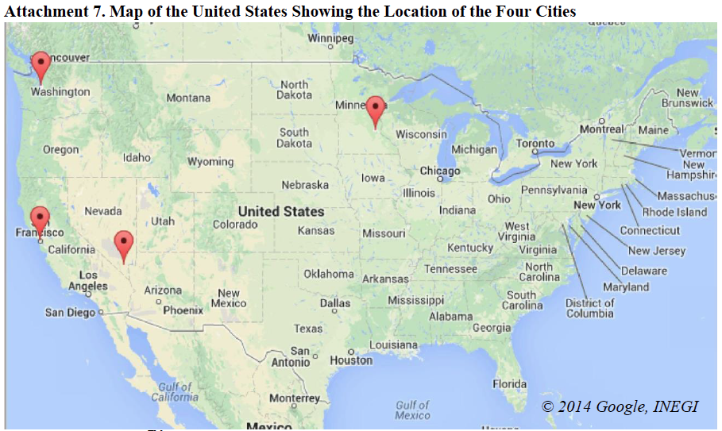
Task Component E:
Students construct an explanation that includes the idea that areas near the ocean do not experience as large of differences in average temperature from month to month as do areas far from the ocean, based on the differences in temperatures (range and minimum temperatures) between Minneapolis, MN and Seattle, WA.

Slide 89
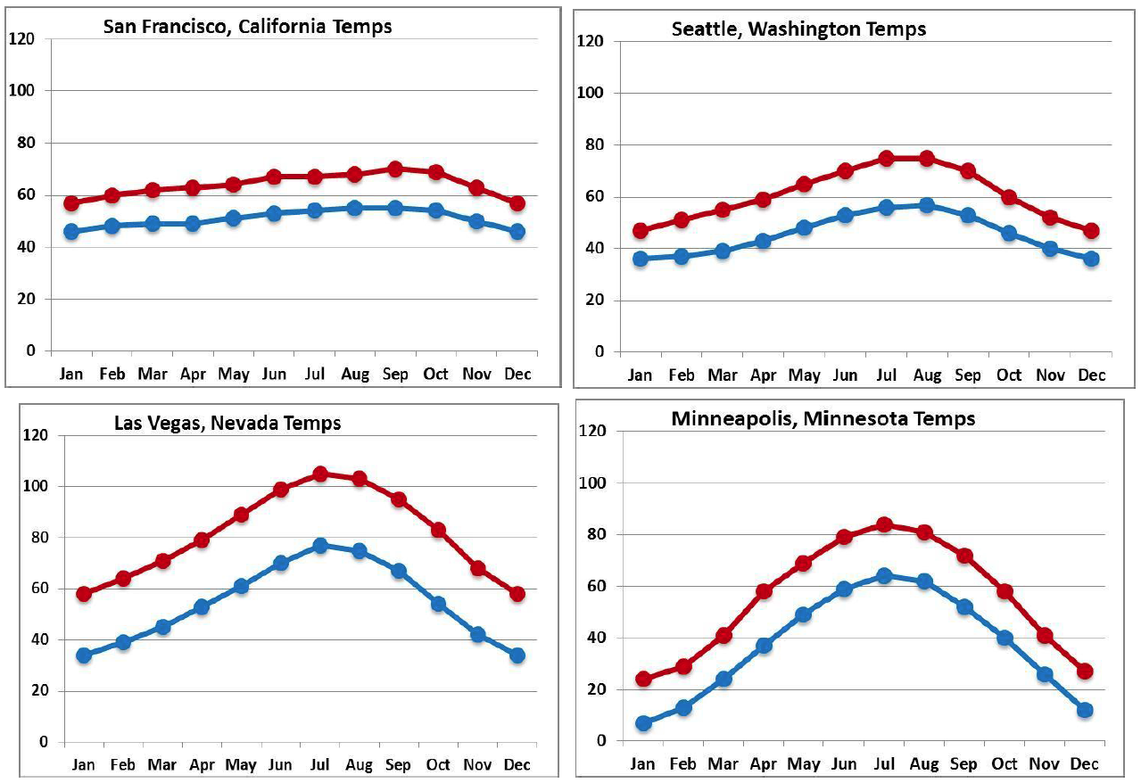
Task Component E:
Students construct an explanation that includes the idea that areas near the ocean do not experience as large of differences in average temperature from month to month as do areas far from the ocean, based on the differences in temperatures (range and minimum temperatures) between Minneapolis, MN and Seattle, WA.

Slide 90
Task Component F:
Students construct an explanation that includes the idea that the differences between the cities temperature ranges and max/min temperatures can be accounted for by the fact that ocean circulation places colder ocean water adjacent to San Francisco, CA relative to Seattle, WA.

Slide 91
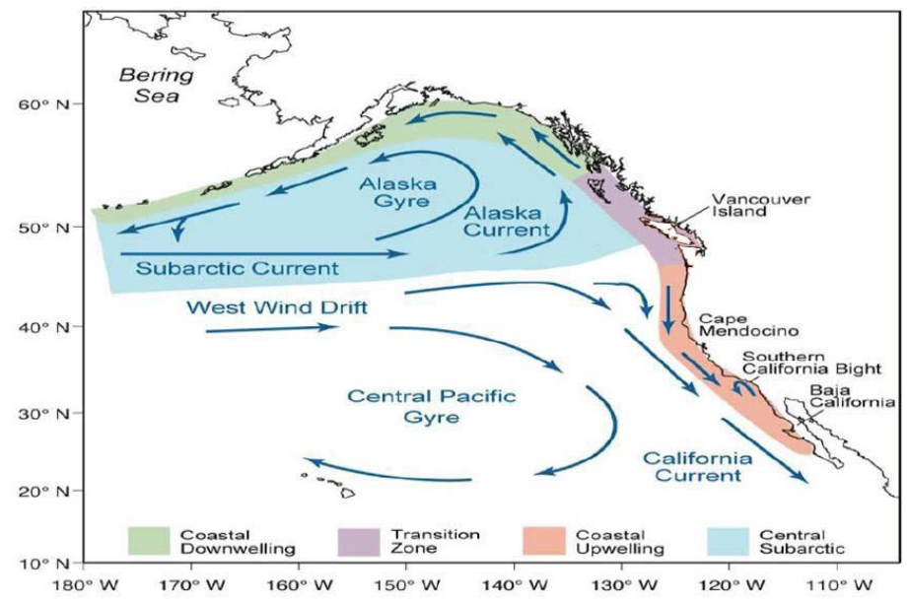
Task Component F:
Students construct an explanation that includes the idea that the differences between the cities temperature ranges and max/min temperatures can be accounted for by the fact that ocean circulation places colder ocean water adjacent to San Francisco, CA relative to Seattle, WA.

Slide 92
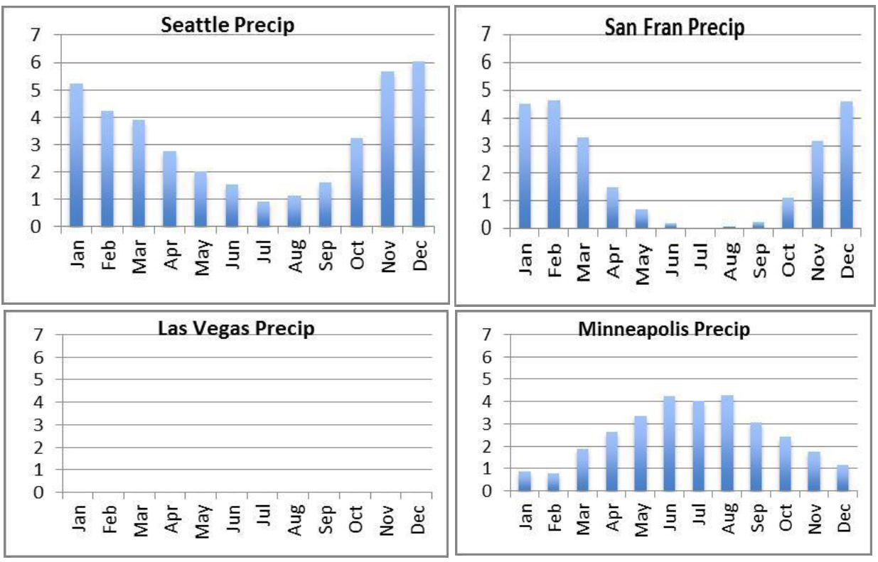
Task Component H:
Students construct an explanation that connects the difference in the amount of precipitation between San Francisco, CA, and Las Vegas, NV, with the direction of air movement from the west to east over an area of great topographic relief, and that includes the idea that areas to the west of the topographic highs get more precipitation than areas to the east of the topographic highs.

Slide 93
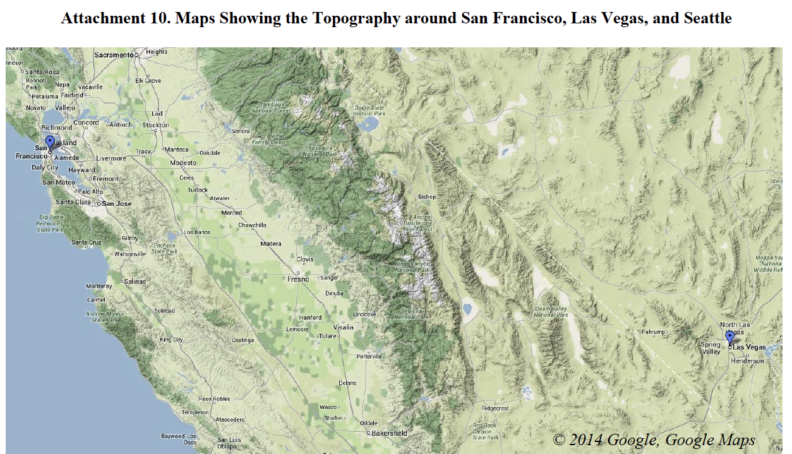
Task Component H:
Students construct an explanation that connects the difference in the amount of precipitation between San Francisco, CA, and Las Vegas, NV, with the direction of air movement from the west to east over an area of great topographic relief, and that includes the idea that areas to the west of the topographic highs get more precipitation than areas to the east of the topographic highs.

Slide 94
Curricular Activity Example: High School Seismic Hazards
Performance Expectations:
(main) HS-ESS3-6: Use a computational representation to illustrate the relationships among Earth systems and how those relationships are being modified due to human activity.
(secondary) HS-ESS3-1: Construct an explanation based on evidence for how the availability of natural resources, occurrence of natural hazards, and changes in climate have influenced human activity.

Slide 95
Curricular Activity Example: High School Seismic Hazards
Could also use this for middle school:
(main) MS-ESS3-2: Analyze and interpret data on natural hazards to forecast future catastrophic events and inform the development of technologies to mitigate their effects.
(secondary) MS-ESS2-2: Construct an explanation based on evidence for how geoscience processes have changed Earth’s surface at varying time and spatial scales.
(secondary) MS-ESS3-4: Construct an argument supported by evidence for how increases in human population and per-capita consumption of natural resources impact Earth’s systems.

Slide 96
WestinMeetings
Password: agufran
Site: www.iris.edu

Slide 97
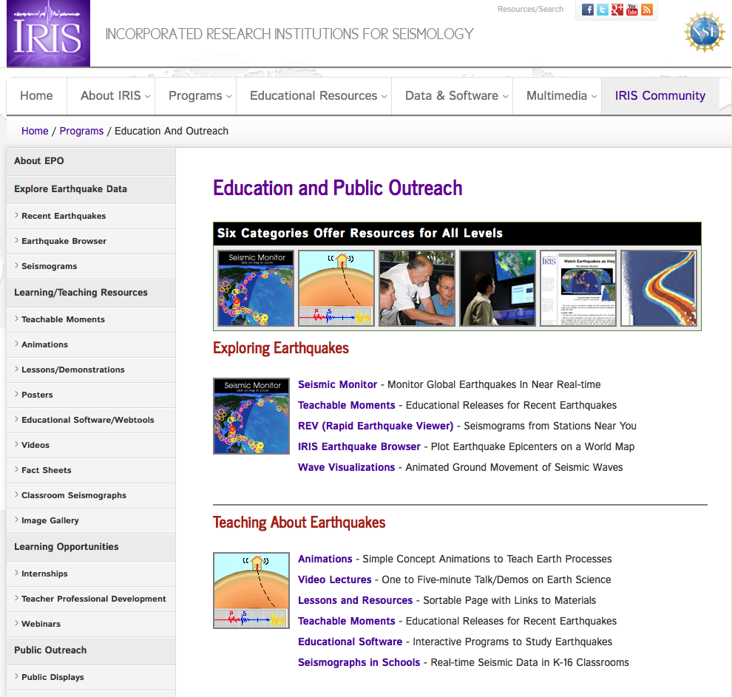
www.iris.edu

Slide 98
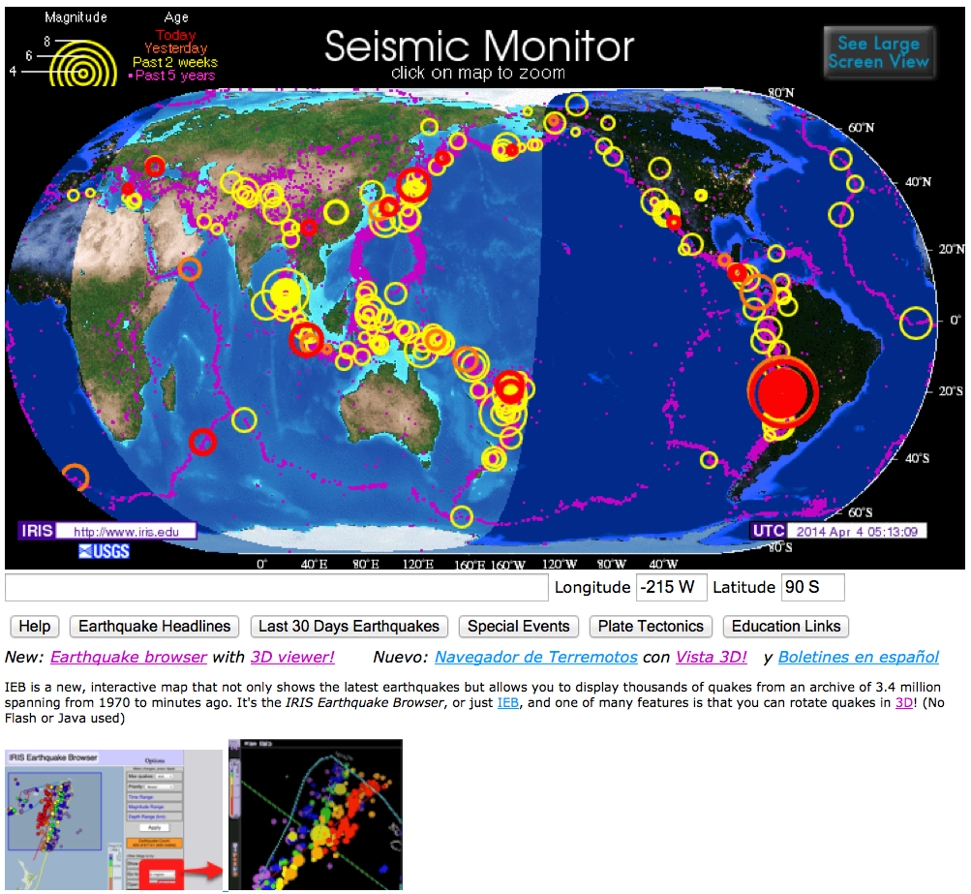

Slide 99
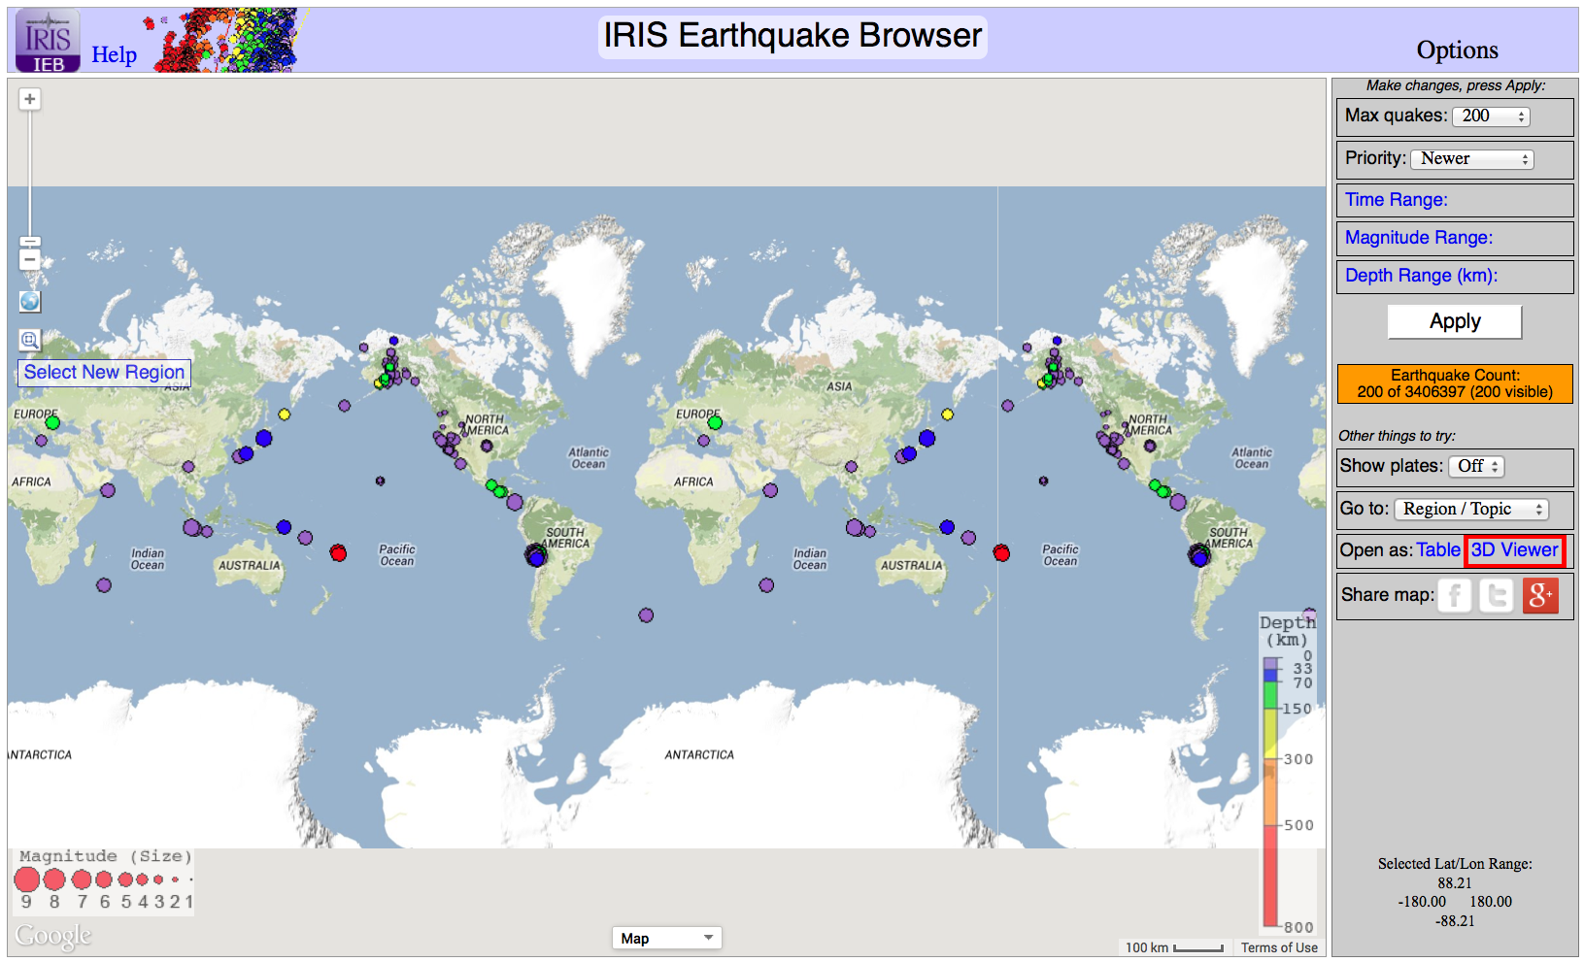

Slide 100
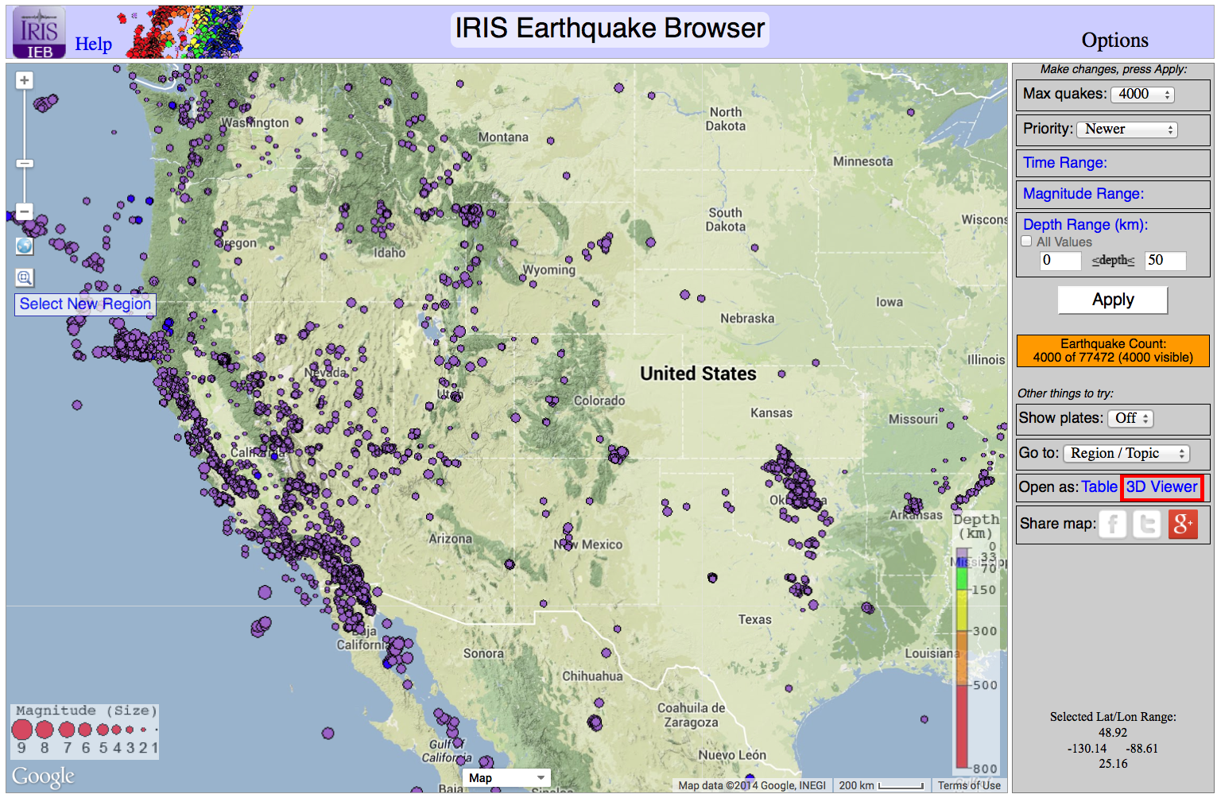

Slide 101
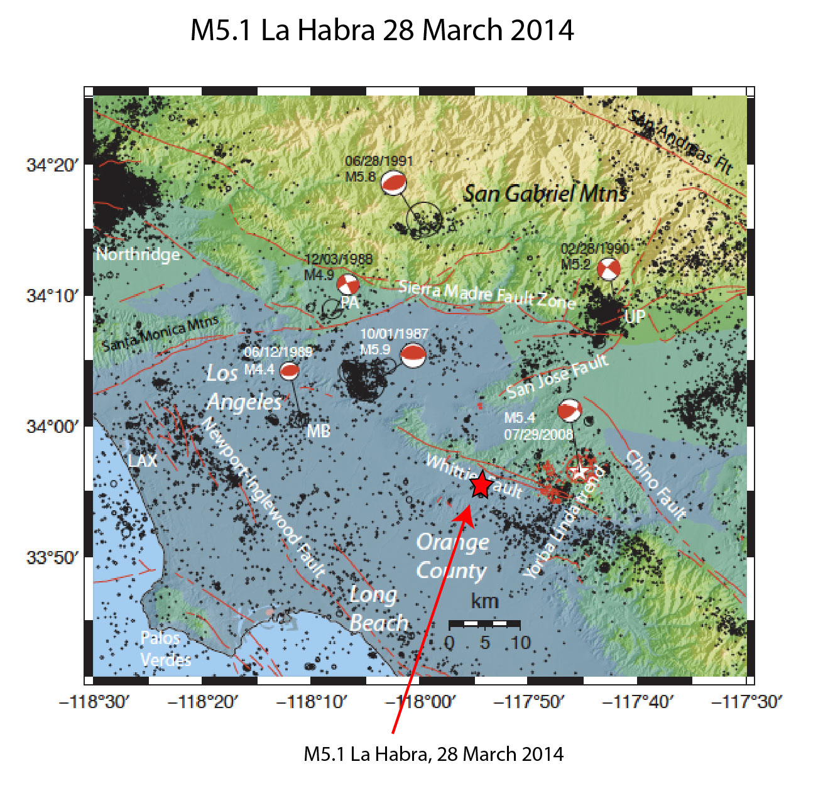

Slide 102
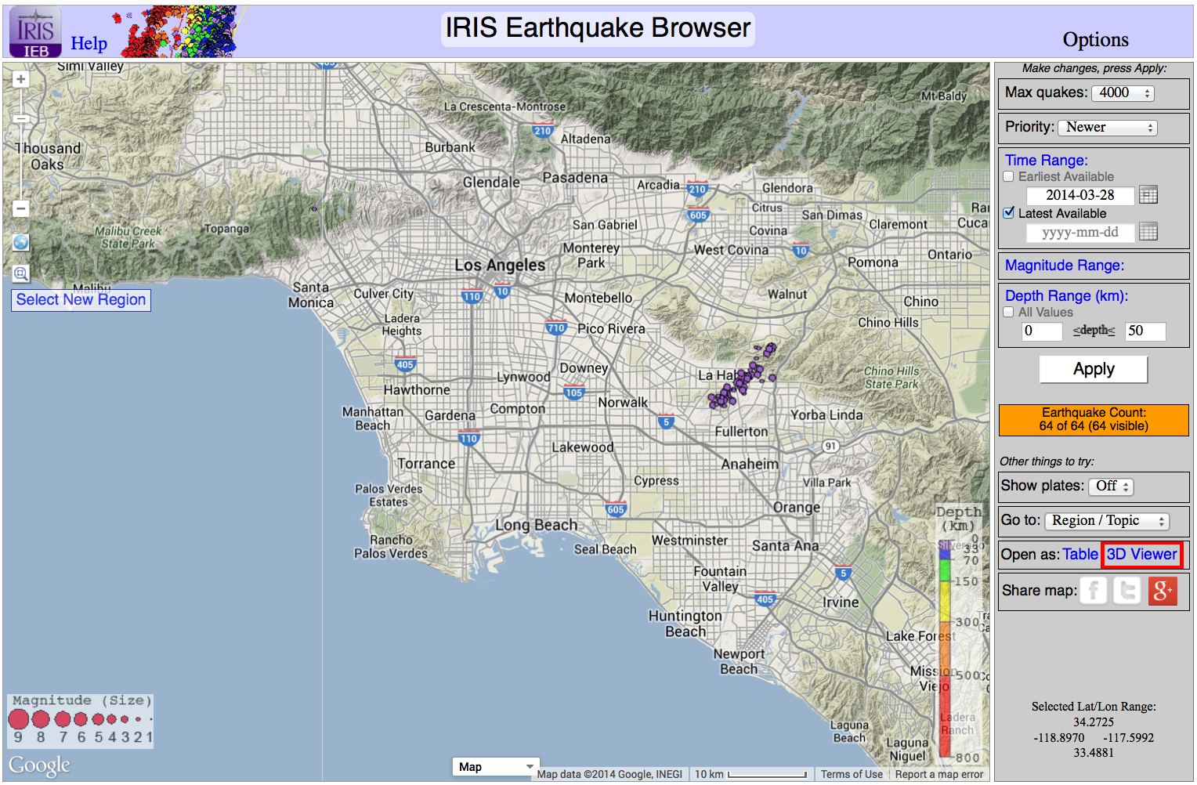

Slide 103
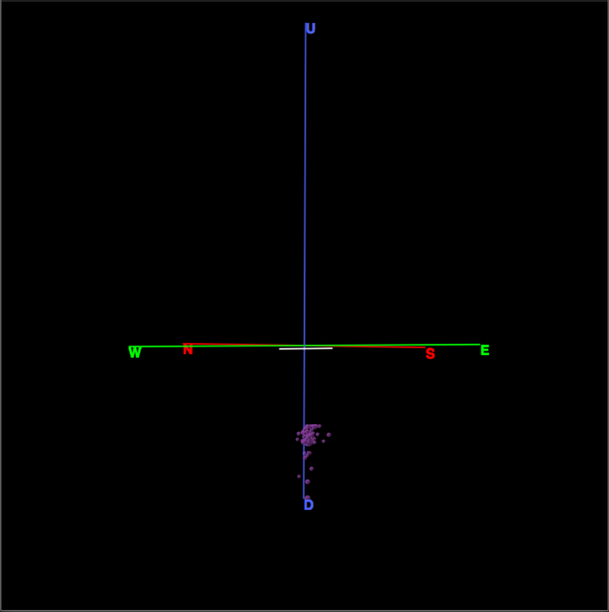

Slide 104
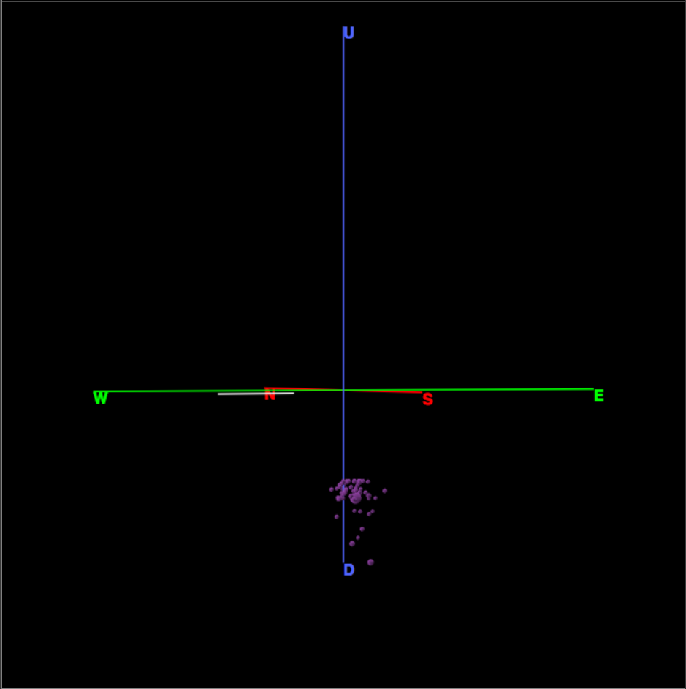

Slide 105
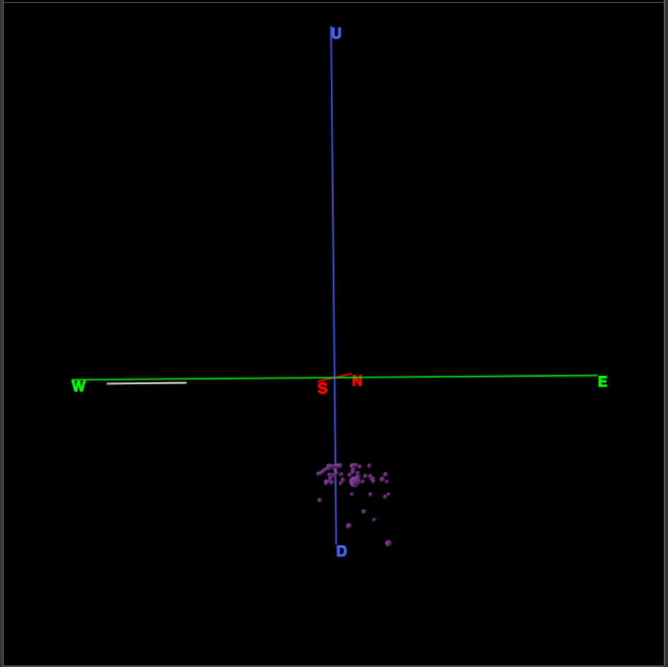

Slide 106
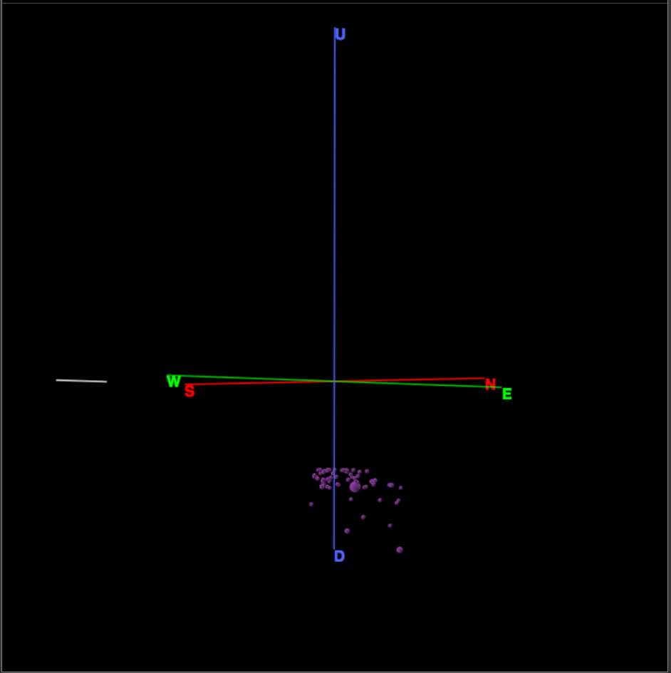

Slide 107


Slide 108


Slide 109


Slide 110


Slide 111


Slide 112


Slide 113


Slide 114


Slide 115


Slide 116


Slide 117


Slide 118


Slide 119


Slide 120


Slide 121


Slide 122


Slide 123


Slide 124


Slide 125


Slide 126


Slide 127


Slide 128


Slide 129


Slide 130


Slide 131


Slide 132


Slide 133


Slide 134

(4, 4.63)

Slide 135


Slide 136


Slide 137


Slide 138



