Slide 1
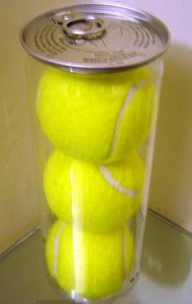
Point, Game,
Set, Match
Science Wins with the Tennis Ball Container
Roberta Johnson
David Mastie
NSTA Regional Conference
Oct. 28, 2010 Kansas City, MO
Marriott KC Downtown: Count Basie Rm.

Slide 2
Ideas for Possible Uses of Empty Tennis Ball Containers with Lids
Basic Classroom Supplies
Storage
Transporting
Unique Advantages
Activity-Specific Equipment & Supplies

Slide 3
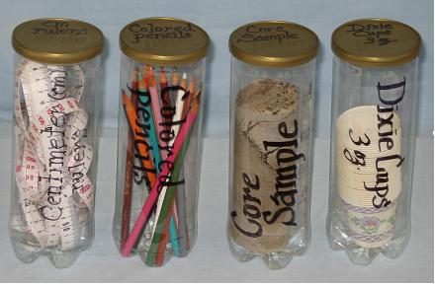
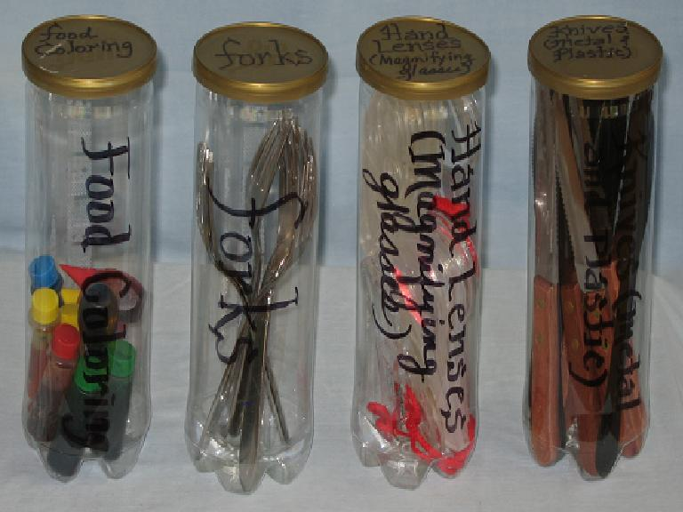
Basic Classroom Supplies
Centimeter (cm) rulers, flexible
Colored pencils
Core samples
Dixie cups (non-waxed, small bathroom size)
Food coloring squirt bottles
Forks (metal)
Hand lenses (Magnifying glasses)
Knives (plastic is OK)

Slide 4
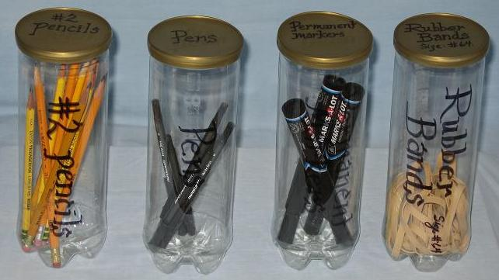
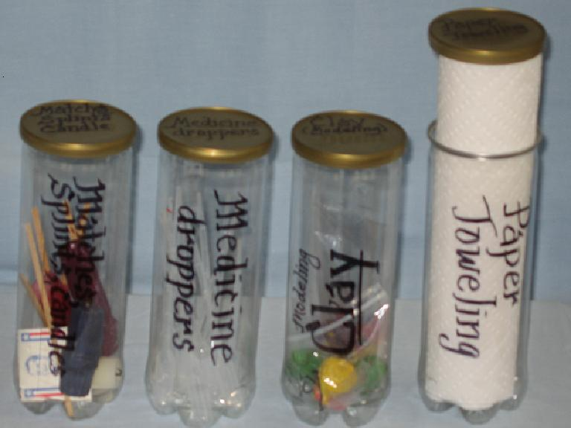
Basic Classroom Supplies
Matches/Splints/Candles
Medicine droppers
Modeling clay
Paper toweling
Pencils (#2 sharpened)
Pens
Permanent markers
Rubber bands

Slide 5
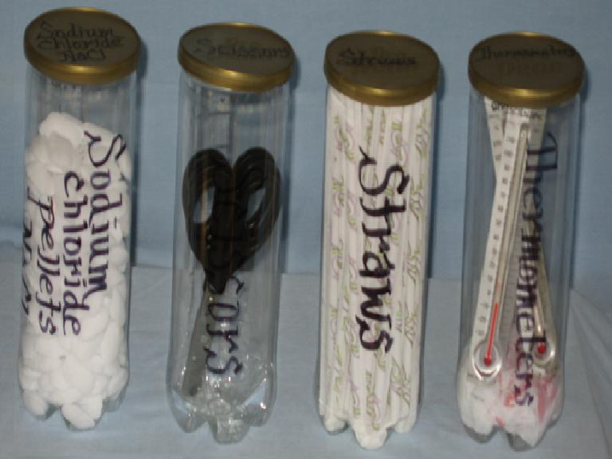
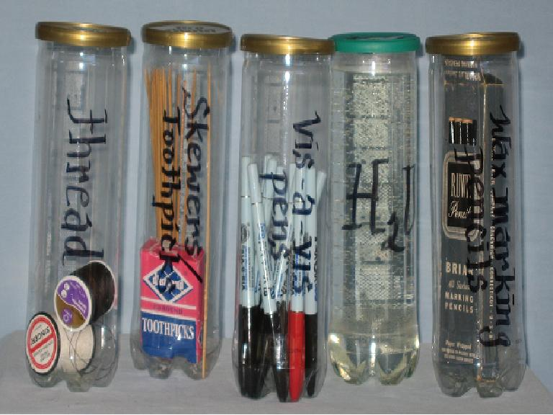
Basic Classroom Supplies
Salt pellets (NaCl)
Scissors
Straws
Thermometers
Thread
Toothpicks /small skewers
Vis-à-vis pens
Water (room temperature)
Wax marking pencils

Slide 6
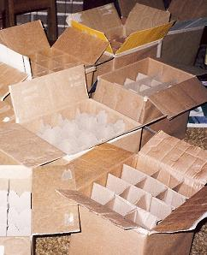
Storage of Tennis Ball Containers
Wine-bottle boxes
Other alcohol-bottle boxes
Holiday-ornament boxes
Any other boxes with internal separations
Flat tops and bottoms allow shelf, cabinet or drawer storage without boxes
Labels can be applied to lids for identification if stored in boxes or drawers

Slide 7
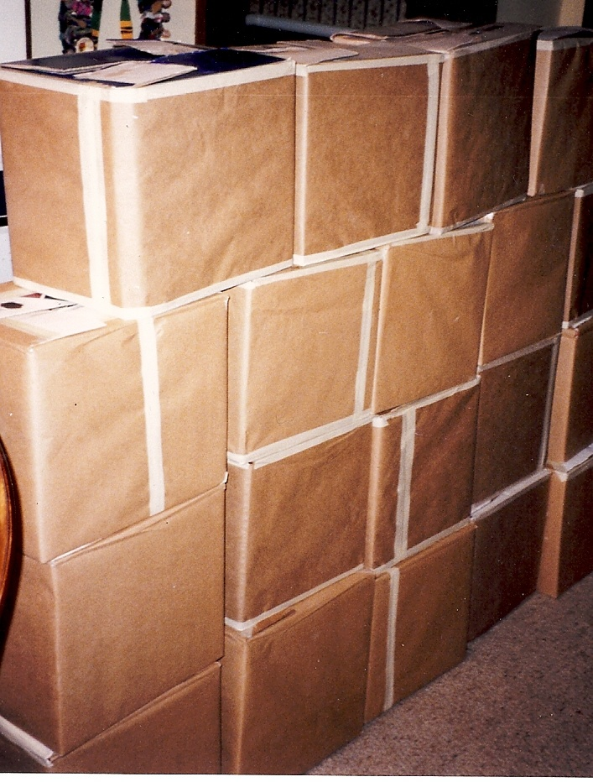
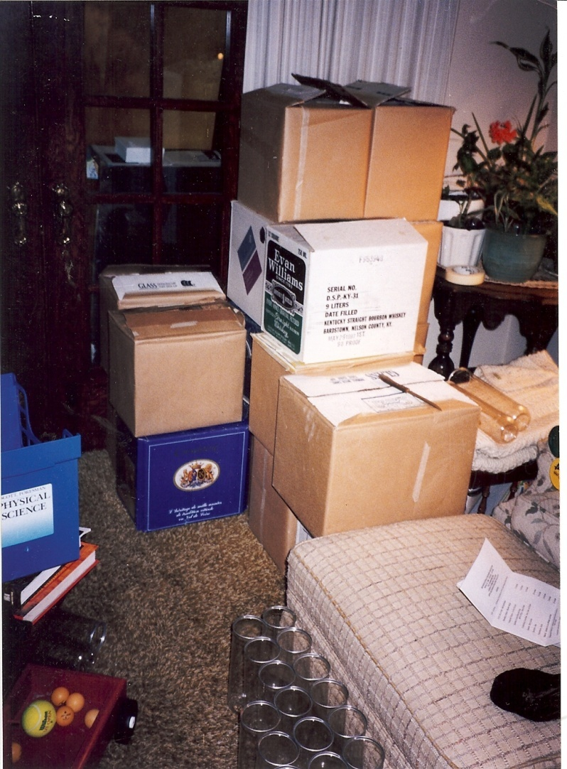
Transporting Tennis Ball Containers
Wrap in butcher paper any drink-related boxes for use in a school
Same-sized boxes allow stacking onto a dolly in great quantity. Use bungee cords as needed for stability.

Slide 8
Unique Advantages of Tennis Ball Containers for the Classroom
Free in great quantities from any tennis club
Unbreakable
Transparent to allow easy identification of contents
Nearly weightless for easy handling
All the same size for simple storage
Washable in dishwasher
Lid differences allow differentiation of categories
“Green” – reduce, reuse, recycle

Slide 9
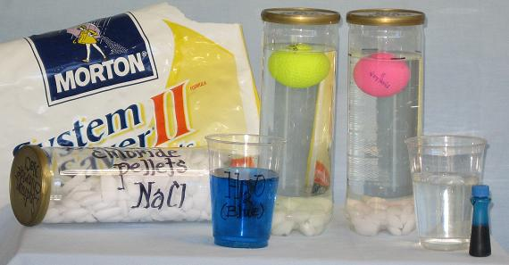
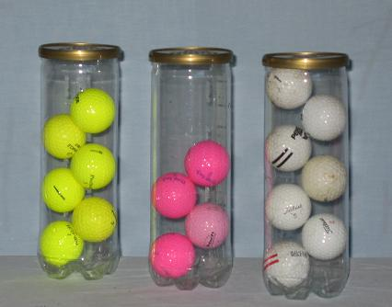
Activity-specific Equipment & Supplies: “Par-5”
Yellow golf balls
in salt water
Pink golf balls
in salt water
Yellow golf balls
dry storage
Pink golf balls
dry storage
White golf balls
dry storage

Slide 10
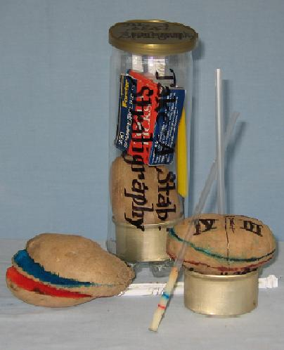
Activity-specific Equipment & Supplies: “Take a Stab” –
Stratigraphy Using Potatoes
Small cans
(e.g. cat food cans)
[Basic Supplies: straws, rubber bands, clay, flat toothpicks, permanent markers, food coloring (red, blue, other)]

Slide 11
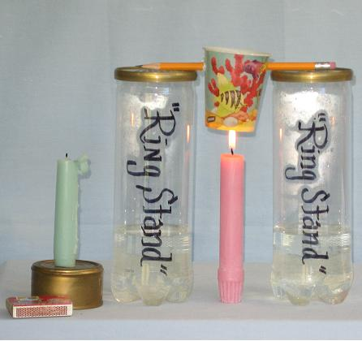
Activity-specific Equipment & Supplies: “Latent Heat” Using Tennis Ball Containers as ‘Ring Stands’
Candle
Cat food can
2” (5cm) water in each of 2 tennis ball containers
[Basic Supplies: sharp pencil, matches, Dixie cups]
Notes:
Water lowers the center of gravity to stabilize the apparatus.

Slide 12
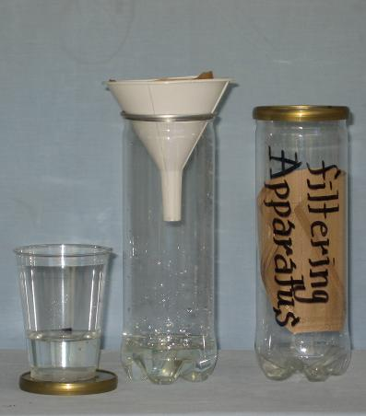
Activity-specific Equipment & Supplies: “Filtration Apparatus”
Funnel to sit on top of tennis ball container
Coffee filter or other filter paper
Liquid to be filtered (e.g. pond water)

Slide 13
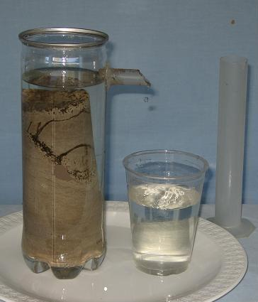
Activity-Specific Equipment & Supplies: “Displacement Apparatus a la Archimedes”
Tennis ball container with ½-inch hole drilled 1 to 2 inches from the top on one side
2 inches of ½-inch plastic aquarium tubing to fit into the hole, creating a spout curling down
Glue (appropriate to the materials)
Cup or other container to collect displaced water
Graduated cylinder to measure volume of displaced water
[Basic Supplies: water]

Slide 14
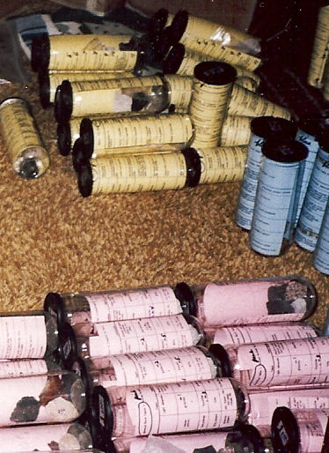
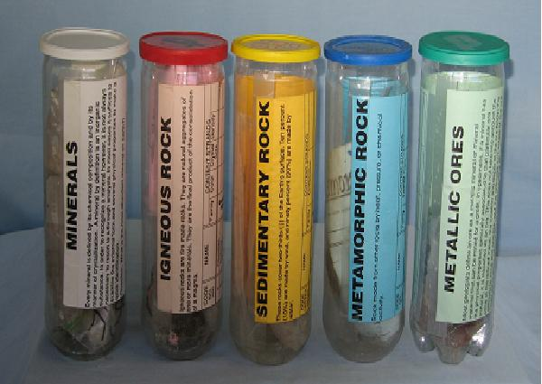
Activity-specific Equipment & Supplies: Rock Types by Lid or Insert Color
White – MINERALS
& White – Hardness Test Items
Pink or Red – IGNEOUS Rocks
Yellow – SEDIMENTARY Rocks
Blue – METAMORPHIC Rocks
Green – ORES of Economic Importance
& Green – Streak Test Items

Slide 15
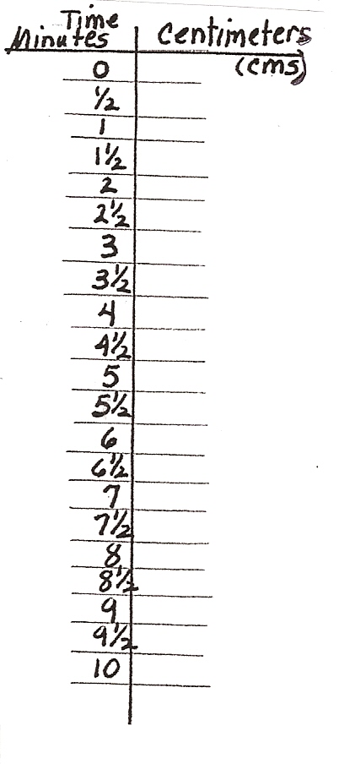
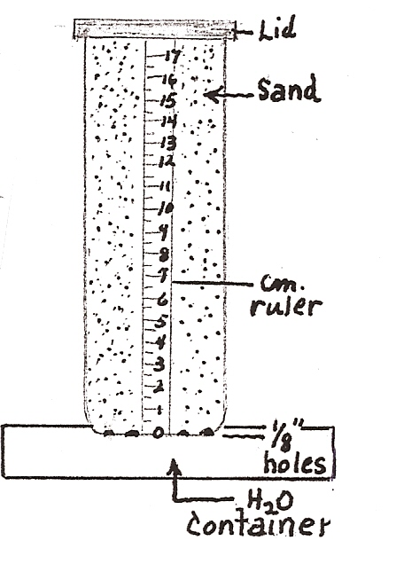
Activity-specific Equipment & Supplies: “Capillarity”
Fine Silica Sand
(sandbox sand)
Coarse Sand
Shallow Tray
Timing Device
with Second Hand
[Basic Supplies:
water, cm ruler]

Slide 16
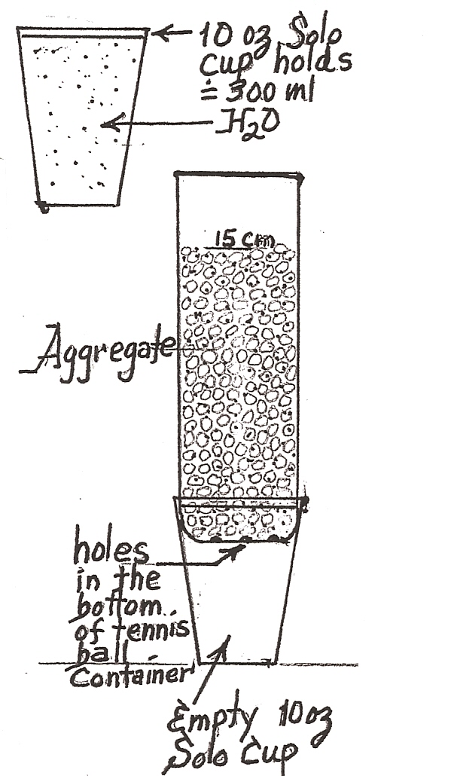
Activity-specific Equipment & Supplies: “Porosity and Permeability”
Tennis ball container with six to eight 1/8-inch holes drilled in bottom
“Small Aggregate” – Pea gravel
“Large Aggregate” – ½ inch or greater sized gravel
[Basic Supplies – water]
Solo Cups (12 oz.)
Timing Device with Second Hand

Slide 17
What Else???
Think of a storage problem in your classroom.
Think of a presentation problem these could solve for you.
Be creative!

Slide 18

WWW.WINDOWS2UNIVERSE.ORG
Friday, October 29
2:00-3:00 - NESTA Share-a-Thon, Conv. Center Rm 1501B
3:30-4:30 - NESTA Rock Raffle, Conv. Center Rm 1501B
Saturday, October 30
8:00-9:00 - Radiation Storm vs. Magnetic Shield: Superheroes of Magnetism and Space Weather Education, Conv. Center Rm 2503B
11:00 - 12:00 - Cloudy Day Activities: Bridging Cloud Science, Literacy, and Art, Conv. Center Rm 2502B
Please remember to fill out the evaluations online!

Slide 19
Contact Information
Dr. Roberta M. Johnson
  Executive Director, NESTA
  rmjohnson@gmail.com
David F. Mastie
  Science Education Consultant
  mastie@umich.edu
Thank You

